Slide 1
Choosing your course and preparing to apply
Alison Wilson
Future Students team

Slide 2
What I will cover
What is UCAS?
The basics of making an application
Making the right choice for you
Thinking about your personal statement
Notes:
CLICK During this session we’ll be looking at how you can start deciding on a course or subject area.
CLICK How you can compare your options in order to narrow down your choices. CLICK where you can find more information.
CLICK and some tips for completing your application
CLICK and finally we’ll look at how you can write your personal statement to help you get offers from all your universities

Slide 3
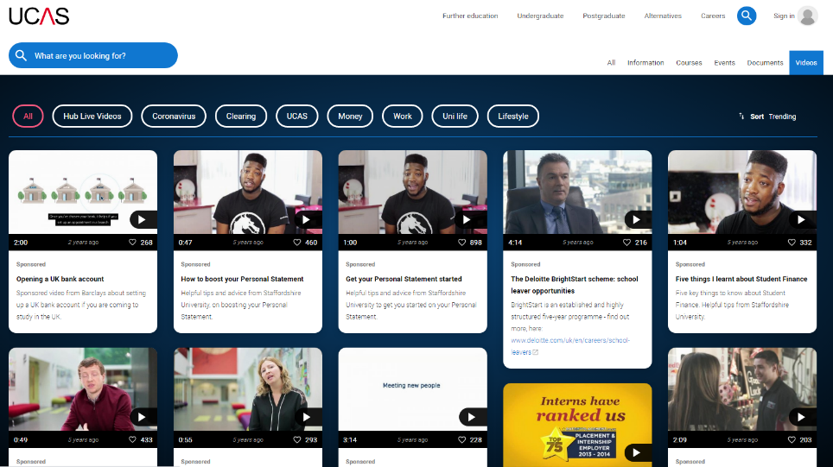
What is www.ucas.com?
Provides an online search, application and tracking service for higher education courses
Also has videos and information to help you and your supporters through the whole process.
Notes:
So what is UCAS? It stands for Universities and Colleges Admissions Service. And you can find its website at www.ucas.com
CLICK
UCAS lets you look at courses and universities to help you decide where to apply to, and to make your application.
CLICK
In addition it provides students and their supporters, with videos and information about the initial stage where you are exploring what is available, through the application process right through to accepting offers and moving to university.

Slide 4
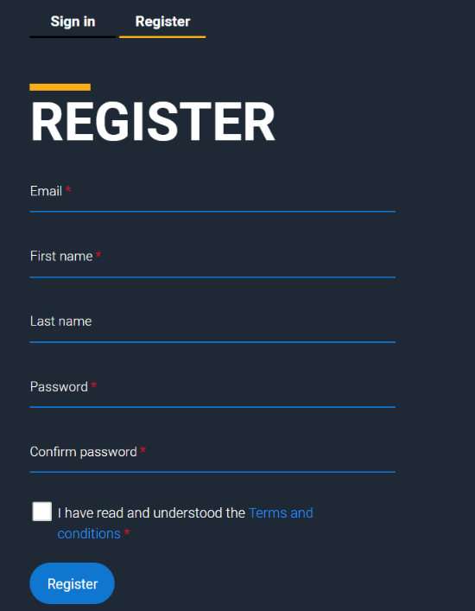
Sign up to UCAS hub
Not school email
Sensible address
You need access during the registration process to enter verification number
Keep a note of the password
Notes:
UCAS has a personal hub facility and one of the first things you will be doing is to create yourself an account to be able to save useful information you find whilst researching that you might want to look at again later. You will eventually submit your application, and track university responses via your UCAS Hub
From the main webpage click on the sign in link and then you’ll be able to register. A few things to bear in mind when you register - We would recommend you create your hub with a non school email address. When you leave Hautlieu your email will eventually be closed and if that’s the address on your UCAS application and you choose to delay your university start for a year it will be slower for us to contact you as we’ll have to use post unless you update your email information.
Make sure your email is a sensible address. This is a professional application and depending on the course you’re applying for they may look at your personal details and social media accounts before making a final decision on whether to interview you or make you an offer.
You will need to access the email address you use during the registration process to enter the verification number and of course keep a note of the password you use.

Slide 5
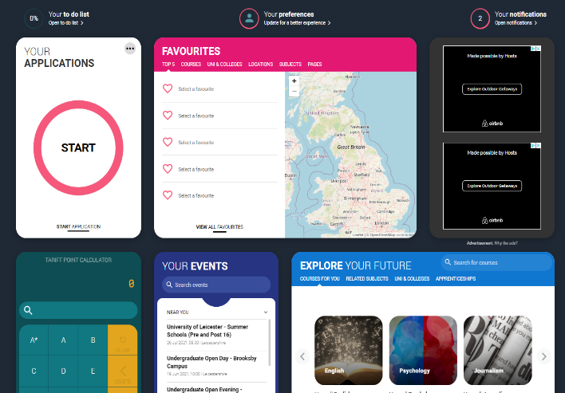
Using the Hub
Notes:
Mr Price will have more detail for you about registering and making your application but The UCAS Hub is a great place for information gathering and storing. It will allow you to research areas of the UK, cities, universities and courses and to put information you find that interests you into your Favourites so that you can easily go back to it again when you want to start narrowing down your choices. You can go back into these and change any of your favourites if you change your mind. There is a tariff points calculator so if you want to convert your grades into UCAS points you can easily do so here. Based on the subjects you entered in your preferences you can do a quick search for universities by clicking on the subject choice here.

Slide 6
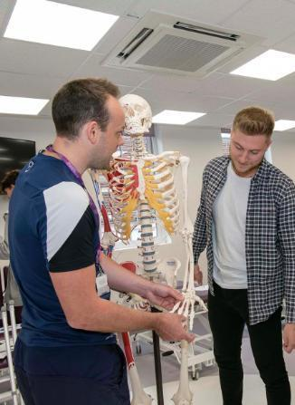
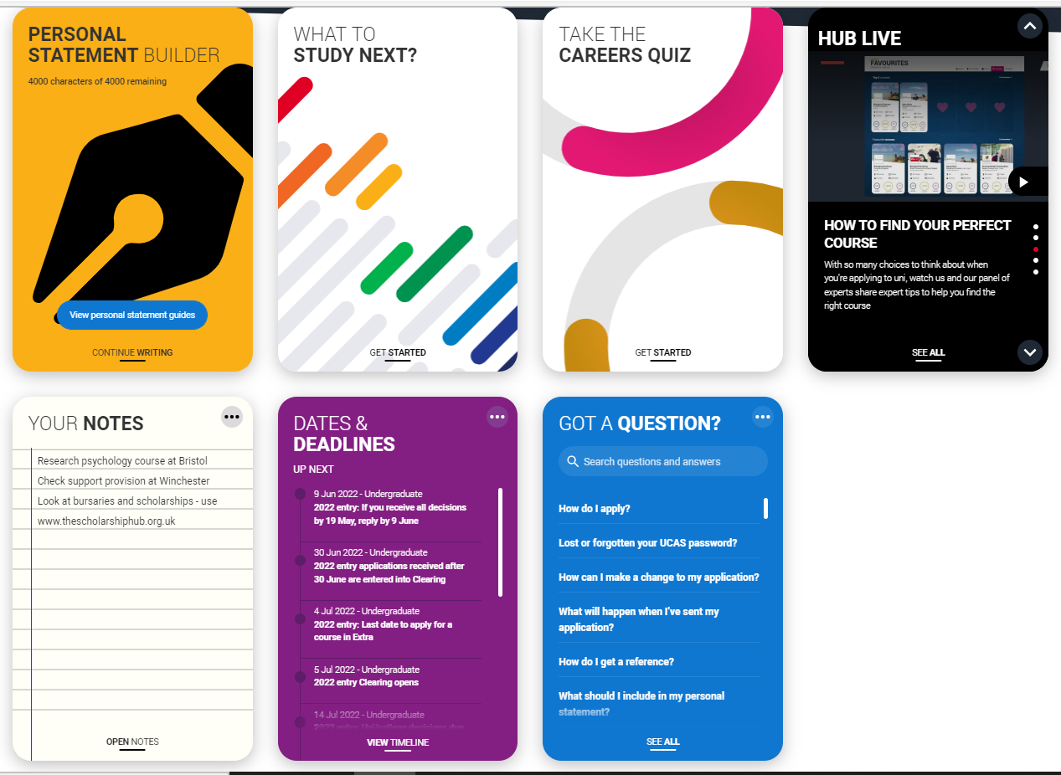
More information in the hub
Notes:
You will find links to different topics on their website and these topics change on a regular basis. There is help to write your personal statement using the great information and hints in their statement builder. Advice on what to study depending on your current A Levels, Live UCAS sessions on a range of different topics to support you throughout your application and move to university. The to do list could be really useful to remind you of things you want to check or research, keeping all your notes in one place. And the purple box with dates and deadlines will be a great reminder of what you need to do next, particularly after you have left school. At first many of the deadlines may be for students starting university this year but it will update soon. If you have any questions this box may answer them.

Slide 7
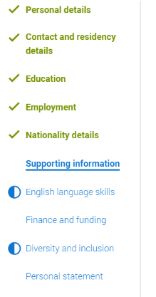
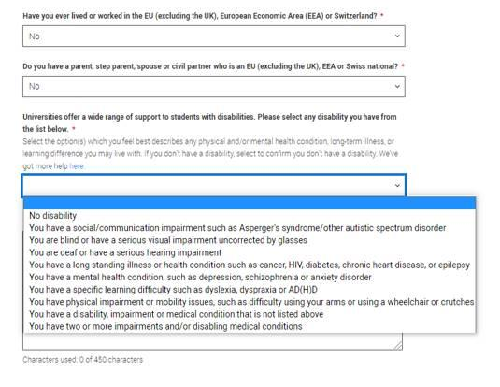
Supporting Information
Notes:
There are various sections of the application and I’m not going to go through them all but I just wanted to highlight a couple that I really recommend you complete (if they’re applicable to you). Universities want to support students through their studies and if you have a physical or mental health condition, long-term illness or learning difference it is really worth declaring it here. This information won’t be used to negatively consider your application and universities would always recommend you declare anything relevant in this section. Although this screen says universities will provide you with information on the support available I would recommend you speak to universities about any needs you may have, as the earlier they know you may need support the more chance this will be in place when you arrive with them. It is also really important that you are aware of how they may be able to help you when you make your decision as to which university is right for you.

Slide 8
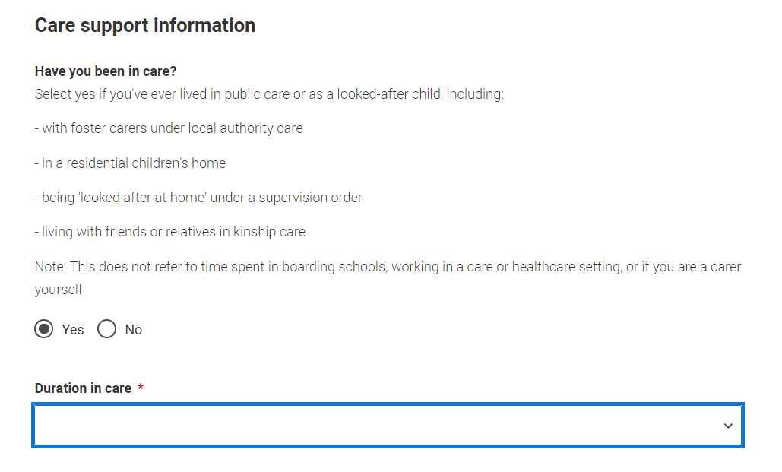
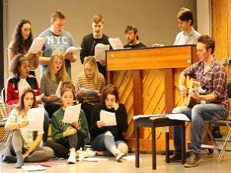
Notes:
An optional section that might be relevant to you is the Care support information. If you’ve spent time in local authority care we recommend you complete this section. Like the disability section universities may be able to offer you support during your study but only if they know you may be entitled to it. This could be practical or financial support so is worth taking if it’s relevant to you.

Slide 9
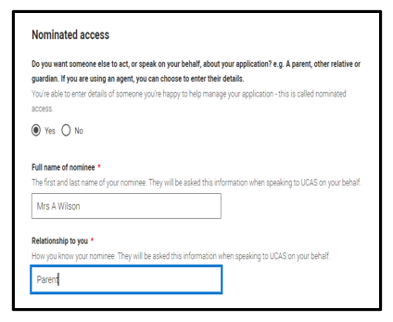
Notes:
My final suggestions for optional information everyone should complete is the nominated access part. This will allow 1 person to speak to the university on your behalf if you list them here. I regularly hear parents or carers ringing our admissions team to ask questions about a students application, but if you haven’t completed this part we aren’t allowed to speak to anyone else so if you can’t make a call for any reason it’s worth having someone else that you’ve allowed us to speak to.

Slide 10
Points to remember
Use a non-school, sensible email address
Keep a note of your password
Declare any support in the disabilities section and ask universities about their support if that’s relevant to you
Notify us if you’ve spent any time in care
Use the nominated access facility
Allow plenty of time to complete your Hub information
Check all your information is correct – qualifications and your choices
Know and MEET any deadlines
Notes:
So before we move onto making the right course and university choice just a recap on what I’ve said so far.

Slide 11
Choosing your course and university
UCAS has over 35,000 courses to choose from
Offered at over 350 universities
4 in Northern Ireland
15 in Wales
18 in Scotland
316 in England
You can only apply to a maximum of
5 courses or universities
Notes:
When you look on UCAS you will find over 25,000 courses offered. These could be 1 subject to focus on a particular area or to allow you to gain accreditation to a professional body, or a combination of courses allowing you to have a broader subject understanding when you graduate or to keep your options open in more than one subject area.
There are over 350 universities in the UK and if you’re happy to travel further afield there are many universities across the world who teach in English or if you’re multi-lingual there may be even more places open to you.
It’s great to have all this choice but you can only choose a maximum of 5 courses or universities to apply to so narrowing down is going to be essential.

Slide 12
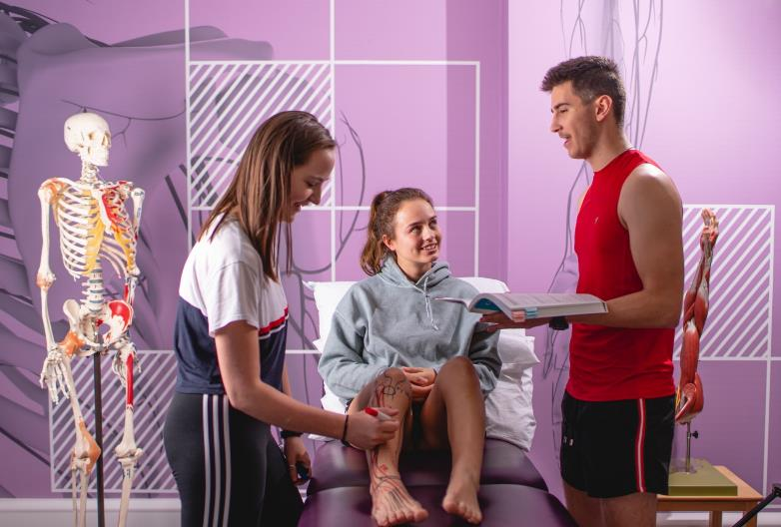
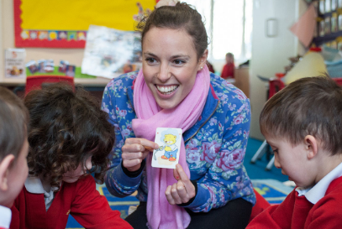
Starting to make your choices
Do I have a career in mind?
Do I need a specific qualification?
Prospects.ac.uk or UCAS.com both have personality and interests tests
Notes:
When choosing your course, The first thing to consider is your future career. Do you have a definite or even a vague idea of what you would like to do? What interests you?
Several jobs require you to have a specific university qualification,
So, if you have a career in mind do explore whether there is a required university level qualification.
If you don’t already have a career in mind you could do a careers, personality and interests test online to get ideas of what jobs or courses might suit you.

Slide 13
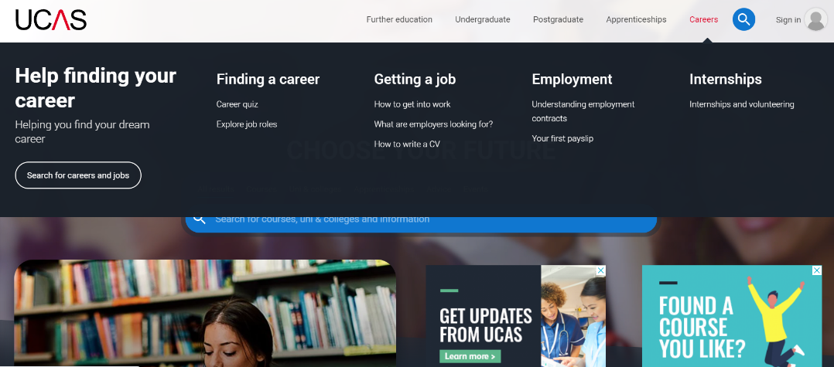
UCAS Explore Jobs (www.ucas.com)
Notes:
Another great resource that you can use is the UCAS Explore Jobs page which you can find through the careers tab on their website. This allows you to look at a job role, see what that job role involves, what you need to do to get started in that industry, the degrees and skills that will help you gain entry in to the career and again, which professional bodies represent the various roles within the industry.

Slide 14
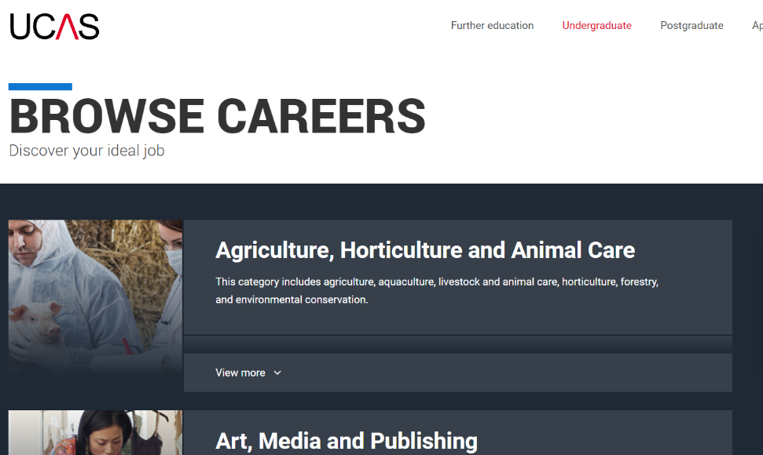
Notes:
You will see many different careers areas here and you can click on an area to find more jobs within that sector

Slide 15
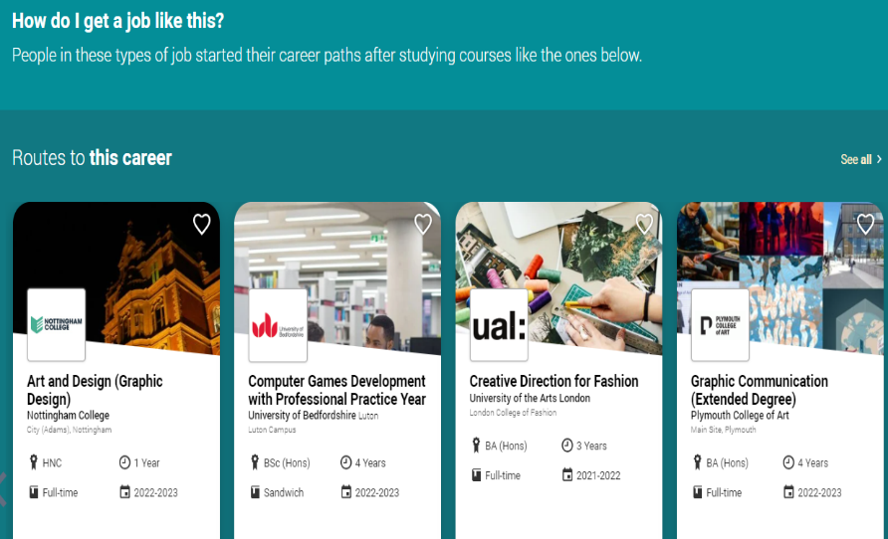
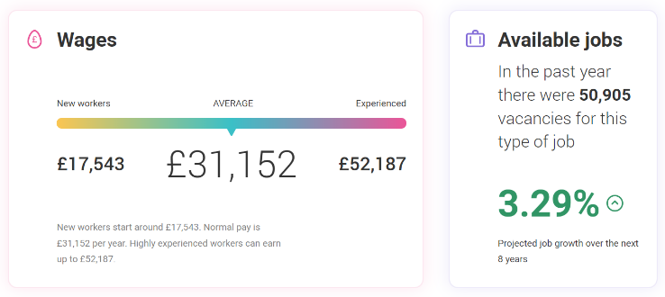
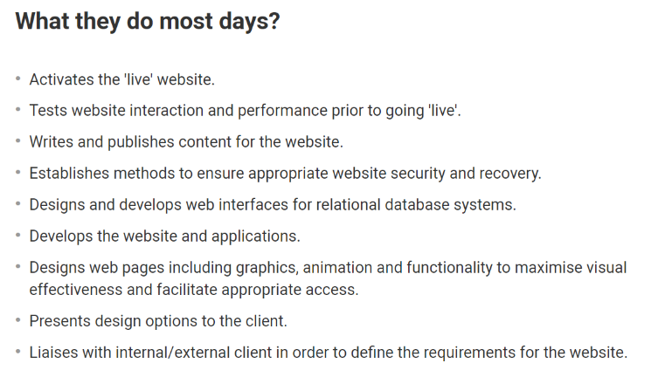
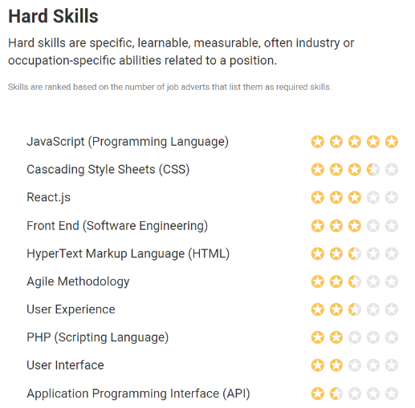
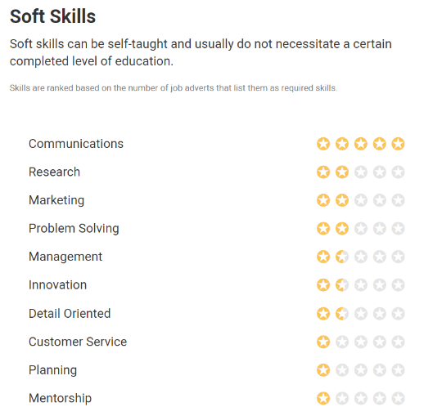
Notes:
Within information technology you’ll find tabs for lots of different roles. Each of these will tell you, what you could earn and how many jobs there are likely to be available. What the role is likely to mean you do each day. The hard and soft skills you’re likely to use and How you can get a job like this or the possible routes into it.

Slide 16
If you don’t have a career in mind, think about a subject
35,000 university courses to choose from in UK, many don’t need prior qualifications in that subject
Study a subject that you know and love, or study something completely new
Whatever you choose, you will improve your career prospects
Notes:
If you do not have a career in mind or the career you are interested in doesn’t have an associated university course then you could have the full range of over 50,000 courses or course combinations to choose from. You can take a subject that you are already studying or choose a completely new one. Many courses will not require you to have studied that subject before but do carefully check the entry requirements for each course before applying.
And whichever course you choose, you will be gaining useful transferrable skills for any future career

Slide 17
Picking a subject – www.ucas.com
Notes:
So how are you going to use UCAS to explore the course options which are available? Here is the UCAS landing page - click on undergraduate which is the collective term for bachelor degrees which you take after completing A levels, BTECs etc.

Slide 18
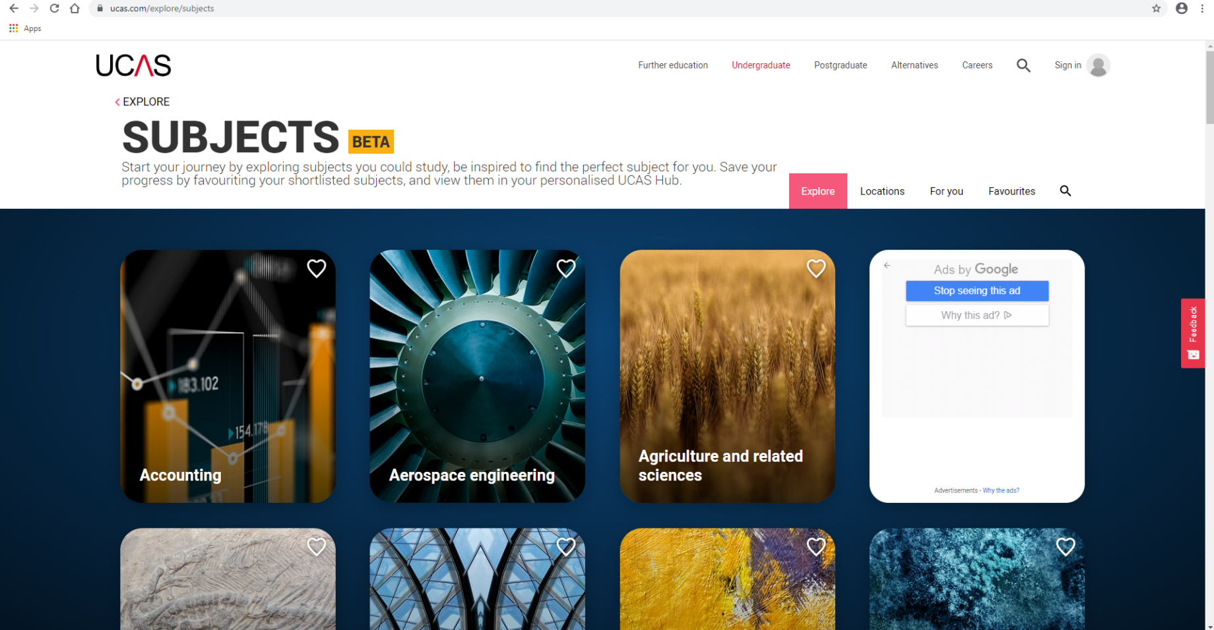
UCAS Subjects
Notes:
UCAS has grouped courses in to subject areas from Accounting at the start to Zoology at the end and a big variety in between.
To give you an idea of the kind of information each tab provides I am going to look at English.

Slide 19
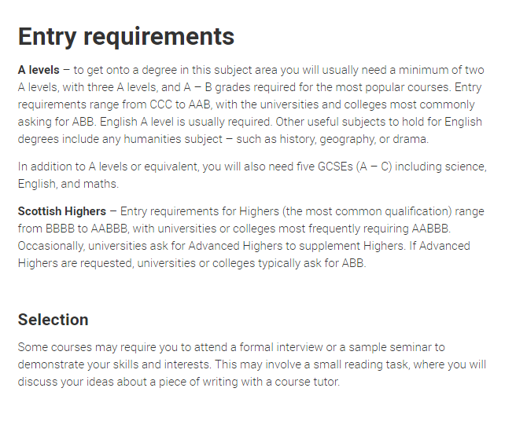
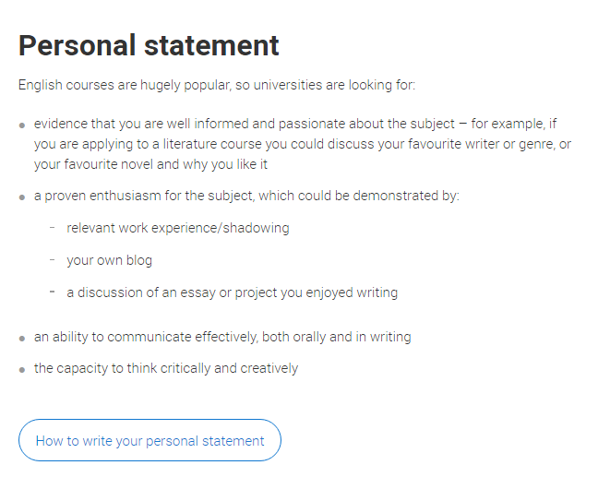
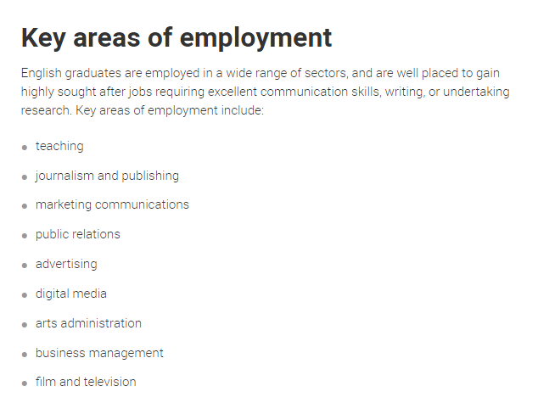
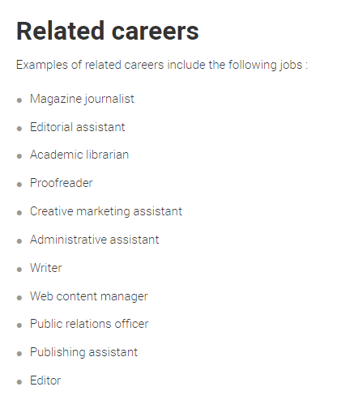
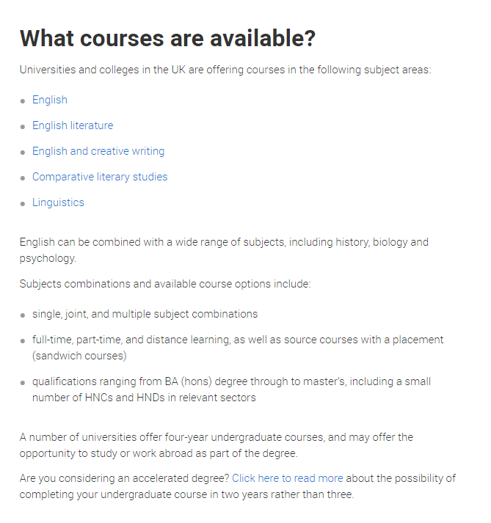
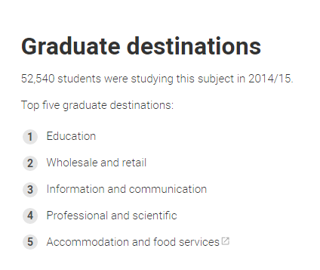
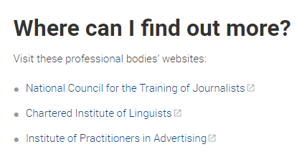

Slide 20
Notes:
Once you have ideas of courses in mind you can go to the main UCAS webpage and type in the course title. I have chosen English Literature as an example. Click on courses.
.

Slide 21
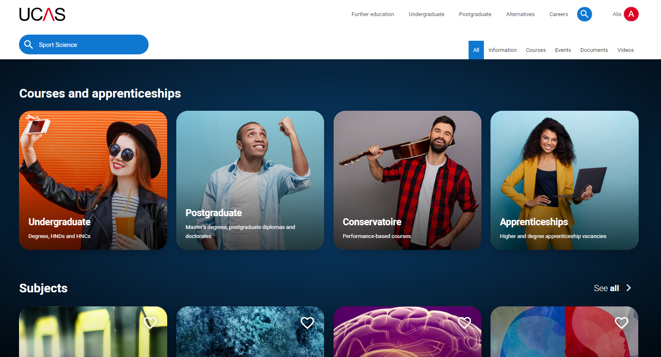
Notes:
Remember at the moment you’re looking at undergraduate

Slide 22
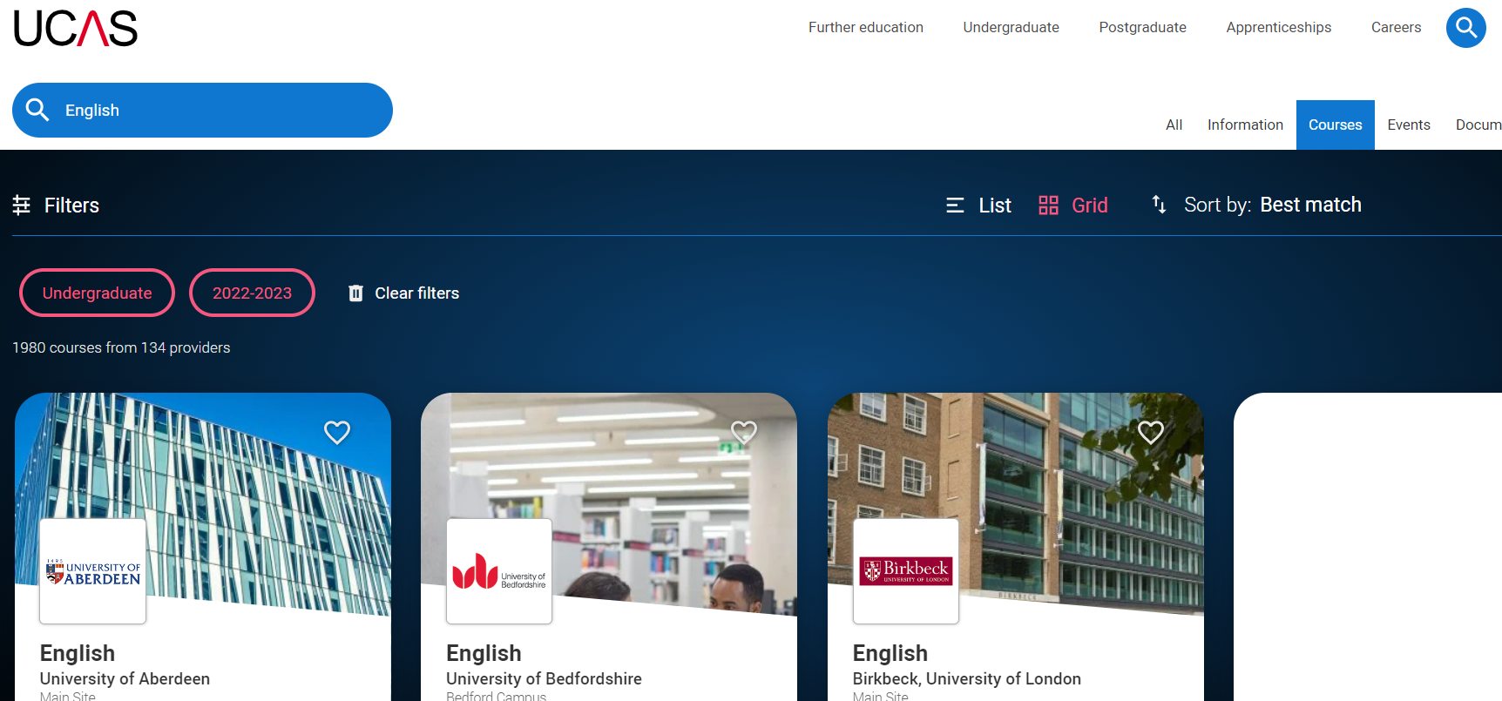
Notes:
And then the search results will show you the options available. Here we can see there are 1129 English Literature courses available at 110 providers. Providers will include universities, further education colleges offering higher education courses and also private universities.
You will need to be careful with the filters. At the moment UCAS will show vacancies for 2021 and 2022 entry. So if you click on filters…

Slide 23
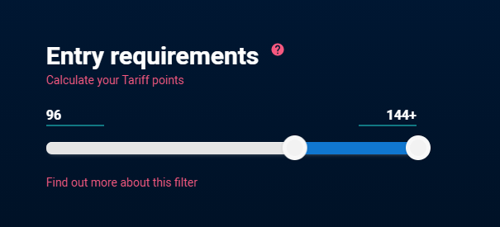
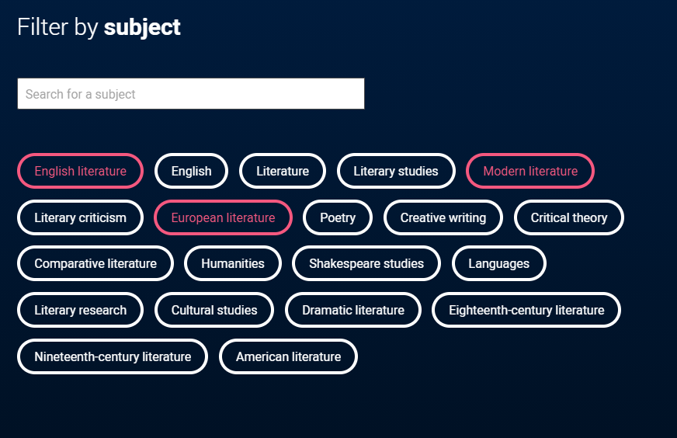
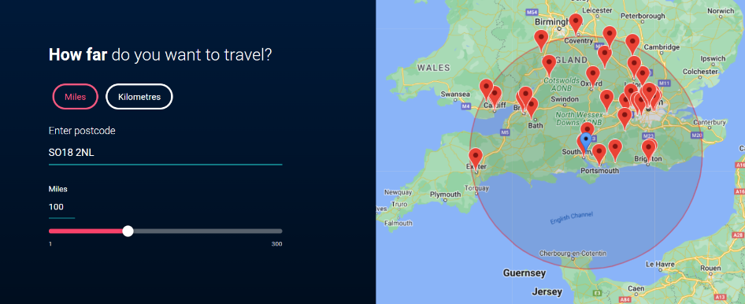
100 miles from Southampton airport
Notes:
Within the filters you can narrow down your options for the entry year, also using the entrance requirement calculator. You enter the qualifications that you are taking and your predicted grades. It will then give you a tariff point score. You can then limit the course results to those which match your predicted grades rather than looking at all courses which are asking for everything from less than 3xCs to 3xA*.
You can also filter the results by subject which is useful if you have a specific course of interest within the wider course area.
And you can focus on a particular geographical area which is useful if you want to stay at home or if you want to study near a specific location. I have entered the postcode of The Holt and asked for the results to only include universities that are within 35 miles of your school. You will then see a map of those institutions and you can click on a red pin to find out who they are and you can go directly to their courses within your subject area. All of these filters will make your search results relevant to you and your preferences when choosing a course and university that is right for you so it’s really worth using them.

Slide 24
Notes:
You can see the choices have now reduced to 176 courses from 20 providers potentially making your search much less overwhelming.

Slide 25
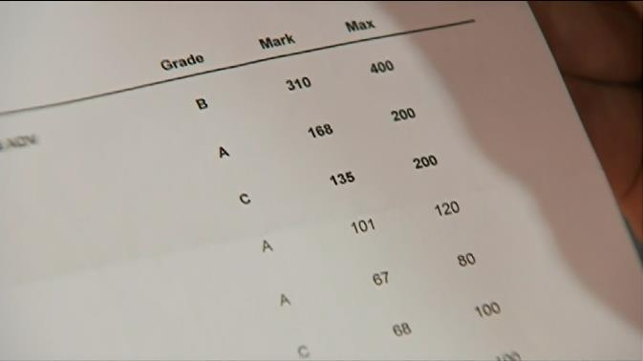
What to consider next
Having chosen your career, subject or course there are some ways to narrow down which ones you apply to:
Entry requirements
Modules
Assessment
Accreditation
Other opportunities

Slide 26
Entry requirements
Course: Geography | UCAS Points/Grades | Additional requirements
University A | 104-120 tariff points (CCB-BBB or DMM or D*D) | Minimum 4 in English Language GCSE
University B | AAB-ABB 0r DDD | Geography A Level grade B
University C | 112-120 tariff points (CBB-BBB or DMM) | Also 5 GCSEs minimum 4 in English and Maths
University D | AAB-ABB or DDD | 1 grade lower offered for EPQ grade A
You may also be able to gain points from some music or sport exams (ABRSM Grade 6 Pass = 8 points, Grade 8 Distinction = 30 points).
Check all information on UCAS or providers website before applying
Notes:
Entry requirements are a really important consideration. Universities will publish their entry requirements either as grades or points. Here we can see 4 universities entry requirements for their Geography degree. University B and D asking for specific grades and these are shown in A level and Vocational qualification likes BTECs University A and C are showing UCAS tariff points. As we saw earlier, you can calculate tariff points on the UCAS website if you’re not sure what yours will be. Often when a university asks for tariff points they will accept your main grades and also EPQ, stand alone AS levels (if you have a subject which you studied for 1 year in year 12 but aren’t carrying that on to year 13) and other qualifications which carry tariff points. When you are applying it is a good idea to make 1/2 of your applications a bit aspirational – perhaps a grade above your predictions, 1/2 of your applications around your predicted grades and 1 of them a grade lower than your predictions in case you miss your grades. It’s also worth noting that although universities often publish a range of grades (for example we’ll take between 104 and 120 points for this course), if you are predicted within that range they are likely to make your conditional offer at your predicted grades to encourage you to continue to achieve your potential rather than a student who is capable of getting 3Bs (120 points) thinking they only want 104 so I can still get in with 2 Cs and 1 B and perhaps not working as hard as you can.
The right hand column shows extra requirements including specific GCSEs, if you need Geography A level and university D has an incentive for a grade A in the Extended Project Qualification.

Slide 27
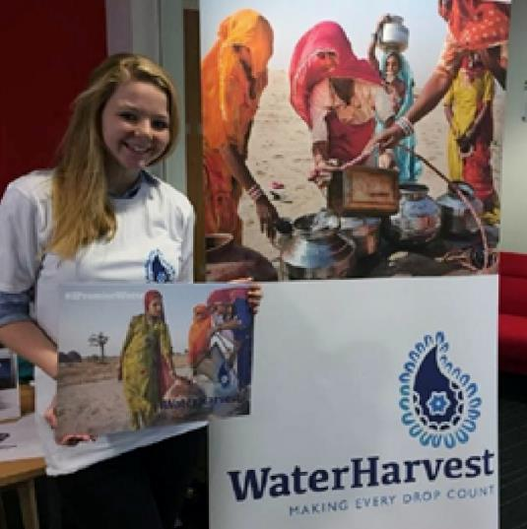
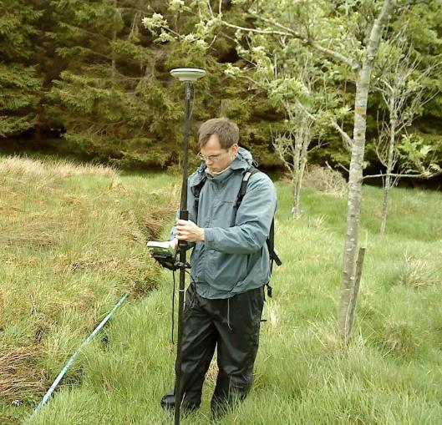
Compare the modules on offer
University A
Core modules in Year 2
Geographies of Environment and Development
Geographical Information Systems
Geographical Enquiry or Project in Physical Geography
Geographical Fieldwork
Optional modules in Year 2 include
Global Environmental Change
Understanding Urban and Rural Societies
Geomatics and Remote Sensing
Volunteering for Geography
Southern Cultures
University B
Core modules in Year 2
Research Design and Data Analysis
Fieldwork and Professional Skills
Optional modules in Year 2 include
Social Identities and Place
Sustainable Environmental Management
River Processes and Freshwater Ecology
Introduction to Teaching
GIS and Remote Sensing
Glaciers and Glaciation
Environmental Change
Notes:
It is important to examine the content of each course you are applying for. Unlike A levels and BTECs, degrees do not follow a set national curriculum. Each university decides which modules to teach and this is a combination of what any professional bodies say should be included for the accreditation, alongside anything the academics feel should be included to give a thorough grounding in the subject and the optional modules often reflect the research interests of the academic staff teaching at that university. Here as an example we have two universities offering Geography. University A are more core (compulsory) modules in year 2 than University B and you can see what choice of optional modules you are likely to have to study alongside the core modules. When you look at modules don’t bank your course and university choice solely on 1 particular module though as if the academic whose research area it was leaves, that module may change.

Slide 28
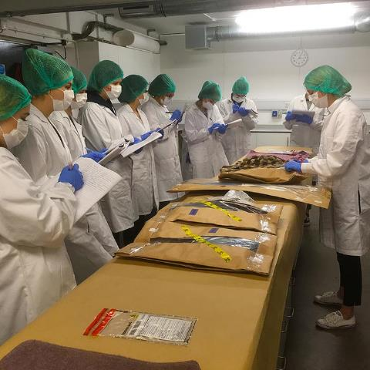
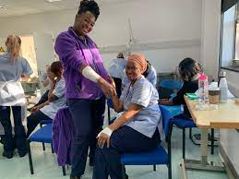
Compare how you will be assessed
University A
Year 1
87% coursework
13% written exams
0% practical exams
Year 2
79% coursework
6% written exams
15% practical exams
Year 3
89% coursework
5% written exams
6% practical exams
University B
Year 1
70% coursework
24% written exams
6% practical exams
Year 2
66% coursework
29% written exams
5% practical exams
Year 3
88% coursework
12% written exams
0% practical exams
Overall
85% coursework
8% written exams
7% practical exams
Overall
75% coursework
21% written exams
4% practical exams
Notes:
You may also want to think about how that university is going to assess you and compare that to your preferred style of working. Here we can see two universities and how they assess a course. In this case, Business Management. And the assessments have been grouped in to coursework, written exams and practical exams.
As you can see, University A has a higher proportion of assessment through coursework but much lower through written exams than university B
University A has nearly double the amount of assessment through practical exams compared to university B

Slide 29
Other things to consider
Professional accreditation
Sandwich or placement year or study abroad
Sport or social opportunities
Which UNIVERSITY is right for you?
Location
Size – university and city
Accommodation
Try to get a feel for it by visiting
Notes:
Some other things that you might want to consider depending on the course you’re looking at Sometimes professional accreditation is a legal requirement before you start in that career such as Social Work or Medical subjects. You may want to consider whether a course offers you a sandwich year (a full year in industry or placements in what would be year 3 of a 4 year course) or a potentially shorter study abroad option (possibly for 1 term) If your degree offers you a placement year and you are able to apply for one, they give you great experience (similar to an apprenticeship) and I would certainly recommend considering it. Our academics say that when a student returns from their placement year it is very obvious that they have improved their understanding of the topic within the real world but also developed their general skills. Some students finish their placement with the company indicating that once they have successfully completed their degree they would be very interested in taking them on as a full time employee, giving them a huge advantage post graduation.
When you are thinking about which UNIVERSITY is right for you here are few things you may want to consider – perhaps it’s location and how easy it is to travel there? Not just the journey but also the cost. Are you going to be able to go home for a weekend or is it more likely to be restricted to the main holidays (and are you happy with that). It may be important to you how big the university is (they range from about 4,000 to 40,000 or potentially how big the city it’s in is. Maybe try to spend a weekend in that city to test it out. Accommodation is likely to be important unless you’re commuting – so think about what you might suit you. Do you want it to be on campus really close to your lectures or might you want a bit of time between getting up and having to be in a lecture. What ever you think is important for you I would always recommend you visit your university choices, ideally for an open day to get the real experience and be able to speak to academics as well as students and other departments such as admissions, student support, or the student union. IF you can’t make an open day see if they have campus tours where you can at least look around the campus/city. You can sometimes get a real gut feel as to whether you can see yourself living there or not, helping you to narrow down your choices.

Slide 30
When you’re ready to start
Reflect upon your career ambitions
Check routes to achieve them
What subject areas do you feel interested in and enthusiastic about?
Consider courses within that subject area
Remember ways to narrow them down
Notes:
So when you start thinking about your future, reflect on your career ambitions – do you now what they are yet? And if you do how will you get there? Consider whether an apprenticeship or university is the right choice for you. If you decide an apprenticeship would be better for you, consider also applying for university as a back up as often apprenticeship applications come in much later than university applications and offers so that way you can keep your options open. Think about what subject areas you feel you could be interested in and that you are enthused about.
It may be that finance is a real concern for you if you go to university so you might want to have a look on the government website to see what support you may be entitled to if choose to study for a degree. Using the students finance calculator might reassure you that university is financially achievable and I think the really important thing to remember is that when it comes to paying back your student loan, you will pay back a percentage of what you EARN rather than what you borrow and even if you’re earning £26,000 which is a good graduate salary you would only pay back £7.50 per month of your £1700 monthly take home pay.

Slide 31
YOUR PERSONAL STATEMENT
What is it?
Your opportunity to tell your chosen universities:
Why you’re applying for your chosen subject
What you know about your chosen subject
Why you’re suitable for your chosen subject
Grades are important, but they aren’t enough on their own
Your personal statement helps you stand out and differentiates you from others
It’s your first, and often only, opportunity to make a good impression
Notes:
What is the personal statement – talk through the slide as before

Slide 32
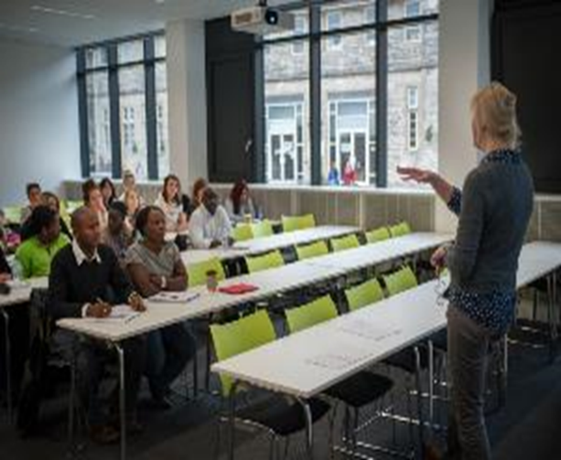
How important is the personal statement?
It helps a university decide whether to make you an offer or invite you to interview.
If you’re interviewed, it is likely to prompt questions
It allows you to talk about your relevant work experience and skills
If you narrowly miss your offer grades, it may persuade a university to still accept you.
Notes:
For the last 10 years the number of 18 year olds has been dropping and places have been easier to secure. The demographic is now turning and 18 year old numbers are increasing so it is going to be more important that your statement makes you stand out among other students with your grades, particularly for very competitive courses and universities.
It is very likely that only a few of you will be interviewed so your ps is the only way we can find out if we think you’re suited to our courses.
If we are going to interview you, your statement will help us find out more about you and ask questions for you to prove your understanding of the course and the issues surrounding it.
It is the only place in your application where you can talk to us about your experiences and what you’ve gained from these being able to tell us about your activities which could be school based, employment or other interests.
It may also be that after results day universities go back to look at your statement again. If you have narrowly missed your offer grades universities will be deciding whether to still take you and if they look at your statement and see a real dedication to your subject and an understanding of your knowledge and relevant skills they are more likely to still confirm your place with them.

Slide 33
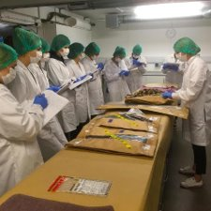
Personal statement – the basics
4,000 characters (including spaces)
47 lines
70% academic – the course and why you’ve chosen it
30% interests – information about you and your skills
If applying to Oxford or Cambridge make it 90%/10%
Personal to you – reflect your abilities, understanding and personality
Only write 1 personal statement for all 5 choices
Notes:
There are a few things that make the personal statement hard to write and I think one of the hardest is the character limit. You can only write 4,000 characters including spaces and punctuation. That’s about 1 side of A4 text and once you start writing you are going to have way more than that to say. They also have a restriction of 47 lines so it’s balancing writing in paragraphs, making it easier to read but acknowledging that a blank line between them uses up on of your 47.
The balance of the statement is really important too. You need to be heavily weighting it around your academic ability and understanding. You should have approximately 70% of it talking about the course you’re applying to, and your understanding of it, your current study and any experiences that link with the subject. The other 30% is about you, so your hobbies and extra curricular activities that give your relevant skills or understanding. If you’re going to be applying to Oxford you would be looking at the balance to be more like 90% academic and just 10% personal.
Making your statement personal, ensuring it doesn’t sound insincere or generic can be the winning ticket. What makes you unique? Don’t be afraid to think a little bit outside the box. Admissions tutors read hundreds of personal statements so saying something a little different or having a less common experience to reflect on is likely to see your application dazzle from the masses.
Finally the other thing that makes it hard is that although you can apply for up to 5 courses which may be slightly different to each other you can only write one personal statement which must fit all your choices.

Slide 34
What are admissions tutors looking for?
Evidence of academic ability - your grades, but also from the information you give us
A genuine interest in the subject and a desire to learn more about it
A commitment to the profession (if it’s a vocational course) and an understanding of what it’s like to work in that industry
Qualities and skills that make you suitable for your chosen course/career
Well written – no spelling/grammar mistakes
Balance – don’t forget 70/30 (or 90/10) split
Notes:
So, what are admissions tutors looking for in your writing?
Evidence, evidence, evidence. They want to see your academic ability – your grades listed in your application will show your predicted ability but the way you write and talk about your currently study (if it’s relevant) and talking about your interest in the subject will tell them a lot about your academic ability too. They want to see EVIDENCE of your interest in the subject – what do you do to immerse yourself in the topic and also to see your desire to learn more about it. If you’re applying for a vocational course they will want to see a commitment to the profession and evidence that you understand what it’s like to work in that industry. They will also be looking for your transferable skills which make you suitable for your course, and potentially the career that will lead to.
You should write confidently about yourself highlighting the knowledge and skills you have and where you get them from. Don’t forget to also tell us how they are relevant to your course or career. They are looking for a well written document so make sure there are no spelling mistakes and don’t rely on spellcheck in your document as it can let you down. If you’re applying for a music degree and you’re talking about a homophonic melody just a single letter change making it homophobic can make a huge difference to your writing!!
Make sure you give yourself enough space to do your statement justice. Many of you are unlikely to be able to really show your understanding, ability and love of the subject if you’re only using 50% of the characters on the topic so use that 70% to the full.

Slide 35
How can I evidence my understanding and interest?
Show off what you know, focus on the detail
My biomechanics module helped me gain a greater understanding of how muscles, bones, tendons, and ligaments work together to produce movement which allowed me to research how this is affected as people age.​
Have you studied it before? What does it involve? But what else?
Both for previous and new subjects - What have you done?
Trips​
Watched​ documentaries
Read​ journals or books
Voluntary or paid work​
Listened to visiting speakers​
What can you make links to – in society, what you know is happening, news, changes, trends.​
Notes:
It’s all very well me saying make it well rounded but what exactly do I mean by that? Show your understanding and interest. Show off what you know and make sure you focus on detail that will evidence your understanding so rather than just saying Biology has shown me how people age you could say the biomechanics module helped me gain a greater understanding of how muscles, bones, tendons, and ligaments work together to produce movement which allowed me to research how this is affected as people age highlighting your knowledge.
If you’ve studied the subject before really think about what it involves but also what it will involve in your future study. But what else? This is where my comments will be the same for a subject you’ve studied before as for those of you who are choosing a new subject.
What have you done? Some of these may be harder for you this year where lots of opportunities have been limited during covid but have you been on trips that would link to your subject. Perhaps you’ve used some of your lockdown time to watch documentaries or read journals, articles and books around your subject. It may be that you have paid or voluntary work which links in with your chosen career or perhaps you’ve been able to listen to visiting speakers either live or virtually. Think about all of these activities and what have you learnt from them. How have they expanded your understanding or made you the person you are today?
Also think about what you can make links to. You can google current issues in engineering, teaching, nursing to find out some of these or speak to people you know already in the profession. This information can be really useful in an interview too but make sure you update yourself so you are really current.

Slide 36
Course Modules: BA (Hons) Primary Education (with QTS)
Notes:
Another way to evidence your understanding is by reading website module information and picking out topics you can talk about. Here in this example of a module in our primary Education degree you can see we look at the role of the educator. Can you talk about this in your statement? What have you seen teachers doing – to may be more than teaching! Think about different approached to learning you may have seen in the classroom or as that may have been much harder for you over the last year perhaps something you’ve learnt about in reading, through MOOCs or by speaking to professionals.

Slide 37
How can I write one personal statement that’s relevant to all my choices?
For combined honours:
Refer to both subjects (in degree balance)
Find common skills necessary for both subjects
For different courses, find similarities and expand on common themes
For something like Philosophy, Politics & Economics or Liberal Arts where you may not find 5 universities offering that exact course focus on your subject at other universities – it may be Politics, and then link the other elements to it
Notes:
If you’re applying for a combined, joint, or major/minor honours degree make sure you refer to both subjects and refer to the in the same balance as the degree. When it comes to your skills think about which are necessary for both subjects. It may be you’re applying for slightly different courses or combinations of courses. Find the similarities in them and expand on common themes, issues or skills.
Some of you may be applying for a multiple course degree it may be that you can’t apply to the same course title at each university so you may be applying for a single subject element as well. If this is the case focus on the single subject you’re applying to and then think about the links or talk about your interest of the distribution of national income and wealth or trade relations.

Slide 38
Including the right information for all universities
Select your information carefully – make sure it’s relevant for every university you’re applying to
University | Skills required | Knowledge required
A table like this one may help -
List the skills and knowledge required,
Highlight the common words
Include this information
Notes:
Many university admissions teams will initially skim read a statement looking for particular phrases or knowledge references. To make sure that their skim read leads them to reading it in full so they can really see your potential, you need to select the content for your statement carefully. You might find it helpful to create a table where you can list the universities you’re applying to and then check their website for information about the skills they might be looking for or knowledge that may give you an advantage. Look at the modules for the first year and see if there is anything you already have an understanding of that you can use in your evidence. List those things down in the table and then highlight anything that applies to every university and this is great information to include.

Slide 39
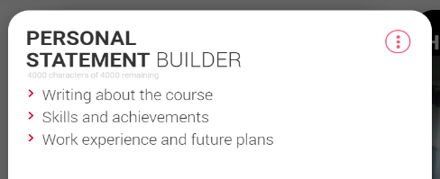
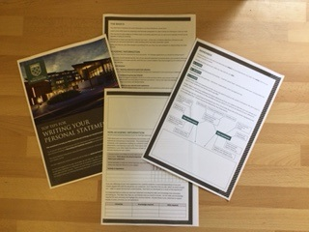
Plan before you write
Write about – What, Why and How are you suitable?
Worksheets to help you
UCAS Personal Statement builder (in the Hub)
Winchester Personal Statement worksheet
You might prefer a mind map
There is an example on our worksheet
You might prefer questions and answers
The UCAS personal statement builder gives you question sections to complete.
Notes:
Hopefully you’re eager to start writing but it’s really worth planning first. You are likely to make lots of drafts of this document before you’re satisfied with it. Keep every draft you write. If you decide to take something out and then realise it was the best paragraph you’ve written you will want to go back to a previous draft and cut and past it in. Start by briefly outline the points you want to make in your statement making sure you answer the questions; what, why and how. What do you want to study? Why do you want to study it? How does your knowledge, and your past experiences and skills prove this.
You may find using a worksheet helpful – either the UCAS statement builder in the Hub section of their website or a worksheet similar to this one we have forwarded to Ms Spiteri and Mr Milner. These can be really helpful if you like to put your thoughts down in a logical process.
If may be you’re more of a visual worker and perhaps something like a mind map would be better for you. We have an example on our worksheet and I’ll look at that in a bit more detail in a moment.

Slide 40
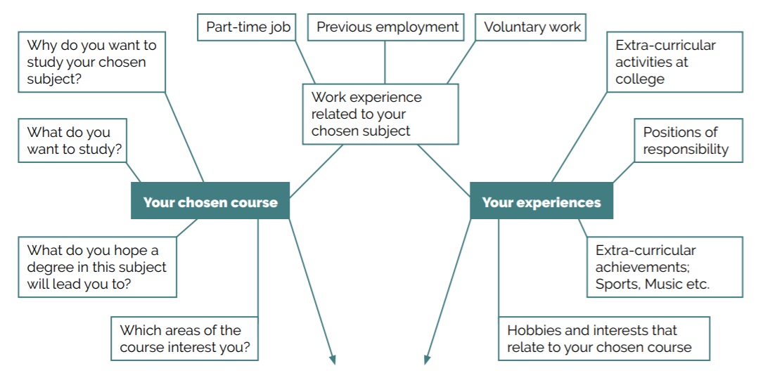
Notes:
So I mentioned the option to use a mind map and get lots of information down on a page for you to then format into a statement. If you choose this option this example will give you an idea of things to include. Start off by really thinking about’ the course you’re applying for. Think about what it is? Why you have chosen that course? Which areas of the course particularly interest you – and why? Do you have thoughts of where you hope the course will lead you? Then move on to think about any work experience you may have. Initially think about work experience which links directly with the course or the career the course will lead you into. This should be your 70% content so lots of information for you to talk about here. Then continuing with work experience now think about any placements that don’t link with your course but will still give you great transferable skills. In the mind map you may want to put lots of detail but it’s quite likely that when you write your statement you will need to condense that. Finally think about your other activities – this could be sporting or musical activities either in school or outside, school responsibilities, employment or hobbies. You will need to be thinking how all these points are relevant to your course choice.

Slide 41
What skills to talk about
Communication
Independent working
Teamwork
Flexibility
Determination
Computer literacy
Organisation
Entrepreneurial skills
Working to deadlines
Presentation skills
Reliability
Trustworthiness
Diplomacy
Problem solving
Initiative
Time management
Commitment
Responsibility
Leadership
Project Management
Those that are relevant to your career or course, or those that will make you stand out
Notes:
You will have many skills which you could evidence in your statement but remember this is likely to only be 30% of your writing so a maximum of 1200 characters. You will really need to think about which you use in your final version. Think about which are most relevant to the course you’re applying to or the career it will lead into if it’s more vocational. If you still end up with a choice of skills think about those that may be less common. Everyone is likely to be able to talk about working in a team but they may not all have project management or entrepreneurial skills. Use the skills that are most relevant but are also going to make you stand out.

Slide 42
Notes:
You don’t want a university reading your statement and saying So What? So when you think about what you are including think also about why you are including it. You may find guidance as to what to write about in the course information on our websites. Looking at this overview of an English Literature degree will highlight it will sharpen your communication skills enabling you to link developing your communication skills in part time work with the degree. If you’re taking an EPQ you may want to link this to your understanding of critical thinking showing your understanding of this area.
It may be you’re part of a debating team and again these skills can be given as evidence of your suitability for this course.

Slide 43
Think about the detail
Working at Costa, part-time making drinks and serving customers has increased my communication skills.
Part-time employment has developed my communication skills with a different audience, as I engage with customers but also my colleagues. Talking to members of the public can be challenging if there is a language barrier, or when individuals were wearing face coverings. Developing ways of communicating including repetition and using non-verbal signals has enhanced my skills.
Notes:
When you’ve identified your skills think about HOW you will talk about them. You could say that working in a restaurant and serving customers has increased your communication skills. Or you could say how part time employment has developed my communication skills due to engaging with a different audience, perhaps customers and colleagues. You may want to talk about overcoming language barriers or if you’ve been working during the covid restrictions how have you had to adapt to this situation.

Slide 44
How should I structure it?
Grab their attention
Show you’re excited and understand the course you’re applying for
Give evidence to prove your interest in the subject
Why are you suited to that course? What events led to your interest?
What do you know about the subject and are excited to learn more about?
Work experience that’s relevant to your course choice
Explain what you’ve earnt from it, don’t just describe the event
Other activities that show your qualities and skills
Activities that demonstrate your interest in your course or relevant skills
Closing statement
Reaffirm your desire to study this course and what you may gain from it.
This could include where you hope a degree in this subject will lead.
Notes:
There’s no right or wrong way to structure it but most people would recommend this sort of order as being a logical flow and talking about things in order of priority. Write paragraphs which fit into these sort of headings. Make sure that each paragraph flows nicely into the next.
Grab the attention of the reader right from the start with a strong opening sentence highlighting why you’re applying for this course. In this paragraph get to the point quickly, there’s the opportunity to expand later on. 1 or 2 sentences should be sufficient to get your point across as an introduction.
Give evidence to prove your interest in the course. Don’t just say you’re interested in it prove it to us by how you talk about you involvement in it or the things you have done that link with the subject. If it’s a subject you currently study use your existing knowledge to prove your understanding and interest. You may want to talk about skills you gain from your A Level subject – perhaps lab work that is relevant to the course. Talk about your A Level subjects that are relevant starting with the one that is the same as or links closest to your chosen degree course. If you’ve done your research brag about it. It’s important to show your understanding so if you’ve read any related books tell us what you’ve learnt from that or what they taught you about the subject or made you think about. Perhaps it challenged you in some way. Particularly if you’re studying Law it’s great to be able to show your ability to question.
If you have relevant work experience think about what that taught you. What did you learn about the subject, the role or the environment you’ll be in. Make sure you don’t just describe what you did but that you really think about what you gained from it. Anyone can describe an activity they took part in but to really reflect on what that taught you shows a level of understanding and maturity.
Then move on to think about your transferable skills which you can bring to your study or perhaps the career your course will lead you into. These are likely to come from hobbies or activities.
Finally close your statement by reaffirming your desire to study this course you might want to reflect on what you will learn from it or how you will use it in your future career aspirations if you know what you want to do with it. Perhaps come back to your main message or it can be good to link your conclusion to your introduction. Like your introduction, this doesn’t have to be long a sentence or two will be fine.
You are likely to find that the first and last paragraphs are the hardest for you to write so don’t get hung up on the order initially. Write your thoughts down in any order and then think about the flow. Once you have written nearly 2,000 characters about why you want to study the course and evidencing your ability and understanding a couple of sentences summing up why you want to study it will probably be much easier to write. You are likely to also have spent time thinking about what you are going to gain from the course and maybe where you want it to take you.

Slide 45
10 most overused opening sentences . . . . .
I am currently studying A Levels in . . . . .
From a young age I have always been [interested in/fascinated by] . . . . .
From an early age I have always been [interested in/fascinated by] . . . . .
Nursing is a very challenging & demanding [career/profession/course] . . . . .
For as long as I can remember I have been fascinated with . . . . .
Fashion is not something that exists in dresses only . . . . .
Nursing is a profession I have always looked upon with . . . . .
For as long as I can remember I have been interested in . . . . .
I am an International Academy student and have been studying since . . . . .
Academically I have always been a very determined and . . . . .
Notes:
Thinking particularly about your introduction it’s worth bearing in mind some of the really overused opening sentences. Most admissions tutors will read these sentences every day of their lives. To be honest if you asked me to write a personal statement it’s quite likely that I’d start off thinking along these lines. Try to rearrange the start so that rather than telling us you’ve always been interested (which to be frank you probably haven’t been interested in archaeology since you were 2) look at what you write as the reason why you feel like it’s always been your focus, what do you love about it, how does it make you feel?

Slide 46
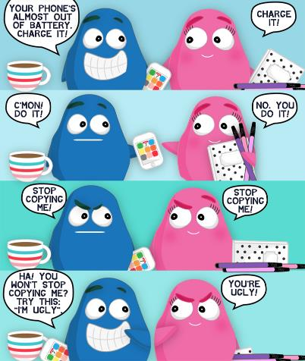
Similarity detection
All personal statements are checked by Copycatch
Any statements showing a level of similarity of 10% or greater will be reviewed by members of the UCAS verification team
The universities are then informed by UCAS and they will decide how to deal with it.
Notes:
Talk about similarity detection system

Slide 47
Reasons given to unsuccessful applicants
“Your personal statement does not strongly support your desire to study your chosen degree”.
“Your personal statement does not show sufficient understanding, relevance or knowledge about the course you’re applying for”.
“Your personal statement does not show sufficient understanding of the role you are entering”.
Notes:
Talk through reasons for not getting offers.

Slide 48
Points to remember . . .
DON’T
Talk about your passion – show it
Use flowery language
Use lots of clichés or quotes
List your current subjects or grades
Mention specific institutions
DO
Write confidently about yourself
Support your skills & experiences with evidence
Make everything relevant
Check spelling and grammar
Ask others to read it

Slide 49
Finally …
In everything you must REFLECT on your experiences and skills and RELATE them to your chosen course.
A – Action – being part of a sports team, voluntary work in a care home, school prefect
B – Benefit – what skills do these roles give you – teamwork, responsibility etc
C – Course or career – relate these experiences and skills to the course you want to study
Better statement = more offers = more choice!

Slide 50
Find out more
Ask questions on whatever platform you’d prefer if you are unsure about anything, we are here to help.
Live Chat to us – use on our website winchester.ac.uk
@_UoW
@uniwinchester
UniofWinchester
@winchesteruni

