Slide 1
An introduction to UCAS and preparing to apply
Some help and advice
Alison Wilson
6th June 2023

Slide 2
What I will cover
What UCAS is
Registering on UCAS
Using UCAS to help you choose
Making the right choice for you

Slide 3
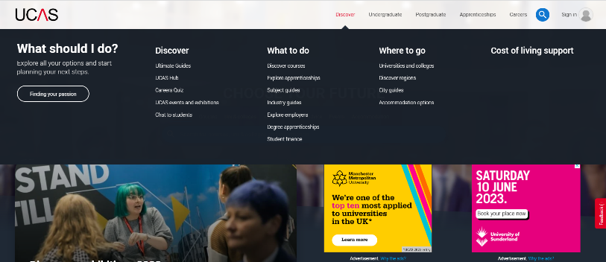
What is UCAS?
Universities and Colleges Admissions Service
Provides an online search, application and tracking service for higher education courses
Offers videos and information to help you and your supporters through the whole process

Slide 4
Sign up to UCAS Hub
Then you can save your search information for future reference
Not your school email
Sensible email address
You need access to your email during the registration process to enter verification number
Keep a note of your password
Notes:
Clicking on Sign in will bring you to the register page.

Slide 5
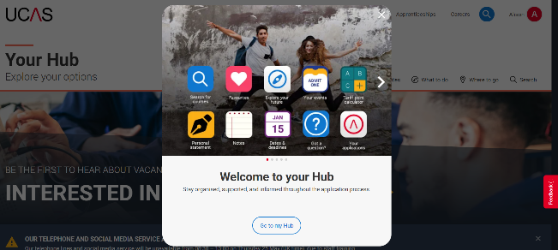
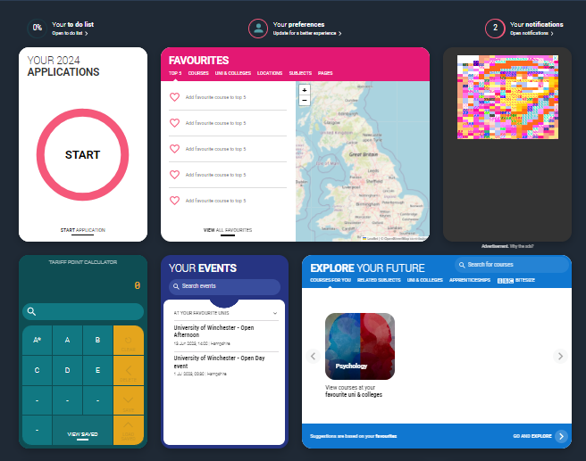
Using the Hub
When you find things you like (courses, universities, towns, areas) save them in your FAVOURITES so you can easily find them again.
Use EXPLORE YOUR FUTURE for finding information on courses, jobs, subjects and more

Slide 6
NOTES – anything you want to put here – doesn’t go to UCAS
HUB LIVE – bitesize help on a range of subjects
PERSONAL STATEMENT BUILDER
WHAT TO STUDY NEXT – list your qualifications and see what people studied
CAREERS QUIZ – see what might be good for you

Slide 7
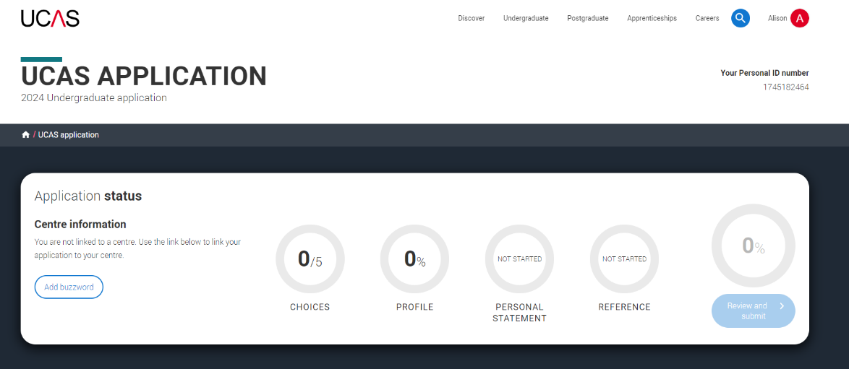
An overview of your progress

Slide 8
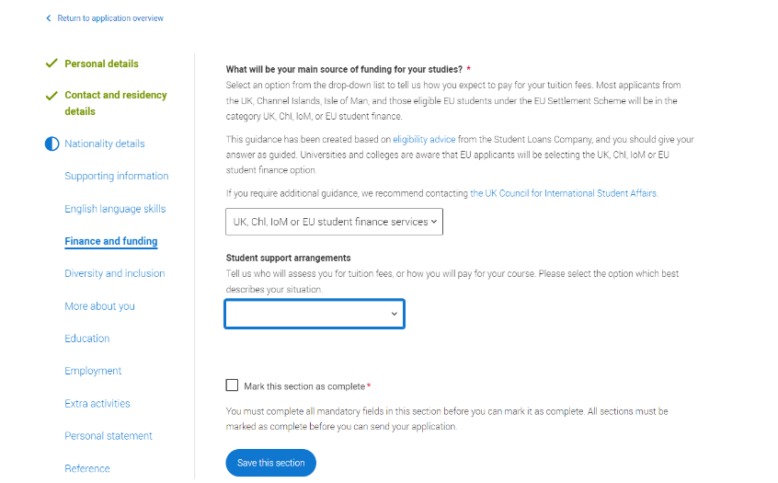
Another way to see your progress
Completed section
Started but not yet complete
Not yet started
Current screen
Mark as complete when you’ve finished

Slide 9
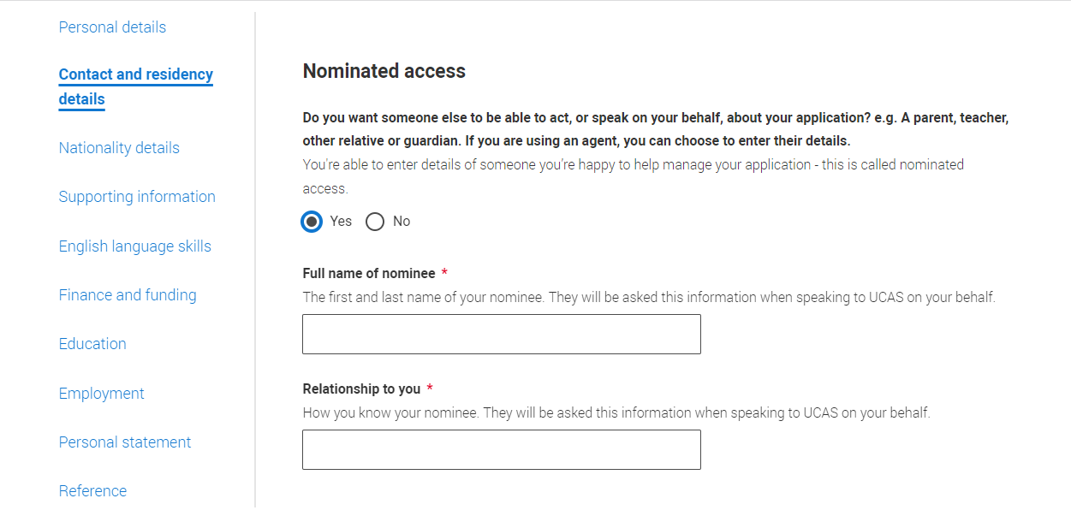
I recommend you include
Nominated access
Notes:
Without completing this section no one will be able to speak to UCAS or a university about your application if you need them to so I would highly recommend you add someone into this section.

Slide 10
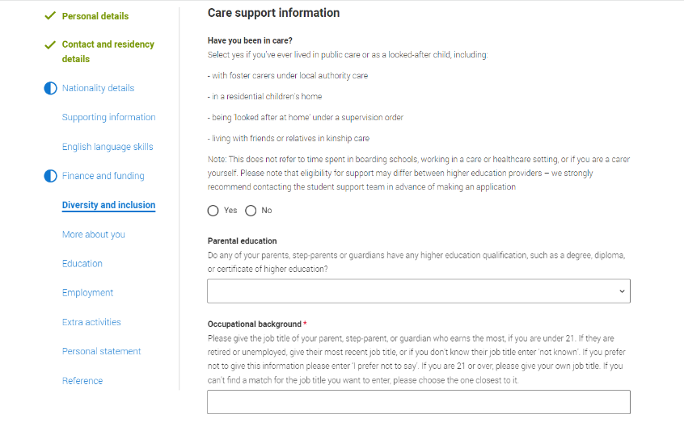
Other information to include
It’s not compulsory but if it’s relevant to you, disclose it.
Some universities offer support to care leavers – either practical or financial.
Notes:
Some sections in the application are compulsory and these will be indicated by a red star. If there is no red star then the question is optional however if you have at any time been within the care system I would disclose it to us. Some universities offer support for care leavers which could be extra sessions prior to arriving, support groups should you need them whilst studying but also some may have financial support for students who have been in care and even if it’s just £100 it’s going to be worth you having it.

Slide 11
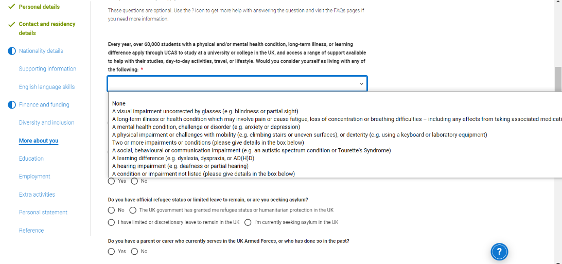
Practical or academic support
This will not go against you when universities consider whether to make you an offer.
It’s better for us to know this so we can prepare for your arrival. Also mention it when visiting.
Notes:
In ‘more about you’ you can let universities know if you have a physical and/or mental health condition, long-term illness or learning difference. Again I would recommend you complete this if it’s relevant to you. Telling us you need some form of extra support won’t go against you when universities consider whether to make you an offer or not. It is much better for us to know you will need some help sooner rather than later. Universities may contact you if you complete this to see how we can help but I would recommend you ask universities about their student support when you’re visiting. You want to know they can ensure you have every chance of performing to the best of your ability and this is an important part of your university choice process.

Slide 12
Important points to remember
Use a non-school, sensible email address
Keep a note of your password
Disclose any support in the ‘More about you’ and ‘Diversity and inclusion’ sections if that’s relevant to you
Notify us if you’ve spent any time in care or will need support but research it too
Use the nominated access facility
Allow plenty of time to complete your Hub information
Check all your information is correct
Know and MEET any deadlines
Notes:
Some reminder points for you about your application.

Slide 13
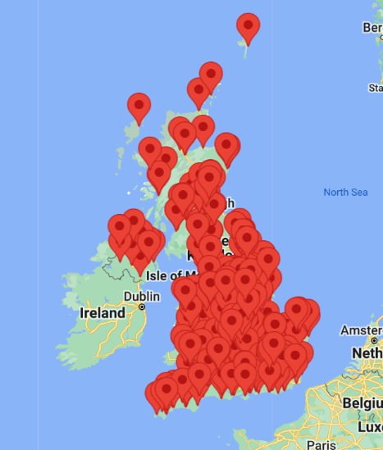
Choosing your course and university
UCAS has over 31,000 courses to choose from
Offered at nearly 250 universities or colleges
England 219
Scotland 21
Wales 15
Northern Ireland 3
You apply to a maximum of 5 courses or universities
4 for medicine or veterinary and a supporting subject.
Oxford or Cambridge.
Notes:
You can apply for up to 5 courses or universities which could be 5 different universities or 5 courses at the same university.
If you’re applying for medicine, dentistry or veterinary subjects you can only pick 4 of these and one supporting subject – could be BioMed or similar.
If you’re applying to Oxford or Cambridge you can only apply to one of these universities – not both.

Slide 14
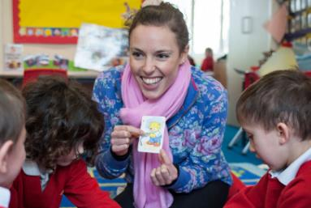
Starting to make your choices
Do you have a career in mind?
Do you need a specific qualification?
Prospects.ac.uk or UCAS.com both have a careers quiz

Slide 15
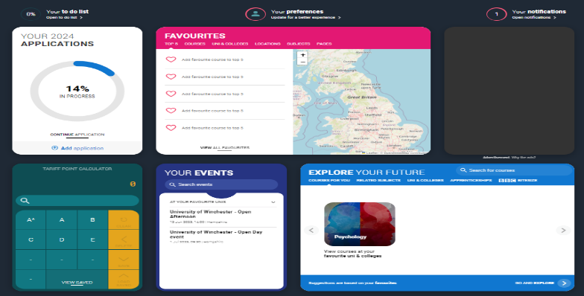
UCAS Explore your future

Slide 16
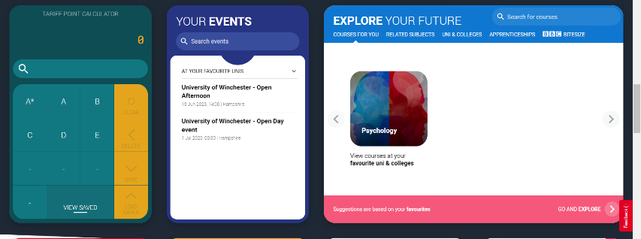
Exploring job options

Slide 20
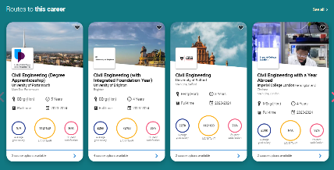
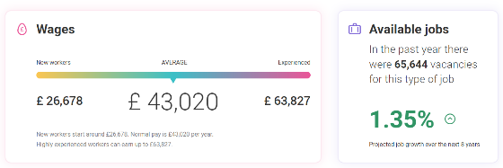
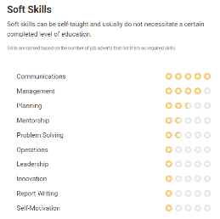

Slide 21
No career in mind – what about a subject?
Over 31,000 university courses (or combinations of courses) to choose from in the UK, many don’t need prior qualifications in that subject
Study a subject that you know and love
Study something completely new
Whatever you choose, you will improve your career prospects

Slide 22
Choosing a subject – ucas.com

Slide 25
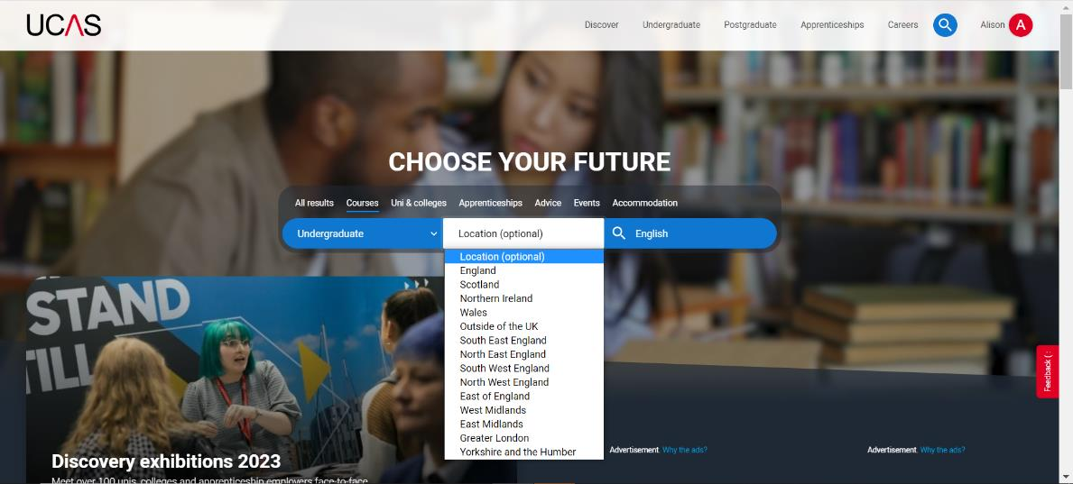
Notes:
When you open UCAS this is the screen you will see. If you’re anywhere else in the website clicking on the UCAS title will bring you here

Slide 26
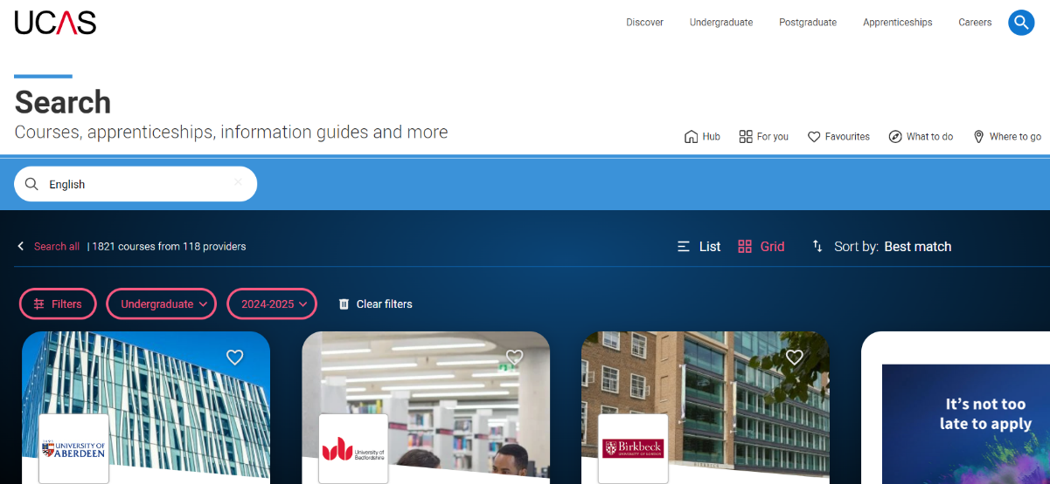

Slide 27
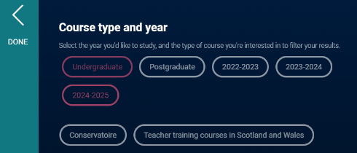
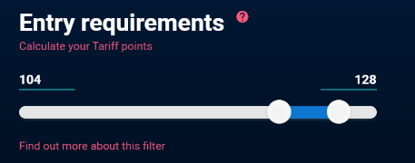
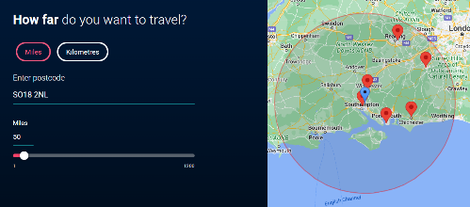
Notes:
If you select any filters make sure you click on save before you leave the page and before returning to the main page click Done otherwise it won’t store your filters.

Slide 28
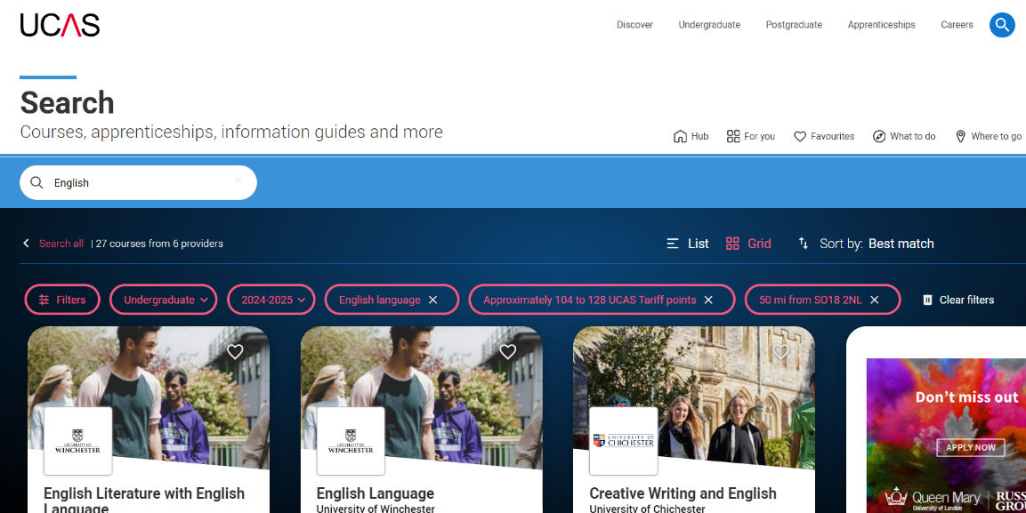

Slide 29
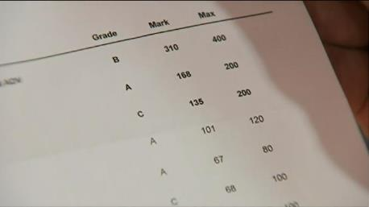
What to consider next
Having chosen your career, subject or course there are some ways to narrow down which ones you apply to:
Entry requirements
Modules
Assessment
Accreditation
Other opportunities

Slide 30
Entry requirements
Course: Geography | UCAS Points | A Level grades | IB points | BTEC grades | Additional requirements
University A | Not accepted | BBB | 32 points including 3 HL 5’s | DDM | Check with university
University B | 104-120 | BCC-BBB | Calculated tariff points to include minimum 2 HL 4’s | DMM | GCSE English Language and Maths at 4
University C | Not accepted | AAB | 32 including HL’s at 6, 6, 5 | Considered on a case by case basis | Excludes General studies and Critical thinking 1 grade lower may be offered with an A in EPQ
You can also gain points from some music or sport exams (ABRSM Grade 6 practical pass = 8 points, Grade 8 practical Distinction = 30 points). Some universities may take up to 32 of these towards UCAS points total.
Check all information on UCAS or providers website before applying.

Slide 31
Compare the modules on offer
University B Year 1
Compulsory modules:
People and Place
Global Risks
Geographical Research and Study Skills
Environmental Change
Exploring Geographical Data
Managing Geographical Issues
Environment and Society
University A Year 1
Compulsory modules:
Contemporary Human Geography
Global Environmental Issues
Environmental Research Frontiers
Research Methods, Field Work and Data Analysis
Tutorials and Study Skills for Geographers
Statistical Methods and Applied Geographical Information Systems

Slide 32
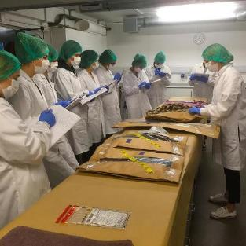
Assessment style
University
Year 1
82% coursework
10% written exams
8% practical exams
Year 2
75% coursework
25% written exams
0% practical exams
Year 3
100% coursework
0% written exams
0% practical exams
University B
Year 1
84% coursework
12% written exams
4% practical exams
Year 2
87% coursework
13% written exams
0% practical exams
Year 3
100% coursework
0% written exams
0% practical exams

Slide 33
Other things you may consider
About your course
Professional accreditation
Sandwich or placement year or study abroad
Equipment or facilities
About your university
Location
Size – university and city
Accommodation
Sport or social opportunities
Try to get a feel for it by visiting

Slide 34
When you’re ready to start
Reflect on your career ambitions
Check routes to achieve them
What subject areas do you feel interested in and enthusiastic about?
Consider courses within that subject area
Remember ways to narrow them down

Slide 35
Connect and ask Questions
Live Chat – use on our website winchester.ac.uk
Open Days
Tuesday 13 June 2023
Saturday 1 July 2023
Saturday 23 September 2023
Saturday 14 October 2023
Saturday 28 October 2023
Saturday 25 November 2023
@uniwinchester
@winchesteruni

