Slide 1
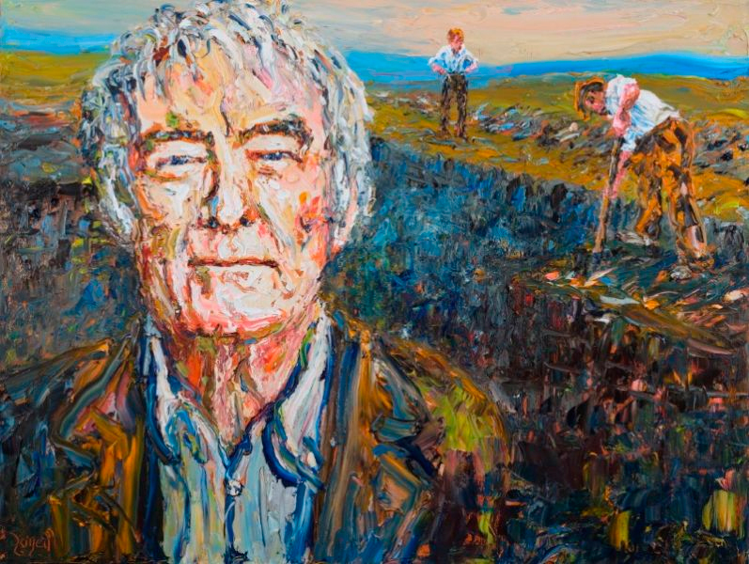
LANGUAGE AND LITERATURE - SEAMUS HEANEY POETRY
c
‘DIGGING’
Notes:
@SPryke2

Slide 2
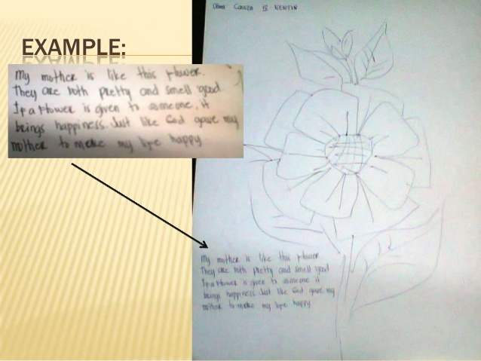
YOUR STARTER
c
Draw a symbol that best represents/ describes the person who helped in shaping who you are today.
Below the symbol, write a brief comparison between this person and the symbol you have just drawn.
‘DIGGING’
Notes:
@SPryke2

Slide 3
YOUR STARTER
c
Let’s discuss this with you peers.
What do your symbols have in common?
Why are these people so significant?
‘DIGGING’
Notes:
@SPryke2

Slide 4
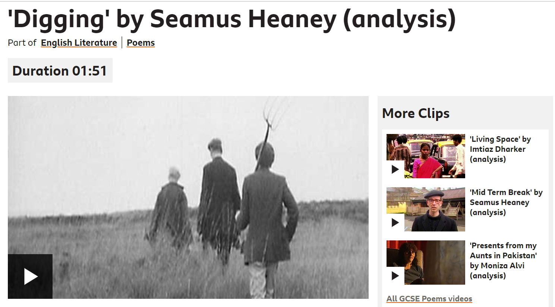
CONTEXT – NOTE DOWN KEY INFO FROM THE VIDEO CLIP
https://www.bbc.co.uk/bitesize/clips/z98s34j
Consider the poetic voice!
DIGGING

Slide 5
WHAT IS THE POEM ABOUT?
DIGGING

Slide 6
Let's annotate the first stanza together.
Global Issues explored in the poems.
How does Heaney present the concept of family?
What view of Ireland does Heaney present?
How does Heaney present his views about the past?
Did you enjoy it and why?
DIGGING

Slide 7
Let's annotate the first stanza together.
Global Issues explored in the poems.
How does Heaney present the concept of family?
What view of Ireland does Heaney present?
How does Heaney present his views about the past?
Did you enjoy it and why?
DIGGING

