Slide 1
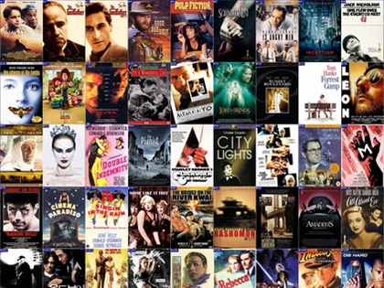
Welcome to IB Film Studies
Ms Magowan

Slide 2
My All-Time Favourites
Best Picture :
Best Director:
Best Actor:
Best Actress:
Q. Did you find this list hard or easy to complete? Why do you think this is?

Slide 3
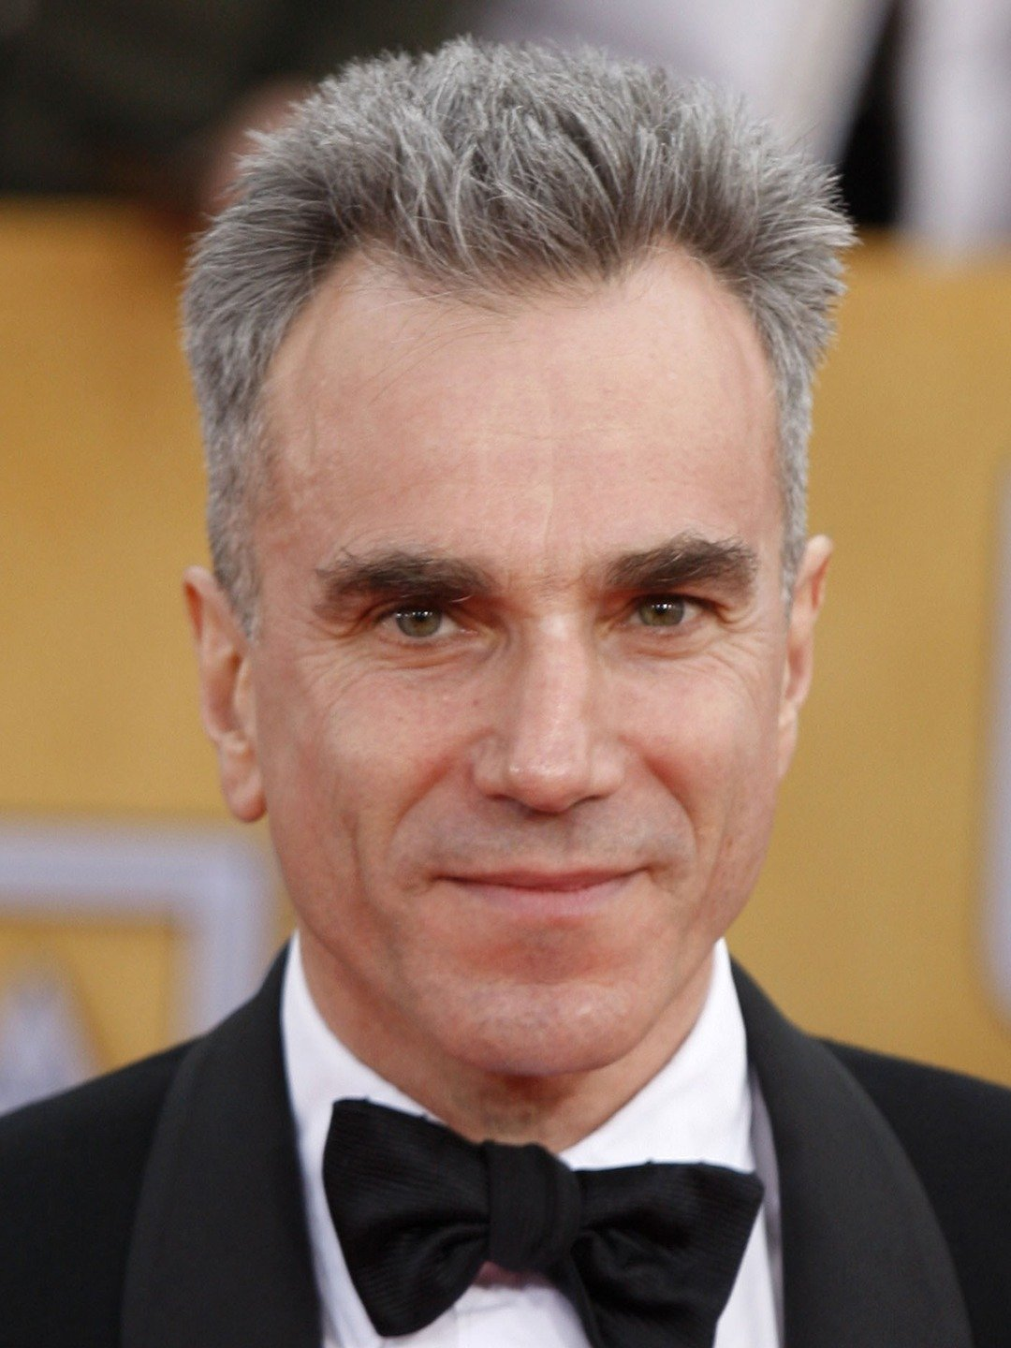
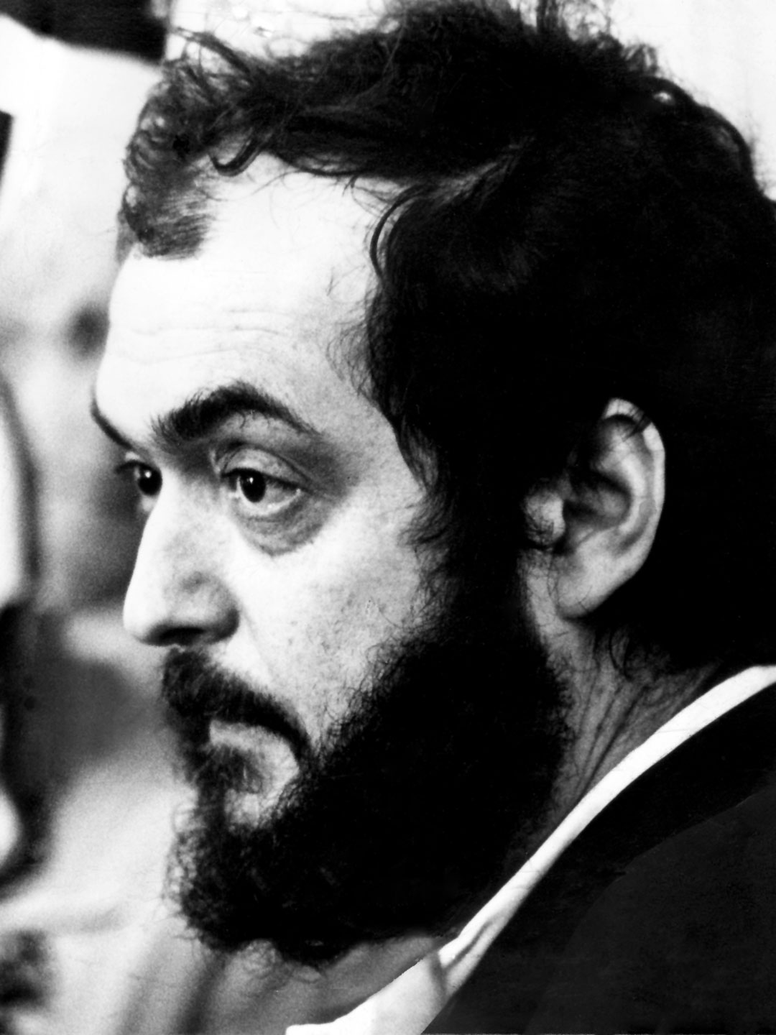
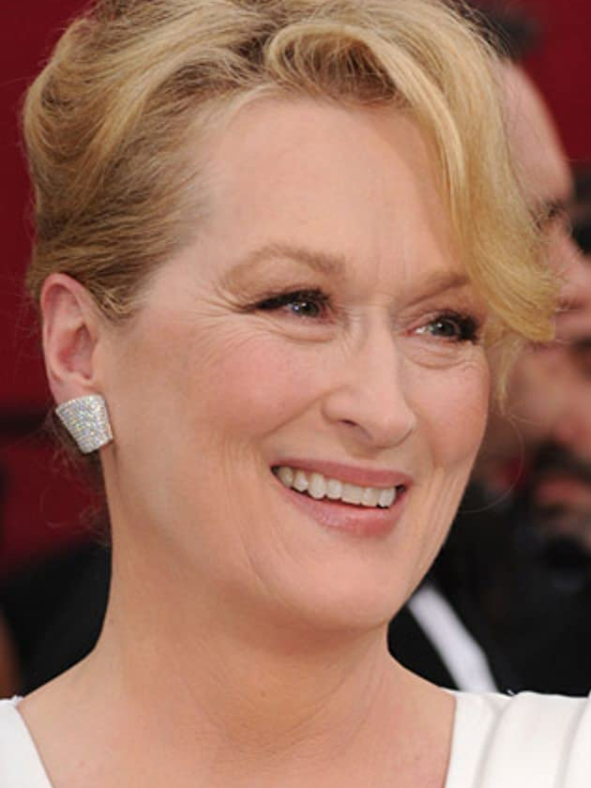
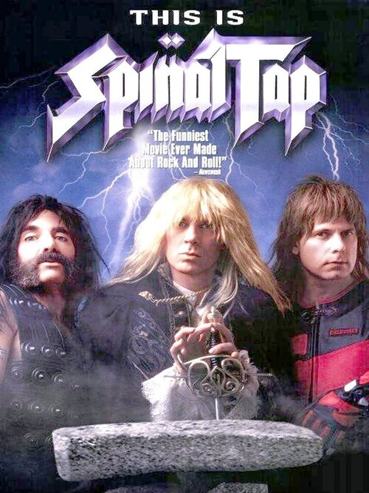
My All-Time Favourites:
Best Picture :This is Spinal Tap
Best Director: Stanley Kubrick
Best Actor: Daniel Day Lewis
Best Actress: Meryl Streep

Slide 4
Oscars 2023
Best Picture ?
Best Director?
Best Actor?
Best Actress?
Q. Why are the Oscars so important for the Film Industry?

Slide 5
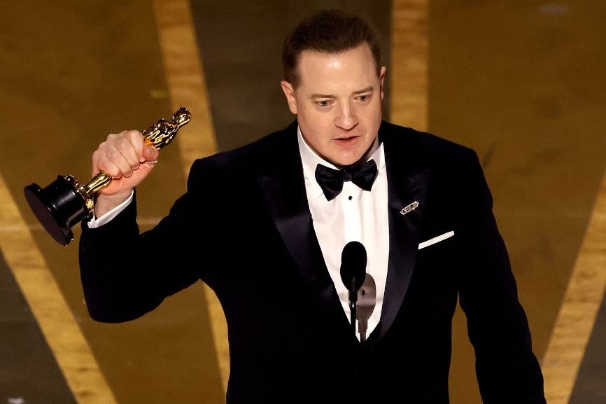
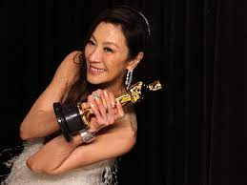
Oscars 2023 Winners
Best Picture: Everything Everywhere All at Once
Best Director: Daniel Kwan and Daniel Scheinert - Everything Everywhere All at Once
Best Actor: Brendan Fraser The Whale
Best Actress: Michelle Yeoh Everything Everywhere All at Once
How many have you seen?
Which genres seem to be popular/unpopular choices for awards?

Slide 6
A Film Can Be Analysed on Two Levels…
FILM TEXT
Micro Elements
Macro Elements

Slide 7
Film Micro Elements
Mise- En- Scene
Sound
Cinematography
Editing

Slide 8
Film Macro Elements
Genre
Messages and Values
Representation
Narrative
Style
Authorship
Theme

Slide 9
IB Film Summer Task: E mail to Ms Magowan on : l.magowan:@hautlieu.sch.je Due Date – 11th September 2023
Q. What makes a film “good” ?
400 to 500-word response.
Try to justify your answer by referring to aspects of both the micro/macro elements featured in your film.

