Slide 1
Application process support for parents
Lucy Dixon
UK Student Recruitment Team
Notes:
Timing 25 mins

Slide 2
Schools and Colleges Co-Ordinator but also… Channel Islands Liaison
Lucy.Dixon@winchester.ac.uk

Slide 3
About the University of Winchester!
1840
Founded as a Teacher Training College
92
Undergraduate Course options
8
Degree Apprenticeship options
5
faculties across the Arts, Social Sciences and Sciences
Campus University in the city of Winchester
60-minute
direct train to London Waterloo
Top 10
for Graduate Employment
(HESA, 2023)
Top 5
safest university cities
(Complete University Guide, 2023)

Slide 4
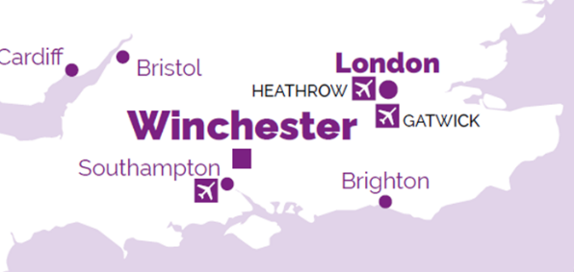
Where are we?
Our campus is a short walk from the centre of the vibrant and beautiful city of Winchester, located just 12 miles from the coast.
The train station is a 15 min walk away and we benefit from good train links.
The closest airport is Southampton Airport, with a 10 minute train connecting Southampton Airport to Winchester Train Station.

Slide 5
What I will cover
University
Why go to uni
What your students can study
Other benefits/opportunities
Student finance
Alternatives to university
What they can do now

Slide 6
Before we start,
let me introduce
you to UCAS…

Slide 7
www.ucas.com
Provides an online search, application and tracking service for students looking to go to university.
Provides videos and information to support students through the application process AND all their post-18 options.

Slide 8
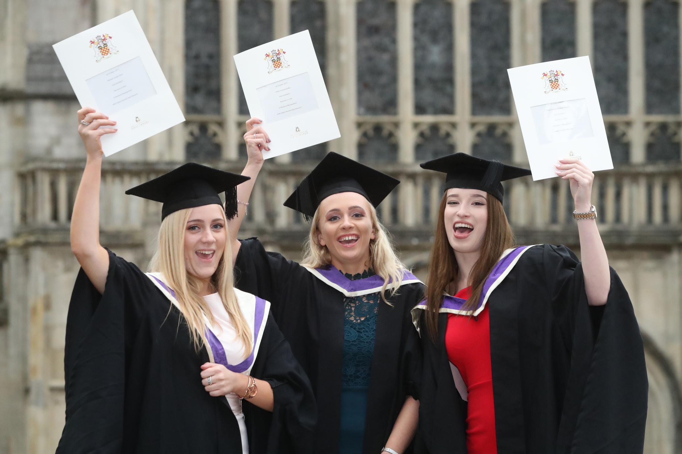
University

Slide 9
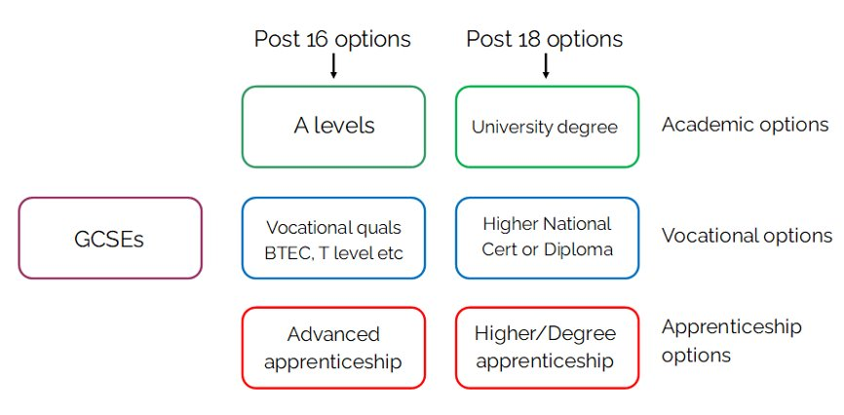
Routes to university

Slide 10
Why do people go to university?
Around 1/3 of 18-year-olds go to university
Qualify for their chosen career
Increase their employability/earning power
Study a subject they love or learn a new one
Meet a variety of people
Experience new opportunities
Increasing independence – commuting or living in

Slide 11
Graduate Labour Market Stats 2022 Median Salary
Median salary of non-graduates
£27,000
Median salary of graduates
£38,500
Median salary of postgraduates
£45,000
Notes:
https://explore-education-statistics.service.gov.uk/find-statistics/graduate-labour-markets

Slide 12
Graduate Labour Market Stats 2022 Employment Rates
Non-graduate employment rate
69.6%
Graduate employment rate
87.3%
Postgraduate employment rate
89.3%

Slide 13
Graduate Labour Market Stats 2022 Highly skilled employment
For example: accountants, scientists, engineers etc.
Non-graduate employment rate
23.6%
Graduate employment rate
66.3%
Postgraduate employment rate
78.3%

Slide 14
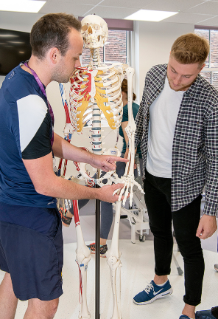
Vocational accredited courses
These qualify students to work in a particular career - people employed in this industry must have the relevant qualification
Primary Education
Nursing
Social Work
Physiotherapy
Medicine
Veterinary
Dentistry

Slide 15
Courses with a career focus
They do not need to do this degree to go into the field of employment, but it would help them learn the skills required
Accounting and Finance
Marketing
Film Production
Sport Management
Journalism
Forensic Investigation and many more

Slide 16
Courses with an academic focus
These degrees give students the opportunity to study a subject that they love while learning important transferrable skills which will help them in their career
History
Archaeology
Psychology
Sociology
Geography
English Literature and many more

Slide 17
Other opportunities
These can be:-
- Fun and rewarding
- A great way to boost a CV
- An accredited part of the course
Volunteering
Work Experience
Study Abroad
Student Union Societies
Student Union Representational Networks
Student Union Sports Teams

Slide 18
Timescales and application process
Year 12 – start their research on courses and universities, attend large UCAS exhibitions and smaller HE/Careers Fairs, attend advice talks or use UCAS advice
End of year 12/summer/early in year 13 – attend open days, narrow down their choices
Year 13 September to January – they apply
Year 13 October to June – they receive offers and make final decisions
Summer after year 13 – results, final preparation before starting uni
Late Summer/early Autumn – begin their course

Slide 19
Student Finance

Slide 20
What students have to pay
The 2 main expenses they will have whilst at university are:
Tuition fees - £9,250* per year for UK and EU students starting full-time undergraduate courses in September 2022
Living costs – accommodation or commuting, food, travel, study materials e.g., books, and other course costs, leisure, social etc. Living costs will vary according to the lifestyle choices they make.

Slide 21
Financial support
For students from Jersey, support is available to help with the cost of course fees and living costs. Financial assistance is means-tested and takes the form of a grant, which does not need to be repaid unless they withdraw from their course.

Slide 22
Financial support
The government of Jersey provides financial help for Jersey students who want to continue studying.
The amount they can receive is means-tested and has two elements:
Tuition fees: Up to £9,250 per year.
Maintenance grant: Up to £8,572 for a standard academic year. This helps to pay some of the living expenses towards accommodation, food, utility bills and books.

Slide 23
Financial support: How to apply
Students need to apply for funding well before their course starts to be sure of receiving a grant for the beginning of term.
Students can apply any time from January for a course starting the following September. Most students submit an application before 31 March because this means all the necessary paperwork will be complete by the time they receive their results.
If students are considering University, but are uncertain about where to go, it is still best to apply to Student Finance as soon as possible to save time. They can always withdraw their application.
*Note: parents/carers will need to submit a new income statement form for each academic year. For continuing students this will be automatically sent out by Student Finance at the beginning of calendar each year.*

Slide 24
Alternatives to going to university at 18

Slide 25
Gap Year

Slide 26
Gap years: the basics
A good choice if they are undecided about the future or would like a break from studying
Employment
Travel
Volunteering
Opportunity to build skills and experience
University application before or during
Or a combination of all three

Slide 27
www.ucas.com/undergraduate/ student-life/gap-year

Slide 28
Degree Apprenticeships

Slide 29
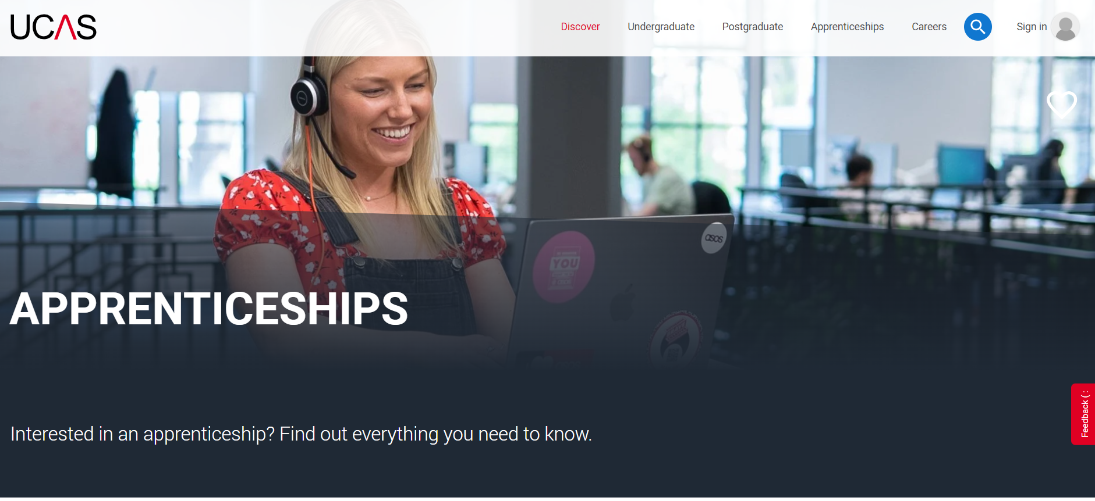
www.ucas.com/apprenticeships

Slide 30
Not Going To Uni at 18

Slide 31
Do they have to go to uni at 18?
Simple answer: No!
Around ¼ applications to university are made by mature students.
Apply with existing qualifications/work experience/one year Access to HE qualification.
Professional courses are popular and enable people to pursue their dream career.

Slide 32
Famous mature students
Micky Flanagan, comedian
Left school at 15 with no qualifications
Restarted education at 25 and gained a degree in his 30s
Steven Spielberg, film director
Went to California State University
Gained his degree in film and electronic arts age 55
Lenny Henry, actor, comedian, presenter and writer
Gained his English Literature degree from the Open University in 2007
Then gained his Masters degree in Screenwriting, followed by a PhD

Slide 33
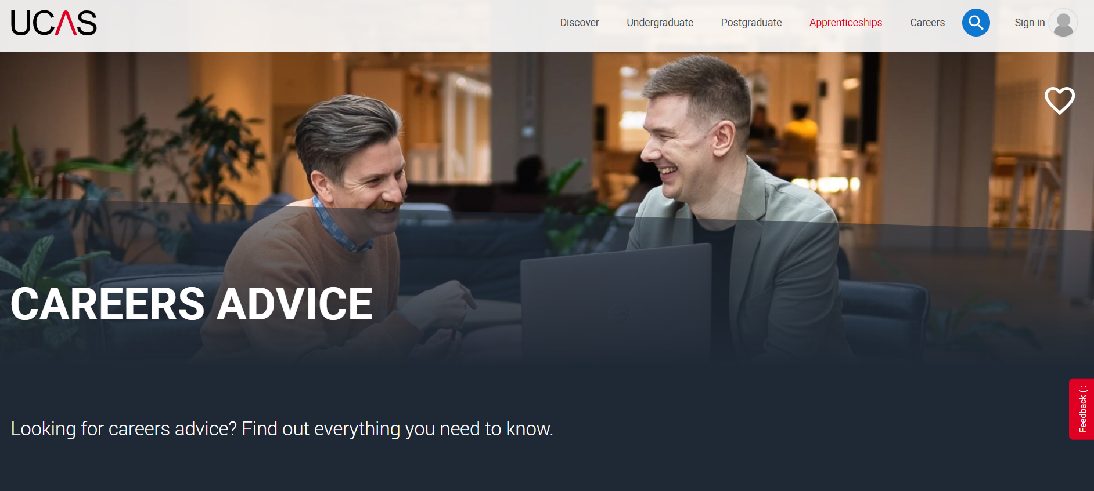
www.ucas.com/careers-advice

Slide 34
What your children can do now/next

Slide 35
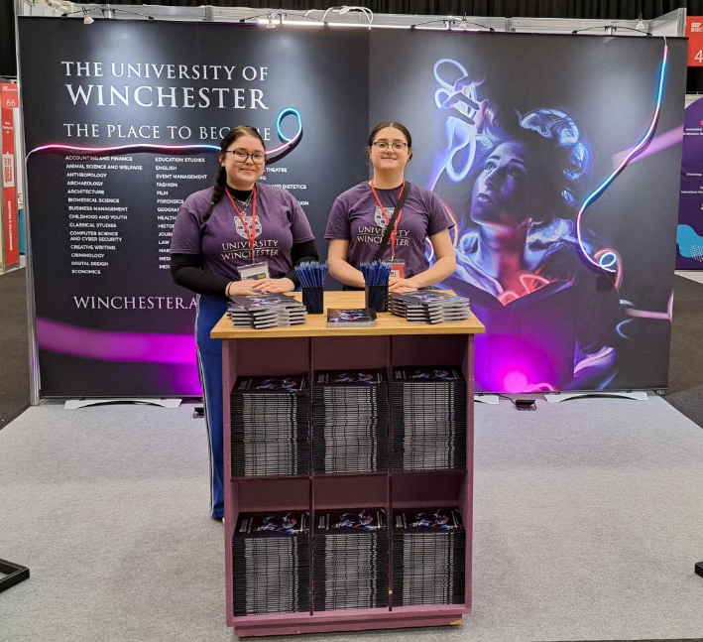
What they can do now/next
Explore post-16 options, post-18 options and career options. The National Careers Service have a great quiz to help them narrow down suitable careers and courses.
Make the most of work experience opportunities to make their applications strong.
Attend Careers/HE Fairs at their school and college and make the most of being able to ask questions of employers and education providers.
Get a part-time job or undertake volunteering.

Slide 36
Keeping their options open
They should do research and narrow down their choices
(Visit sixth form colleges and plan best case scenario and back up options)
BUT they can pursue more than one option/route
University AND apprenticeship applications
Consider a gap year AND apply to university

Slide 37
Remember www.ucas.com for advice about all their options

Slide 38
Other great websites
Prospects – www.prospects.ac.uk
Discover Uni – www.discoveruni.gov.uk
The Student Room – www.thestudentroom.co.uk
Martin Lewis/Money Saving Expert – www.moneysavingexpert.com/students
National Careers Service Skills Assessment – www.nationalcareers.service.gov.uk/skills-assessment
University of Winchester Information for Parents and Carers - www.winchester.ac.uk/accommodation-and-winchester-life/student-life/information-for-parents-and-carers-/

Slide 39
Find out more
@uniwinchester
@_UoW
@winchesteruni
www.Winchester.ac.uk
@UniofWinchester

Slide 40
Thank you!
www.Winchester.ac.uk
lucy.dixon@winchester.ac.uk

