Slide 1
CV writing and interview tips
2024

Slide 2
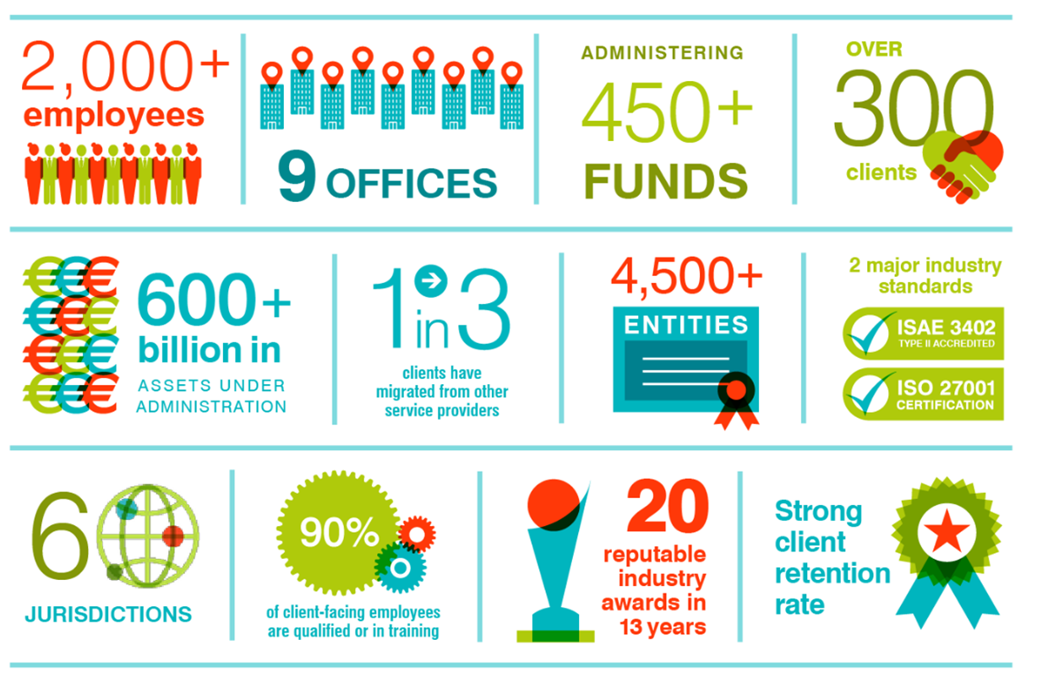
AZTEC
GROUP
IN
NUMBERS

Slide 4
CV Writing
Securing yourself an interview is the first step
CV should represent you - make sure it is a good representation of yourself
Make sure you stand out from the crowd, we are receiving a large volume of applications on a daily basis
First impressions count

Slide 5
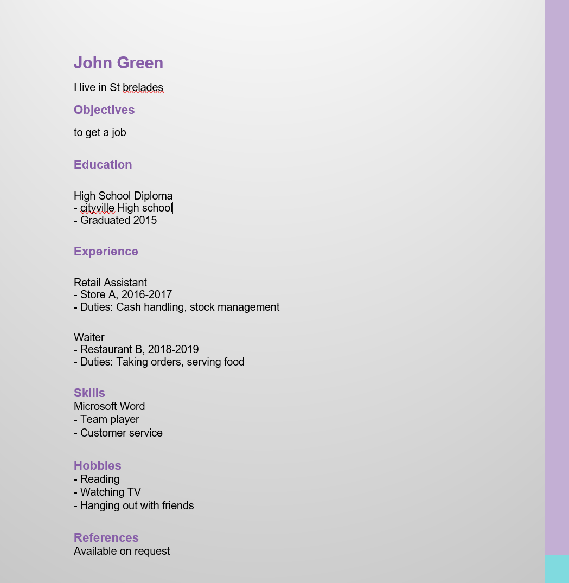
CV Example 1
Why is this a bad CV example?
No contact details.
Incorrect punctuation.
No qualifications or grades mentioned.
No statement about why they think they would suit this role, or what attracted them to it.
Basic role and responsibility details. Needs to include the exact month/year worked.
Include at least 5 skills. Try to match the job description.
Not the most exciting hobbies.

Slide 6
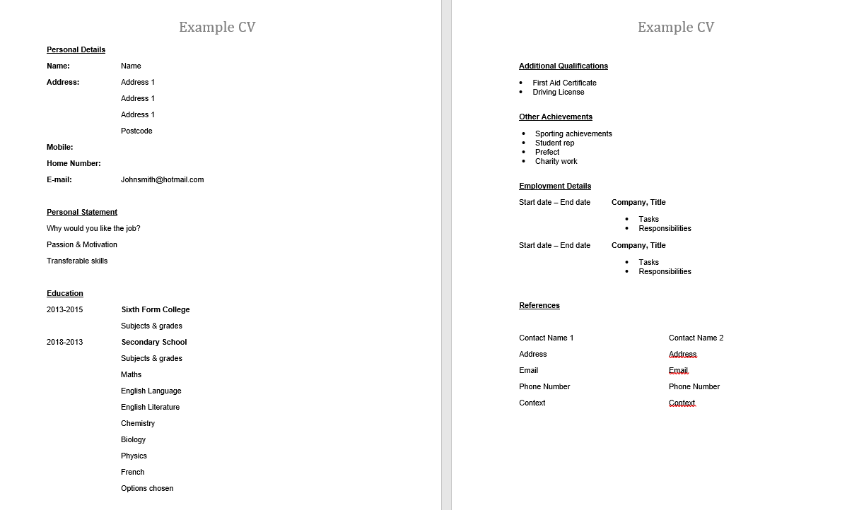
CV Example 2

Slide 7
Format:
2 pages maximum
Clear headings
Consider Layout – heading, bullet points etc
Easy to read
Check grammar and punctuation thoroughly
Make sure the font you use is easy to read
Ensure there is fluency throughout the CV

Slide 8
Content – Personal contact details
Name
Address
Phone number
Email address
Include a profile that briefly describes your reasoning behind wanting this job in particular, highlight your knowledge and skills and demonstrate your motivation and passion for the role.

Slide 9
Education and Qualifications
Qualifications achieved (GCSE/A Level/ Degree)
What date the qualification was achieved
Grade/Level
If still in education – predicted grades
Schools/Colleges attended (include names and dates)

Slide 10
Work Experience
Saturday Job / Summer placements / Work placement / Trident placement
Name of company/business
Dates worked
Title of role
Brief explanation of responsibilities of the role
Optional – bullet point key transferrable skills learnt
Interests/Hobbies
Personal interests
Hobbies outside of school

Slide 11
References
Suggest 2 contacts
Contacts that have known you for minimum 3 years
Professional capacity
Examples: Manager from Saturday job or work experience, Form tutor/Careers tutor or likewise from school
List Name, Title, Address, Contact details (Email & phone number)
Please ask your referees if they are happy to be a contact should any employers wish to contact them

Slide 12
Ensure all the information you have included is accurate and correct – if the information is false, when the company conducts a pre-employment screening check they will identify any errors which could cost you the job, all references are contacted, educational checks are completed, and all information verified.
Be positive, honest and concise.
Research the company and job description – amend your CV to relate to better suit the role you are applying for

Slide 13
What do Employers look for?
Good grades
Work experience – exposure to office or other working environments
Motivation/Passion – demonstrated in other areas such as hobbies or interests
Clear, concise, and easy to read CV - clearly highlighting your qualities
Transferrable skills e.g. communication skills, organisation, people skills, responsibility
Try to tailor your CV to the specific job you are applying for – match your skills to the Job Description provided to show that you are the most suitable candidate for the job

Slide 14
How to apply…
Most applications are now either online via a website or by emailing your CV
Ensure that if you email your CV, you write a short cover letter in the email body which should confirm your name, the position you are interested in and attach your CV to the email
Cover Letter – optional, but can be a good addition to your application; however, you could include this information in your profile

Slide 15
Interview Process
Keep your eye on your email and phone calls
Read through email thoroughly and ensure you respond with answers to all questions asked by the recruiter
Respond as soon as possible, as most employers will be moving fast paced
When responding via email… be clear and concise, with a professional email structure
If/when you receive an interview time… put it in your diary!

Slide 16
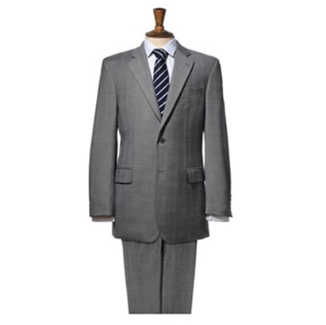
Interview tips
First impressions count:
Arrive early or on time – arriving late will not set a good first impression to the interviewers
Dress smart – even if the company has a ‘casual’ dress code, remember you are formally interviewing for a role and want to impress the interviewers
Check the location of the interview - Is there an address on the invitation or is it a virtual call?
Preparation:
Thoroughly research the company and what they do
Read through the job description a few times to understand the basics of the role you are interviewing for
Practise your interview questions with friends and family, be prepared for anything
Ensure you have investigated the company values and beliefs
Memorise your CV and details on it from previous work experience as this will likely be discussed in an interview process

Slide 17
Any Questions?

Slide 18
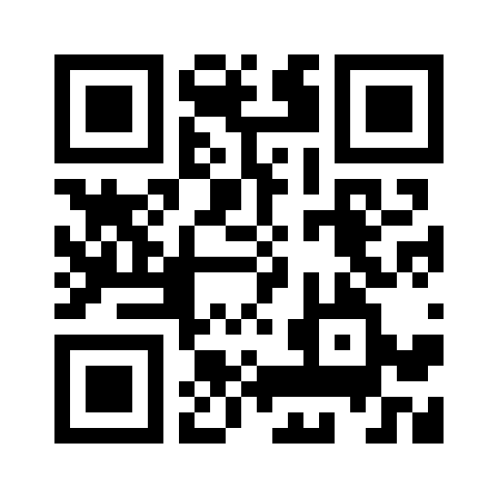
Please don’t hesitate to contact us with any questions related to our trainee vacancies, career development opportunities or upcoming events:
GET
IN
EMAIL: careers@aztecgroup.co.uk
PHONE: 01534 833017
TOUCH
Aztec Group is authorised to carry on financial services in the jurisdictions in which it operates.
Explore: aztec.group/students

