Slide 1
Enhancing Successful Outcomes

Slide 2
Enhancing Successful Outcomes
Attendance and links to attainment
Support for attendance
Go4Schools
Reporting at Hautlieu
Study habits and supporting learning at home
Support for students at school
There will be smaller sessions to give parents on the following support:
  ML
  Eligibility for Jersey Premium
  SEN
  G&T
  Student well-being

Slide 3
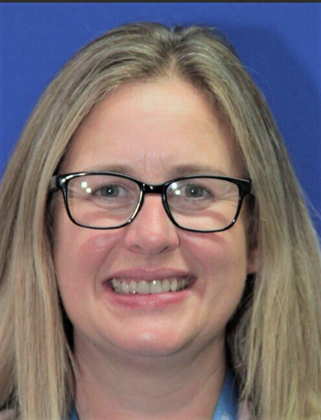

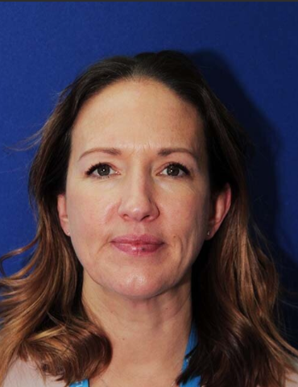

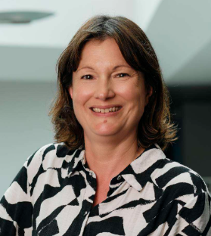
Miss Carroll
Assistant
Headteacher
Miss Hearne
Teaching and Learning Lead Practitioner
Mrs Wilson
AHOY Year 12
Mrs Kedge
Student Support Lead and Positive Mental Health & Well-being Manager
Miss Stoddart
Attendance & Education Welfare Officer

Slide 4
Attendance
Regular attendance is a vital part of student welfare
Target – 96%
90% - Sounds pretty good?!
  Almost 4 weeks of school missed
  Up to 100 lessons in total

Slide 5

Monitor and Support
Check term dates
Parent/Guardian must contact the school to report absence
Miss Stoddart
Attendance & Education Welfare Officer (KS4)

Slide 6
Assessment and Reporting
Interim and Full Reports
Support student progress
Improve study habits of learners
Student ownership and parent/carer understanding of progress in learning and predicted attainment
Monitor and evaluate student progress
  Appropriate support

Slide 7
Grades
Target Grade
  Fixed
  Informed by prior attainment (CAT4 / GCSE)
  Intentionally aspirational
  Predicted Grade
  Realistic indication of A Level / GCSE outcome
  Professional judgment of subject teacher
  Contributing factors
  Current Grade
  Informed by internal data and any external examinations
  Reflect qualification grades and components

Slide 8

Go4Schools
Transparent and accessible
Track Attendance – View overall attendance as well as attendance to individual lessons,
View Reports – Access Interim and Full Reports as they are published throughout the year, and
Monitor Progress – Explore detailed information about progress in each subject, providing an understanding of what learning has taken place.
Notes:
This insight allows parent/carers to stay closely connected to the learning journey of their son/daughter. We hope that this encourages productive conversations at home about their growth and accomplishments so that we can work in partnership to enhance the progress.
We also want students to use the platform regularly so that they can take ownership of their learning, understand exactly where they are, and recognise what they need to do to reach their potential with the support and guidance of their teachers.
We will continue to maintain and develop the platform throughout the year and beyond to refine and unlock the sharing power of Go4Schools so that teachers, students and parents can prioritise learning development. The Current Grade shared will continue to change over the course of the year as students complete assessments – it will reflect a snapshot of their most recent attainment as well as other tests completed throughout the year.

Slide 9
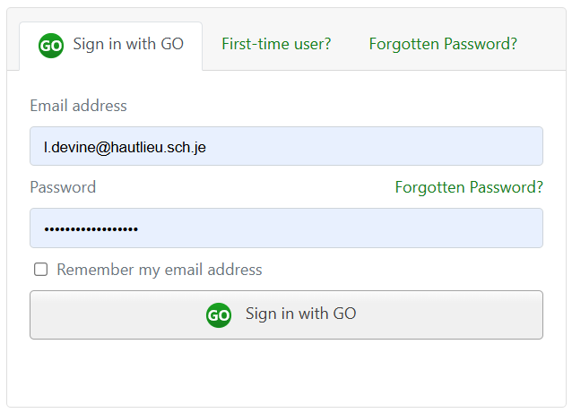
Logging In

Slide 10


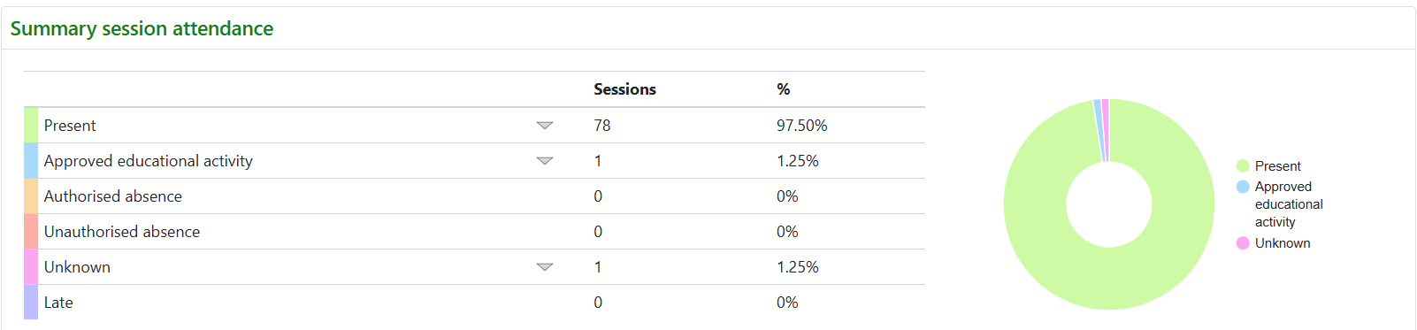
Attendance

Slide 11
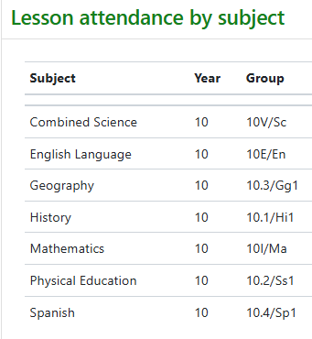

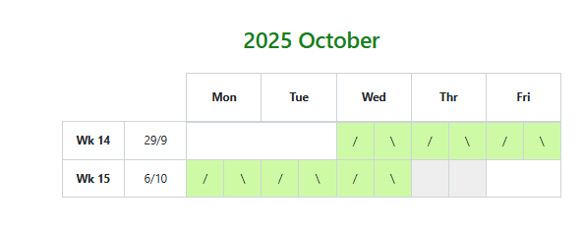
Attendance

Slide 12


Progress
Residual Legend

Slide 13
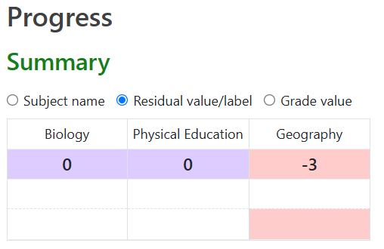
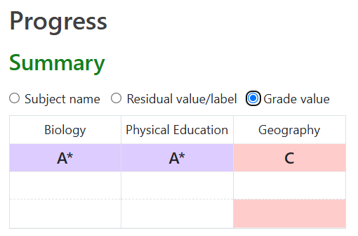
Progress

Slide 14
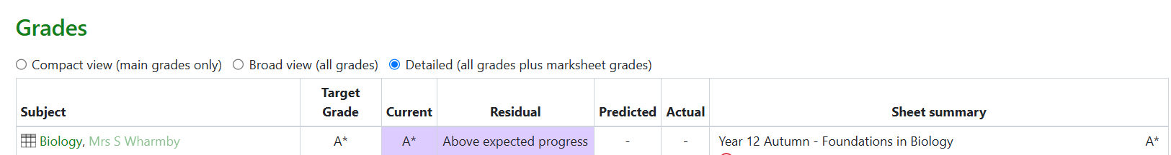
Progress

Slide 15


Reports

Slide 16
Grades
Target Grade
  Fixed
  Informed by prior attainment (CAT4 / GCSE)
  Intentionally aspirational
  Predicted Grade
  Realistic indication of A Level / GCSE outcome
  Professional judgment of subject teacher
  Contributing factors
  Current Grade
  Informed by internal data and any external examinations
  Reflect qualification grades and components

Slide 17
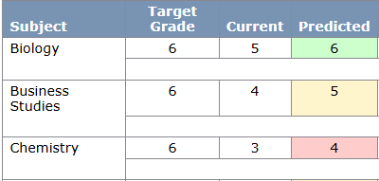
Residual

Slide 18
Attributes for Successful Learning
Work in class – Engages actively in class, contributes productively, and works well with others.
Work out of class – Completes homework and independent tasks on time and to a high standard.
Behaviour for learning – Demonstrates a positive attitude, respect for others and supports a productive classroom environment.
Organisation – Arrives punctually, prepared and manages learning responsibly
Outstanding – consistently models
Good – Frequently models
Developing – Occasionally models, prompting requires
Requires improvement – Infrequently models, emerging concerns

Slide 19
Study Habits
Why it matters:
Good study habits lead to: better learning, confidence, and successful exam outcomes
Notes:
Link to school motto – aim for highest
Working together in partnership students, home and school

Slide 20

How Students Learn
Notes:
In order to support study habits important to know how students learn and how consistent study habits and revision can consolidate learning and support successful outcomes
Video 3 minutes How We Learn ADD video ask Stacey

Slide 21


Slide 22
What are GOOD Study Habits?
Consistency – Regular study routines, not just cramming.
Organisation – Using planners, folders, and checklists.
Time Management – Breaking tasks into chunks, avoiding last-minute rush.
Active Learning – Using flashcards, quizzes, teaching others.
Healthy Balance – Sleep, breaks, and downtime are essential.
Notes:
Run through bullet points

Slide 23




Learning WALKTHRUs
Notes:
We have heard of these techniques but it is important to complete them with precision to be most effective to learning, study and revision
Steps for each will be available in a handout on way out
Let's look at flash cards...

Slide 24
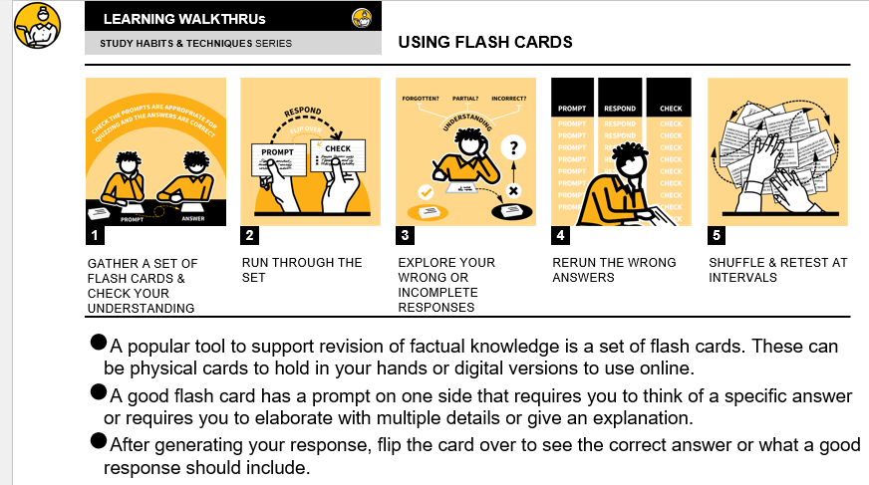
Notes:
Introduce step 1 - can be bought CGP or created, complete their own does not need to be fancy, paper, card, keep simple
Follow and demo steps 2-5– be honest – encourage student to use, use them with as a parent - YES, some, NO piles
Break and then try again next week – No pile getting smaller
Being precise with the steps support better use of them

Slide 25
Flashcards
When we learn, information transfers from our short-term memory and into our long-term memory
Completing retrieval tasks regularly and spacing them out over time will help this process so that information becomes embedded in your long-term memory
Retrieval tasks involve having to think hard, engaging with information, and practising what you are trying to learn E.g. recall, quizzing
Long-term memory = necessary for effective learning
Notes:
Run though bullet points

Slide 26
How to support at home…
✅ Create a Study-Friendly Environment
Quiet space, good lighting, declutter, minimal distractions.
Access to basic supplies (pens, paper, charger, etc.)
📅 Encourage Routine
Help set a regular homework/study schedule.
Use visual planners or apps to track tasks.
💬 Talk About Learning
Ask what they’re working on.
Praise effort, not just results.
Notes:
Run though bullet points

Slide 27
How to support at home…
📵 Limit Distractions
Support phone-free study time.
Encourage focus blocks (e.g. 25 mins study, 5 mins break).
🧠 Promote Wellbeing
Encourage sleep, healthy eating, and downtime.
Watch for signs of stress or burnout.
Notes:
Run though bullet points

Slide 28
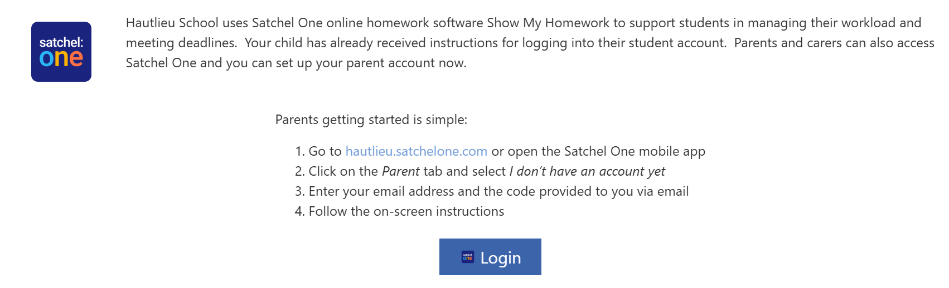
Satchel:One

Slide 29
Support in school…
Subject teachers
Mentor
Academic Heads of Year
Learning Support Team – Mrs Priestley
Student Support Team – Mrs Kedge

Slide 30


Slide 31
Further Information for Families

Slide 32

Next Steps... 16+
Prospectus, available October 2025 on the website
16+ Evening and online application – 20th October 2026 @ 6pm
Deadline for Applications – 18th December 2026
Information re: Interview Process to follow (visits to Schools)
Highlands application – support, opens in November
GCSE Results
Transition Days – 24th & 25th June 2027
STUDY LEAVE – 6th May

Slide 33
Enrichment Programme
Year 12 – Compulsory
1 x Enrichment Session per week
Rotate Enrichment options each term
Students complete a form to submit requests for their choice of sessions
Personal Development: Builds confidence, leadership, and teamwork skills beyond the classroom.
Broadened Horizons: Exposes students to new interests, experiences, and potential career paths.
Enhanced Applications: Strengthens university, apprenticeship, or job applications through well-rounded experiences.

Slide 34
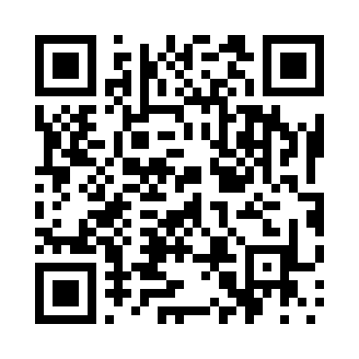
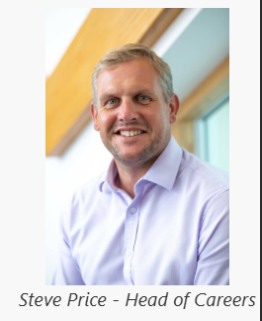
Next Steps...
FE / Employment
Year 10 – Trident
Year 11 – 16+ Opportunities
Year 12 – Careers Activities, 1-2-1 Mentor, Unifrog , Higher Education Fair, University Talks
Year 13 – Employment Opportunities, Employer Visits, UCAS support

Slide 35
Support for University Applications
Applications for eligible students are paid for by the school.
Miss Devine may be able to help financially with visiting universities for open days.
Information about support with university fees and maintenance can be found on the government website Student Finance guidance and application

Slide 36
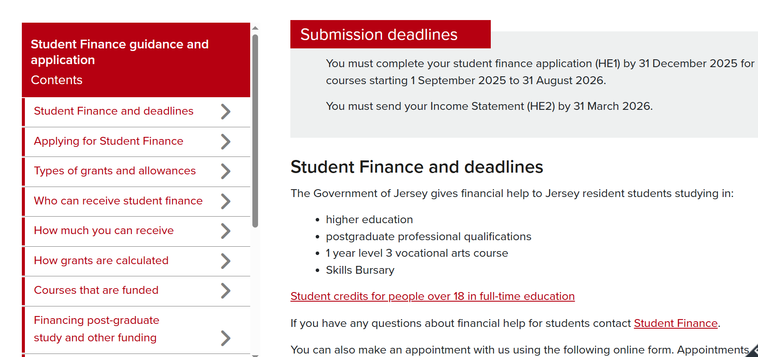

Slide 37
Support for University Applications
Student Finance can be contacted with any specific questions you have
studentfinance@gov.je 01534 449450
Current or ex-students can apply to the Hautlieu Trust for some funding Hautlieu School Trust – Hautlieu – applications three times a year, Mr Joe Harvey: j.harvey@hautlieu.sch.je

Slide 38
Support for University Applications
Universities can help with student finances. Speak to individual Student Unions at each university or discuss this on Open Days.
Bursaries are available for support with finances and to get work experience during holidays. A list is on the government website Educational trusts, bursaries and gift funds

Slide 39
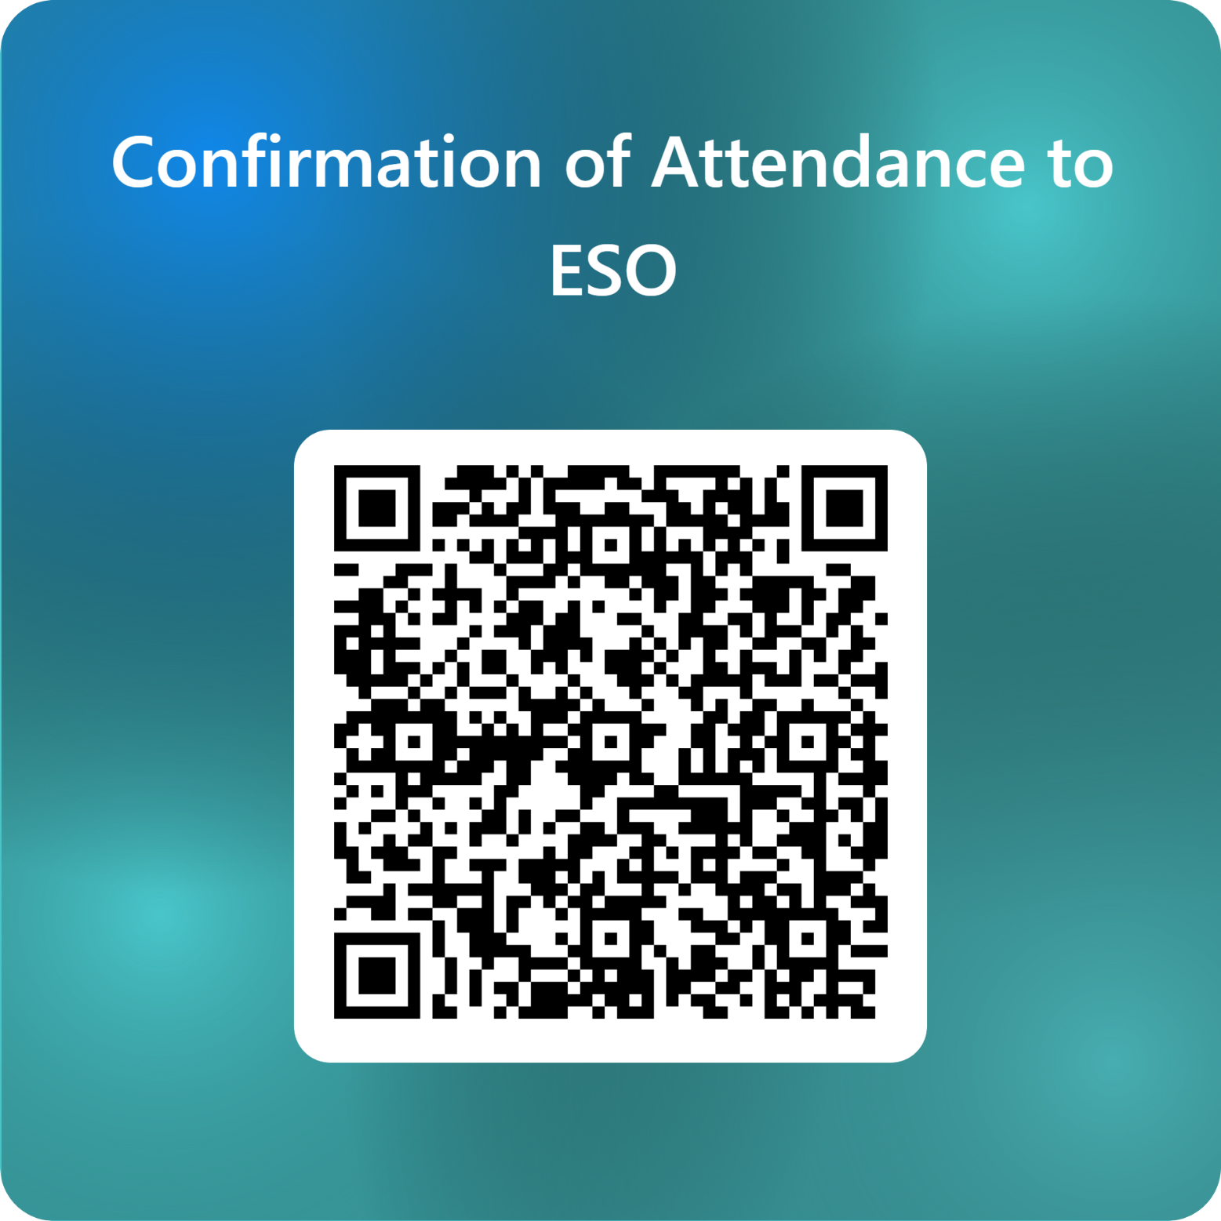

Slide 40
Breakout Sessions
18:50pm – 19:00pm
19:05pm – 19:15pm
Jersey Premium – Miss Devine (ICT1)
Multilingual Learners – Miss Rid (ICT2)
Special Educational Needs – Ms Priestley (ICT 3)
Gifted and Talented – Miss Sinfield (ICT4)

Slide 41

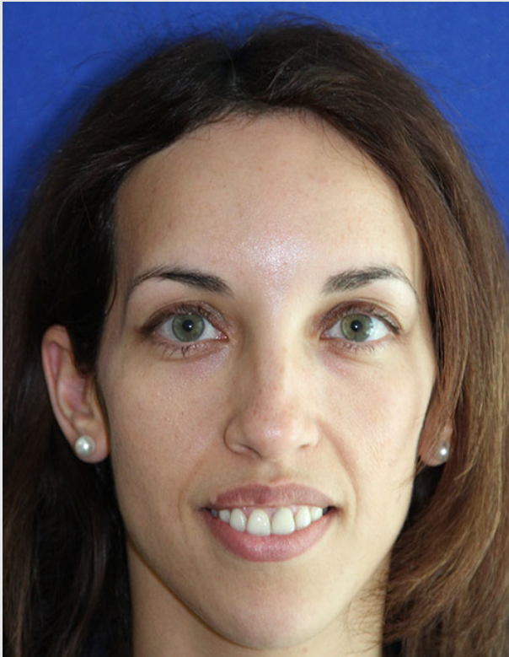
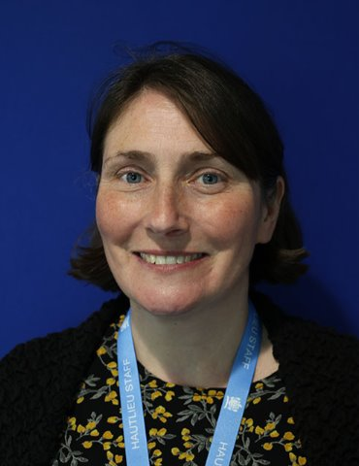
Miss Sinfield
G&T Lead
Miss Rid
ML Lead
Ms Priestley​
SENCO
​

Slide 42
Gifted and Talented Students
Rachel Sinfield​
Coordinator of Music ​
and ​
Gifted and Talented Students

Slide 43
How do we identify a student as ​
Gifted and Talented at Hautlieu School?
At Hautlieu School we determine a student as Gifted and Talented if they meet one or both of the following criteria: ​
They are the most able 10% in their year group. This is determined from their scaled mean CAT Score or GCSE Point Score, and these figures vary slightly each year.​
Students who have a GCSE Point Score of at least 7.75 or over and for Key Stage 4 students, a scaled mean KS3 CAT Score of 133 or over, are considered to belong to ALPS BAND 1,a national benchmark of the highest attaining students.

Slide 44
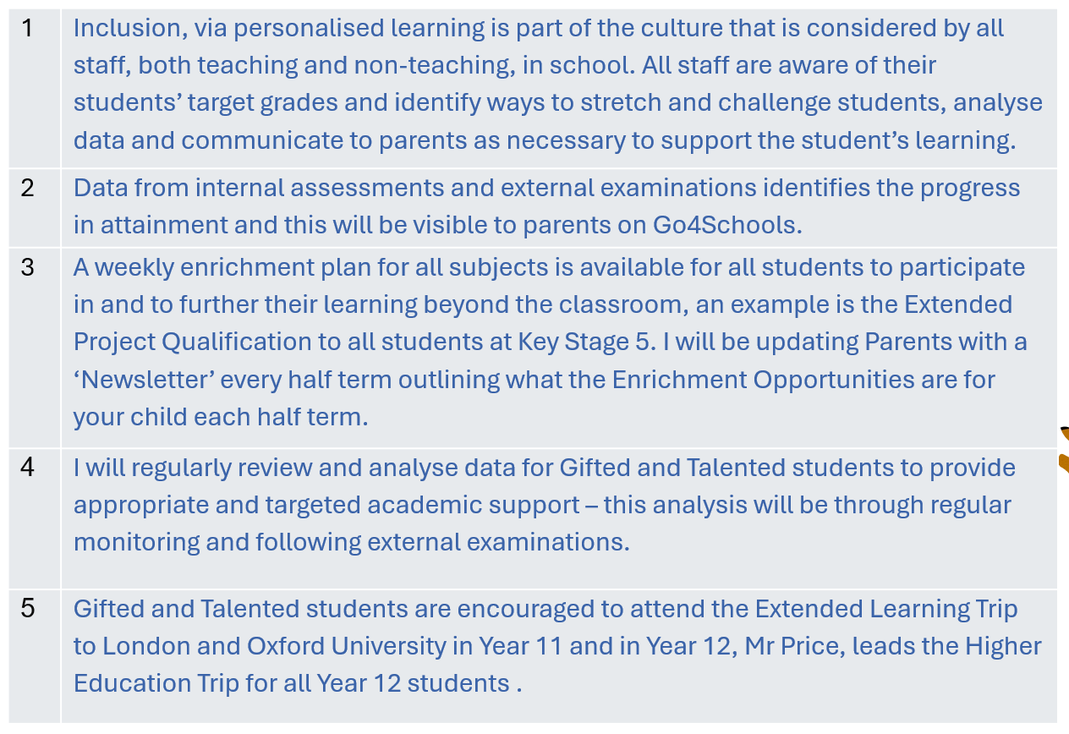
How we Stretch & Challenge our G&T Students to exceed their Target Grades

Slide 45
Areas of Strength and Challenge for G&T Students
Strength:
Rapid ability to learn
Preference for complex topics
Often have high expectations of themselves
Meticulous learners
Challenges:
Perfectionism
Supporting students facing challenges associated with SEN, well-being, and / or, with barriers to attendance

Slide 46
How can you support G&T Leaners at home?
Help them to focus on putting in the maximum effort with their learning in each lesson; asking questions and completing all work to the best of their ability.
Check the homework that has been set on Satchel One and monitor that the work is being completed
Regularly check Go4Schools for updates on your child’s current performance in comparison to their Target and Predicted Grades
Read their reports
Encourage them to attend Extra-Curricular activities.
Being organsied for their lessons each day with correct books and equipment
Help them to create a manageable revision timetable in preparation for up-and-coming assessments
Encourage them to get enough rest

Slide 47
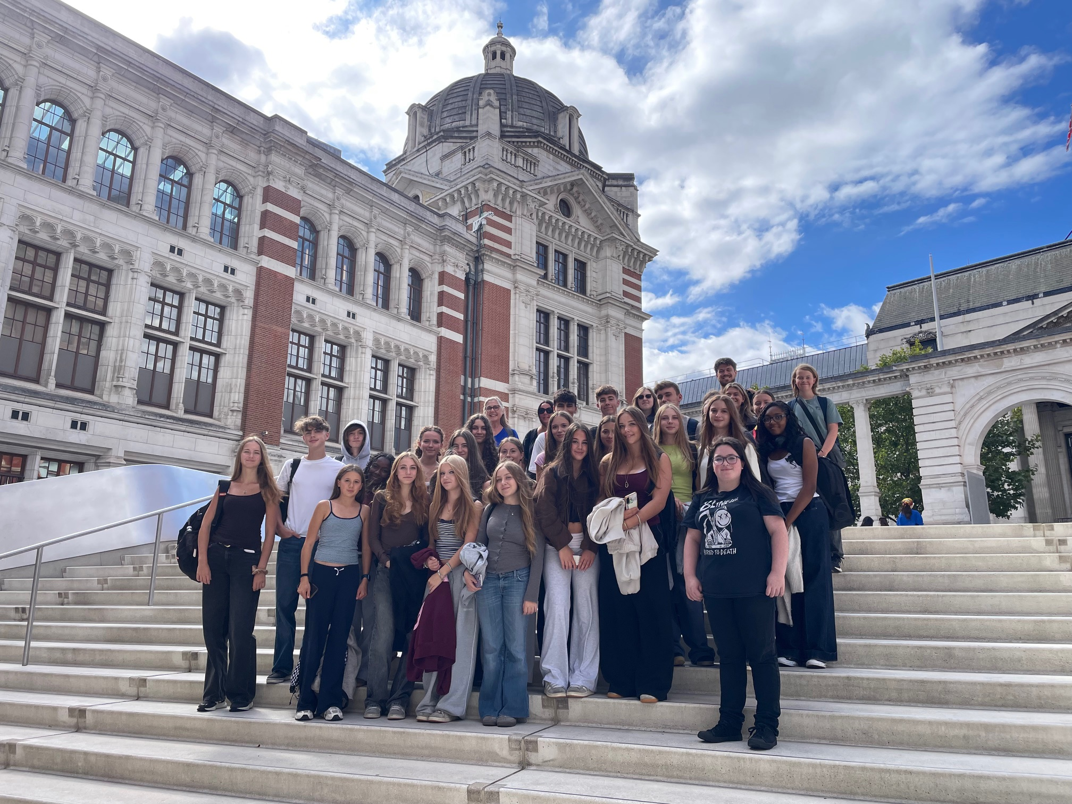
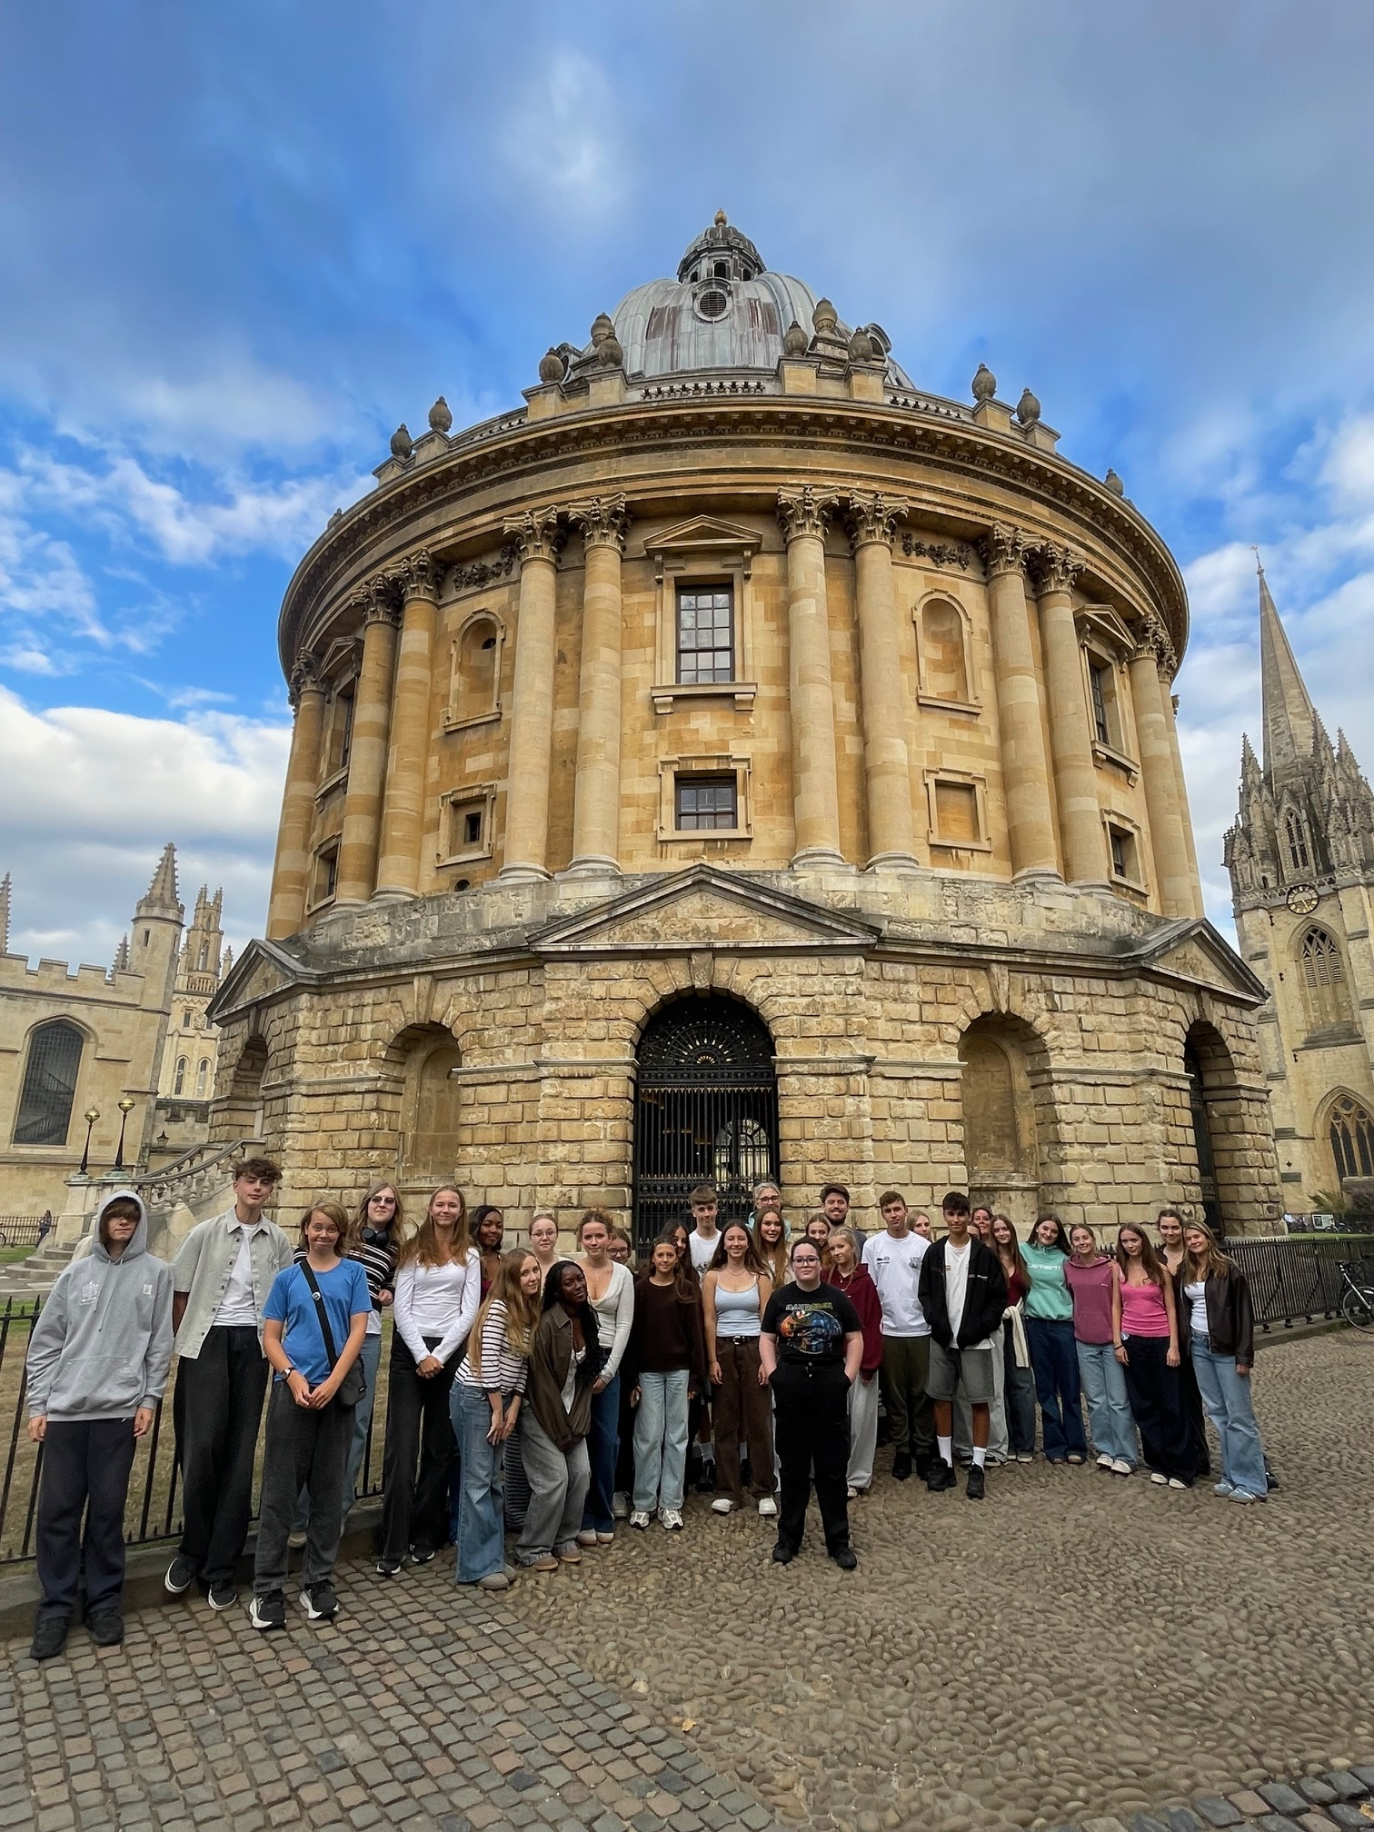
EXTENDED LEARNING TRIP
3-day Enrichment Trip to London and Oxford
September 2027 for Year 11 Students
Raise aspirations of all students at GCSE Level (Oxbridge and Russell Group Universities)
Opportunities not on-island

Slide 48
Special Educational Needs
Orla Priestley
Special Educational Needs
Co-Ordinator

Slide 49
SEN at Hautlieu
Specific Learning Difficulties: students may have needs associated with difficulties in reading, writing, spelling or processing​
Our Specialist Assessor is qualified to assess in compliance with JCQ regulations and determine what exam adaptations may be required

Slide 50
Neurodiversity
Neurodiverse students may have educational needs associated with their condition​
Hautlieu endeavours to support students in and out of the classroom, ensuring that they know that they are valued members of our school community

Slide 51
Social, Emotional and Mental Health
Schoolwork, relationship challenges and exam pressure can add to the stress that students feel​
Adaptations in lessons can support students when they are feeling overwhelmed​
Wellbeing and Academic support is available

Slide 52
Medical Conditions
Adaptations may be required in lessons and around the school to ensure that students with medical conditions can access their learning​
Consideration to what exam arrangements may be required to provide students with the best opportunity to share their knowledge and be successful

Slide 53
Support in school…
Provision Map to communicate needs to all teachers​
Learning Plans for students who require adaptive teaching within lessons
Student Support and Learning Support teams in contact with students who require regular check-ins

Slide 54
Support in school…
Homework Club for students who need some supported study time​
Learning Support Assistants in some lessons to help the teacher support students requiring extra help (MITA)​
Emotional Literacy Support Assistant trained staff (x3)

Slide 55
Exam Access Arrangements
Any AA allowance in exams (Extra Time, Rest Breaks, use of a Word Processor) are the responsibility of the SENCO​
There are stringent regulations around their allowance, and we are required to have evidence that they are necessary​
We will be inspected at least once a year to ensure compliance

Slide 56
Exam Access Arrangements
Privately commissioned Dyslexia or SPLD reports are not acceptable for awarding Exam Access Arrangements​ as per exam board regulations
Our in-house Specialist Assessor is qualified to test for Access Arrangements

Slide 57
Exam Access Arrangements
Recommendations made in other reports, for example ADHD or Autism reports, are not a guarantee that those arrangements will be given​
We are always subject to the Joint Council for Qualifications regulations and must adhere to them

Slide 58
If you have concerns…
Make contact (Mentor, Academic Head Of Year, SENCO)​
Do not commission any reports without seeking guidance from the SENCO first

Slide 59
Homework Club
Monday – Thursday from 3.30 until 4.30 in ICT 1​
Learning Support Assistant support available to help prioritise assignments, find resources and produce revision materials
Padlet https://padlet.com/HAU_SEN/hautlieu-special-educational-needs-wrenpxqv07g1lkzi

Slide 60
ML – Multilingual Learners
Nadia Rid
Teacher of World Languages​
and ​
Multilingual Learner Lead

Slide 61
ML Lead – My role at Hautlieu
Promoting multilingualism, diversity and inclusion within the school community
Supporting wellbeing and inclusion of Multilingual Learners (MLs) & families
Coordinating EAL (English as an Additional Language) intervention/support
Supporting staff with assessing MLs’ Proficiency in English & understanding of classroom support strategies
Facilitating Home Language GCSE & A Level opportunities.
Notes:
How are they supported? 1-2-1 meetings with MLs:
Linguistic background
Strengths / areas of difficulty
Opportunities to take GCSE/A Level in Home Language
Referrals from subject teachers / self-referrals.
Advising subject teachers or areas of difficulty & support strategies.
Involvement in school events.

Slide 62
How are Multilingual Learners identified?
Multilingual Learner: Any student with Home Language(s) and/or First Language(s) other than English (used instead of or alongside English)
Home Language – Language used regularly at home
First Language – Language a child has been consistently exposed to from birth
Home / First Language information collected in Admissions Booklet when students join / through further discussions with students
Notes:
BANDS A-B:
Developing Basic Interpersonal Communication Skills (BICS) (Jim Cummins, 1979).
Conversational fluency, functional social use of language.
6 months – 2 years to develop.
Bands C-D: Intermediate Learners
Students will be mostly focusing on developing Cognitive Academic Language Proficiency (CALP).
Oral and written language needed for academic success (e.g. writing essays, participating in everyday classroom activities and flourishing in the curriculum).

Slide 63
Common strengths for Multilingual Learners
Multilingual awareness
How language works and transferring knowledge/skills from one language to another
More flexible & creative with language learning
Often excel in Language lessons
Cultural perspective
Bring rich cultural knowledge & alternative viewpoints → enhanced classroom discussion
Strong intercultural communication skills & adaptability
Resilience & motivation
Persistence, independence, strong work ethic
Motivated to succeed academically and integrate socially

Slide 64
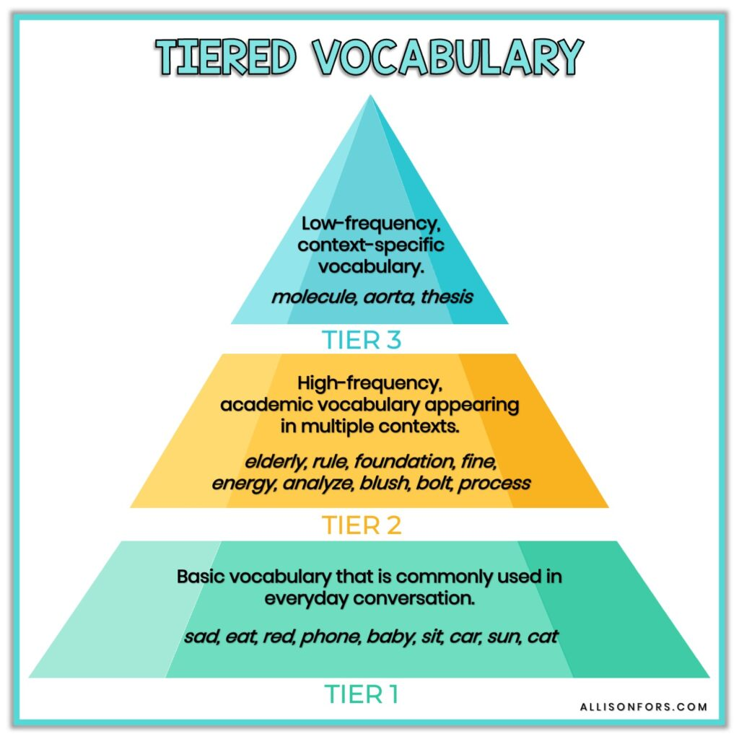
Common areas of challenge
Academic vocabulary & subject-specific language
May be very competent in everyday English but not the formal / abstract language needed for exams
Tier 2 / 3 vocabulary & vocabulary with different meanings depending on context (e.g. volume in Music, Science & English)
Grammar & syntax in writing / speaking
E.g. verb tenses, word order, prepositions (“on”, “at”, “to” etc.), cohesive devices (“however”, “therefore”)
Sentence structure may mirror First Language
Reading / Listening comprehension
Difficulty inferring meaning from complex language
Idiomatic language, metaphors or culturally-specific references
Can impact confidence & participation
Notes:
Meaning of words and phrases in different curriculum contexts e.g. ‘volume’
Music (turn up the volume)
Science (measure the volume)
English (published in three volumes).

Slide 65
How can I support my child at home?
Keep using the Home Language - bilingualism is an asset!
Strong foundation in First / Home Language supports second language learning – vocabulary, grammar & thinking skills
Encourage speaking, reading & writing in Home Language.
Wider reading / books / subtitled series & films – supports vocabulary, grammar and spelling
Discussions, reading aloud & explanations – in any language
Talk to them about what they’re learning in school – encourage use of subject-specific vocabulary (and explanations!)
Vocabulary building
“Word Wall” or notebook of new English words & Home Language equivalent
Work with teachers / ML Lead
Vocabulary / Skills to focus on at home
Let us know of any concerns
Notes:
One parent mentioned that English has become their son’s main language. This can happen as young people use English more frequently at school and with friends. The home language can still remain an important part of family life. At this age, it helps to involve your child in choosing how to keep using it, through conversations with relatives, books, films or topics that interest them

Slide 66
ML: Online Resources
https://www.bbc.co.uk/learningenglish/ - videos & mini lessons on pronunciation, vocabulary & grammar
https://www.bbc.co.uk/bitesize – access the curriculum in smaller chunks (videos/text)
https://www.oxfordlearnersdictionaries.com/wordlist/american_english/academic/ - 570 of the most important academic words, with links to definitions. Can be used as reference point or for flashcards for learning.
https://etc.usf.edu/lit2go/ - collection of narrated stories & poems; exposure to literary language & extended listening
https://learnenglishteens.britishcouncil.org/ - Listening, speaking, reading, grammar & vocabulary in English
https://www.audible.com/start-listen (subscription) - good for extended listening practice in English (& some other languages e.g. French, Spanish, Italian, German & Japanese)
https://ed.ted.com/ - videos, often by inspirational speakers on specific topics/questions. Enter as a student to watch videos and access guided mini lessons with comprehension questions. Transcripts often available.
https://www.englishclub.com/learn/ - activities & materials to practice listening, reading, pronunciation, grammar and vocabulary - audio tracks, subtitled videos, interactive quizzes.
Online bilingual books sites to read/listen: https://bloomlibrary.org/; https://bilinguator.com/en/; https://worldstories.org.uk/?fbclid=IwAR1GFoYchkRj4DuCkEH2ID0SJXzCaZvLLd3nm-UAV_I0cjhv8yldIi2Q3Fg; https://librivox.org/; https://www.gutenberg.org/

Slide 67
Home Language GCSE / A Level
Portuguese:
GCSE & A Level lessons offered by the Instituto Camões (after school – at Grainville / Hautlieu)
Home Language GCSE
Languages available through an exam board, subject to suitable arrangements and specialist availability
Timetabled option subject – blend of independent study & periodic support language specialist
Extracurricular - in addition to GCSE subjects
In both cases – dependent on whether ML Lead identifies an appropriate language specialist to carry out speaking exam and provide periodic support where possible
Home Language A Level
Spanish & French offered at A Level and can be chosen as timetabled option
For other languages (where offered by exam board), whilst we do not support a 4-A Level programme, students may be able to be entered for exams
Studied for independently in addition to 3 A Level subjects
Notes:
There are two aspects here: maintaining the home language, and working towards a qualification. The opportunities described on this slide depend on the language, the qualification available and access to suitable specialist support. Please speak to me so that we can explore your child’s situation individually.
If we do not have a teacher who speaks your child’s language, please still contact me. We can explore suitable resources and whether specialist support is available. For an exam entry, we would need to check the requirements and whether the necessary arrangements can be made. We cannot guarantee lessons or an exam entry in every language

Slide 68
JP – JerseyPremium
Lauren Devine
Assistant Headteacher

Slide 69
CYPES
Eligibility for Jersey Premium determined by CYPES
Eligible students and funding (January – December)
Not a personal fund for students
Strategy and autonomy outlined by individual schools and agreed by CYPES

Slide 70
My Role
Visible to students and families
Identify the challenges for students
Training and communication for staff
Support for students to achieve academic success and personal development
Monitoring and tracking of progress
Working with other Lead colleagues

Slide 71
Common challenges
Access to food and resources
Uniform
Extra-curricular
Trips
Punctuality and attendance
Lower academic outcomes
Positions of leadership and responsibility

Slide 72
What do we do…
Get to know our students, as individuals
Understand the barriers and support with this
Priorities high-quality teaching and learning
Appropriate intervention following data analysis
BUILD POSITIVE RELATIONSHIPS
Notes:
GCSE
100% 5 X 9 – 4
Significant improvement in result since 23-24
Average Grade – 6 – same for our non-JP
A-Level
Similar % of students achieving A* - C as non-JP, fewer A*
Focus for next year
Significant improvement in result ssince 23-24

Slide 73
What can you do…
Communicate – challenges and successes… how can we help?
Support students at home with learning and study habits
Encourage attendance and punctuality
Positive relationships with school

