Slide 1
Year 12
Parents' Information Evening
Building a Home-School Partnership
Tuesday 28th September

Slide 2
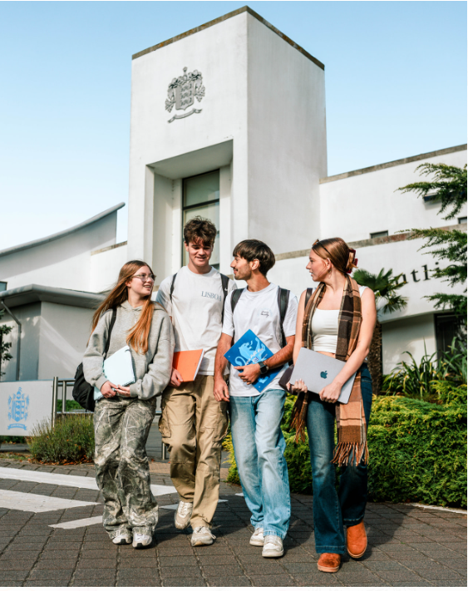
Welcome to the Class of 2028!
Mr. Nick. Falle, Headteacher

Slide 3
“Summa Petamus”
“Put simply, Hautlieu is an extraordinary school that nurtures extraordinary students. We take great pride in providing a calm and focused learning environment that enables excellent examination results and first-class preparation for university entrance and employment.”
Nick Falle
Headteacher

Slide 4

Sixth form is a journey

Slide 5
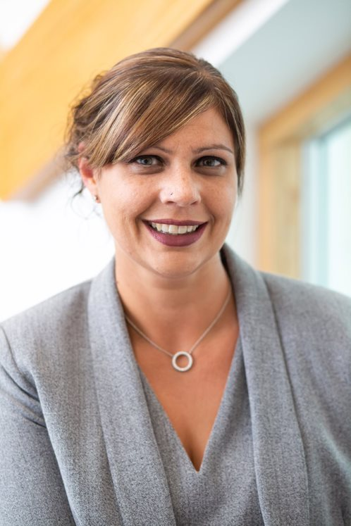
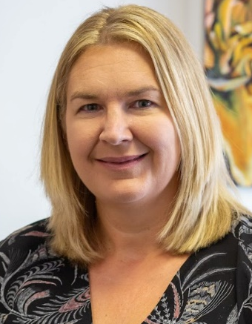
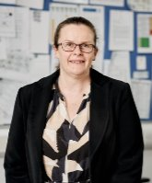
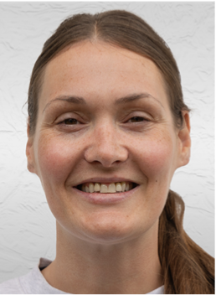
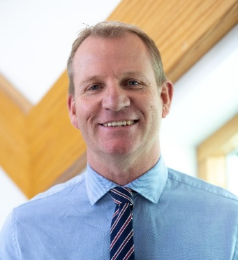
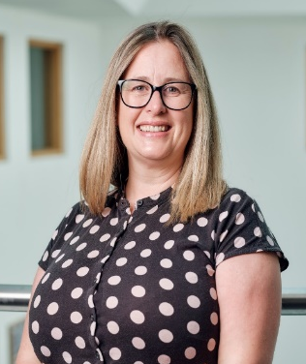
Our Senior Leadership Group
dedicated to student success
Miss Martin
Miss Jackson
Miss Blackhall
Miss Devine
Mr Campbell
Miss Carroll

Slide 6
Academic Head of Y12
dedicated to Y12 success
A levels are a big step up from GCSE
Minimum of 5 hours per week per subject of independent study
‘Free periods’ should be used for study

Slide 7
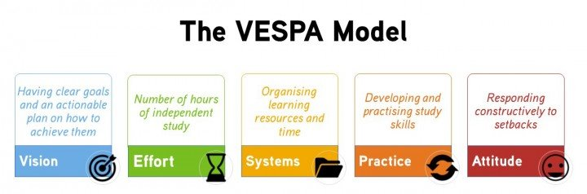
Throughout Year 12 we will help the students develop the skills to succeed in sixth form
With greater freedom comes greater responsibility, but also greater opportunity. Over the next two years, students will gain far more than qualifications; they will develop the independence, character, skills and experiences that will prepare them for success in whatever path they choose next.​

Slide 8
Working together will help your child to succeed
Home
School
Students

Slide 9
Home
School
Students
What we commit to providing
High-quality teaching & learning
Mentor check in & guidance every morning
Pastoral support
UCAS/Career development
Opportunity for further enrichment
Regular assessment & feedback
School leadership & sporting opportunities
Head of Year challenge & guidance

Slide 10
Home
School
Students
What we expect of our Sixth Form students
Show personal responsibility for learning
Be curious and actively participate
Be on time and attend every lesson and every mentor session (in by 08:30am)
Be open to developing new skills – e.g. resilience, grit, time management, organisation
Follow the 6th form dress code and wear a lanyard
Ask questions and seek support
Try their best!

Slide 11
Home
School
Students
How can you help at home?
Encourage your child to plan and organise their study periods and time at home
Help them to achieve the additional study requirements (5 hours per subject per week) - start now
Support good sleep habits
Sign up for Go for Schools and Satchel One to keep track of your child’s attendance and progress
Be curious and initiate discussions – let them teach you
Inform us early of any concerns and stay connected

Slide 12
Mentors are your first point of contact
Your child’s mentor is the first point of contact for both you and your child
We have an experienced and dedicated team of 13 mentors
Mentors are committed to:
  Providing guidance to steer their mentees in the right direction
  Providing support both academically & emotionally
  Offering advice based on their experience
  Helping their mentees to develop & grow throughout the year
"Success starts with turning up—consistently, positively, and ready to learn."

Slide 13
The Year 12 Mentor team
Mrs. L. Bedward​ | l.bedward@hautlieu.sch.je
Mr. T. Fallon​ | t.fallon@hautlieu.sch.je
Mr. A. Fitzpatrick​ | a.fitzpatrick@hautlieu.sch.je
Miss. L. Bramfit | l.bramfit@hautlieu.sch.je
Miss. S. Jackson​ | s.jackson@hautlieu.sch.je
Dr. N. Barker​ | n.barker@hautlieu.sch.je
Mr. A. Shea​ | a.shea@hautlieu.sch.je
Miss. L. Syvret (Mr. J. Harvey Mon) | l.syvret@hautlieu.sch.je j.harvey@hautlieu.sch.je
Mr. D. O’Kane​ | d.okane@hautlieu.sch.je
Mrs. J. De Jesus-Oeillet​ | j.dejesusoeillet@hautlieu.sch.je
Mr. G. Constable​ | g.constable@hautlieu.sch.je
Ms. G. Bruckner​ | g.bruckner@hautlieu.sch.je

Slide 14
Mentor time is much more than just registration
Daily support and 1:1 check ins
Mentors write the university references
University choices, careers advice, study guidance
Work experience, CV writing, job opportunities
Become part of the school community – make friends, belong, take part in events

Slide 15
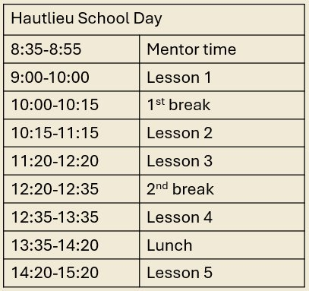
Every day starts at 08:35
Sixth form students are required to be in mentor time every day by 08:35. They are also required to use their ‘free’ periods as independent study in the LRC. If a student has no lessons P4 or P5 they can leave the site to study elsewhere.

Slide 16
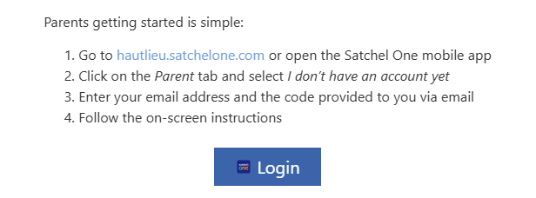
Keeping track of homework
Parents have information on how to access Satchel One.
Students can view all homework, assessments and key deadlines in one place.
Parents can log in using their child's PIN to monitor homework and progress.
Remember: success at sixth form requires independent study as well as set homework.

Slide 17
Study Habits
Good study habits lead to better learning, confidence, and successful exam outcomes.
What are good study habits?
Consistency – Regular study routines, not just cramming.
Organisation – Using planners, folders, and checklists.
Time Management – Breaking tasks into chunks, avoiding last-minute rush.
Active Learning – Using flashcards, quizzes, teaching others.
Healthy Balance – Sleep, breaks, and downtime are essential.
What can parents/guardians do to support?
✅ Create a Study-Friendly Environment
Quiet space, good lighting, declutter, minimal distractions.
Access to basic supplies (pens, paper, charger, etc.).
📅 Encourage Routine
Help set a regular homework/study schedule.
Use visual planners or apps to track tasks.
💬 Talk About Learning
Ask what they’re working on.
Praise effort, not just results.
📵 Limit Distractions
Support phone-free study time.
Encourage focus blocks (e.g. 25 mins study, 5 mins break).
🧠 Promote Wellbeing
Encourage sleep, healthy eating, and downtime.
Watch for signs of stress or burnout.
Notes:
Link to school motto – aim for highest

Slide 18
Attendance

Slide 19
High attendance is vital for success at A level
Please encourage your child for full attendance
8.35am Mentor time is a compulsory part of the school day EVERY DAY
Absence requests may be made in advance to the school via office@hautlieu.sch.je
All unplanned absences should be reported to the office as soon as possible by parents/carers (not the student) using the email office@hautlieu.sch.je
Our attendance team monitors the attendance of Year 12 students and will look at interventions where needed
Study sessions should take place in school where possible. There are always study and revision tasks that can be completed
  You can access attendance data using Go4Schools. Instructions for doing this can be found on the school website (Attendance and Punctuality – Hautlieu)

Slide 20
Why does attendance matter?
% Attendance​ | Lessons missed​ | Lessons missed per subject​ | Equivalent lost teaching time per subject​
100​ | 0​ | 0​ | 0​
99​ | 10​ | 3-4​ | Nearly 1 whole week​
98​ | 20​ | 6-7​ | 1-2 weeks​
97​ | 30​ | 10​ | 2 weeks​
96​ | 40​ | 13-14​ | Nearly 3 weeks​
95​ | 50​ | 16-17​ | More than 3 weeks​
90​ | 101​ | 33-34​ | Nearly 7 weeks!​
A levels are hard
In years 12 and 13, students will have over 1000 lessons
Lessons missed = lost learning
You can’t afford to miss any lessons, the pace means it’s difficult to catch up
If you didn’t need to attend all the lessons, we wouldn’t schedule them!
Notes:
Y12 = 39 weeks, 3 subjects, 5 lessons per week per subject = 585 lessons.​
Y13 = 28 weeks, 3 subjects, 5 lessons per week per subject = 420 lessons​

Slide 21
What to do if your child is unable to attend a lesson
A parent / guardian must contact the school office
If we are not notified by a parent, it is recorded as unauthorised
Family holidays are “unauthorised absence” by CYPES
If students become ill during the school day, then they should sign out at the office
Please do not arrange driving lessons / paid work during lesson time. Absence for driving tests will be approved if we are notified by parent
Students, as a matter of courtesy, should email their teachers to catch up on missed learning – please encourage your child to do this

Slide 22
What if attendance falls below expectations?
Attendance is reviewed every two weeks. Students whose attendance falls below 90% will enter the “attendance support process”
Stage 1: Attendance concern email sent to student and parents
Stage 2: Further attendance concern email sent to student and parents
Stage 3: Attendance review meeting with Senior Leadership, student and parents. Support interventions discussed and agreed
Stage 4: Further parental meetings/support interventions and programme reviewed

Slide 23
Student Support

Slide 24

Student Support

Slide 25
If your child feels things are getting on top of them…
Don’t just let them hide away and bury their heads in the sand
They should:
Talk to their parents
Talk to their mentor
Talk to their teachers
Talk to the school counsellor
Talk to someone
Let us help you

Slide 26
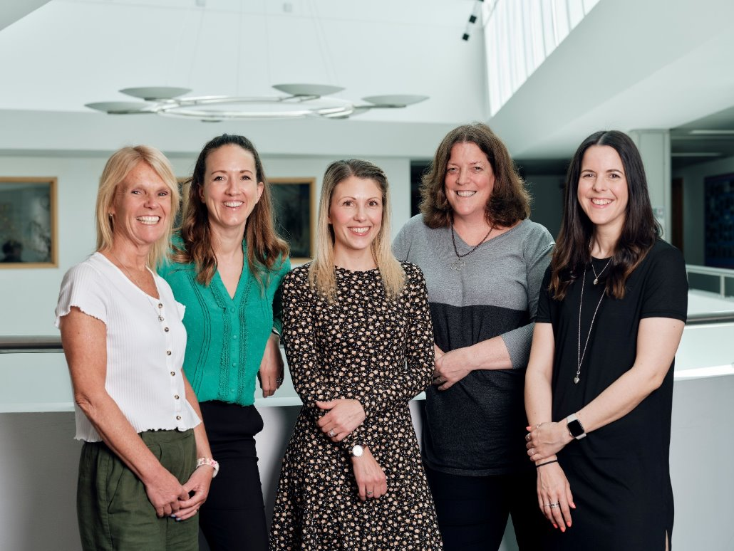
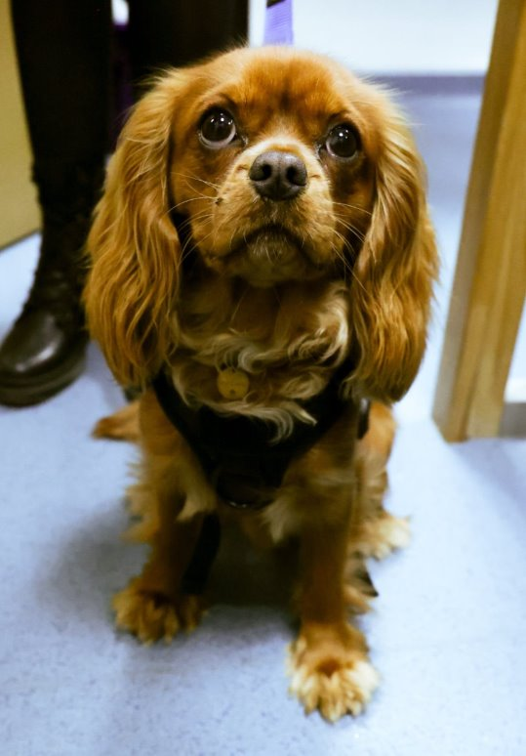
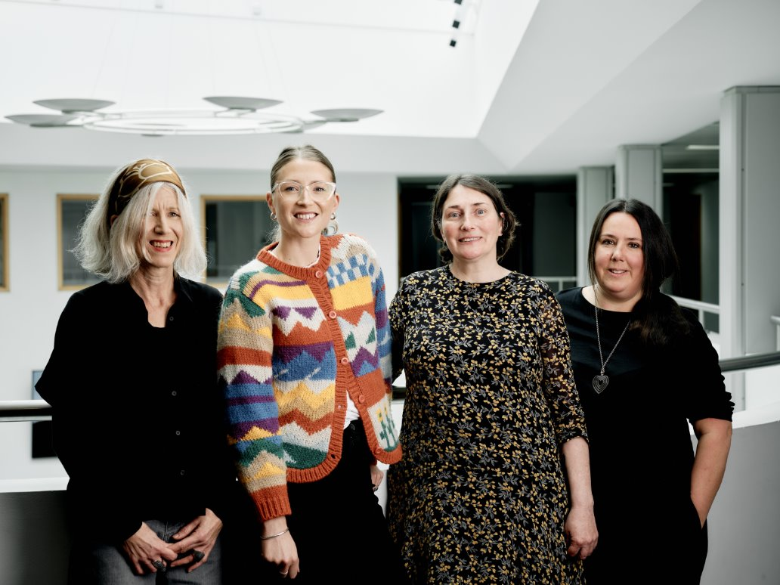
Our student support team
dedicated to student wellbeing

Slide 27
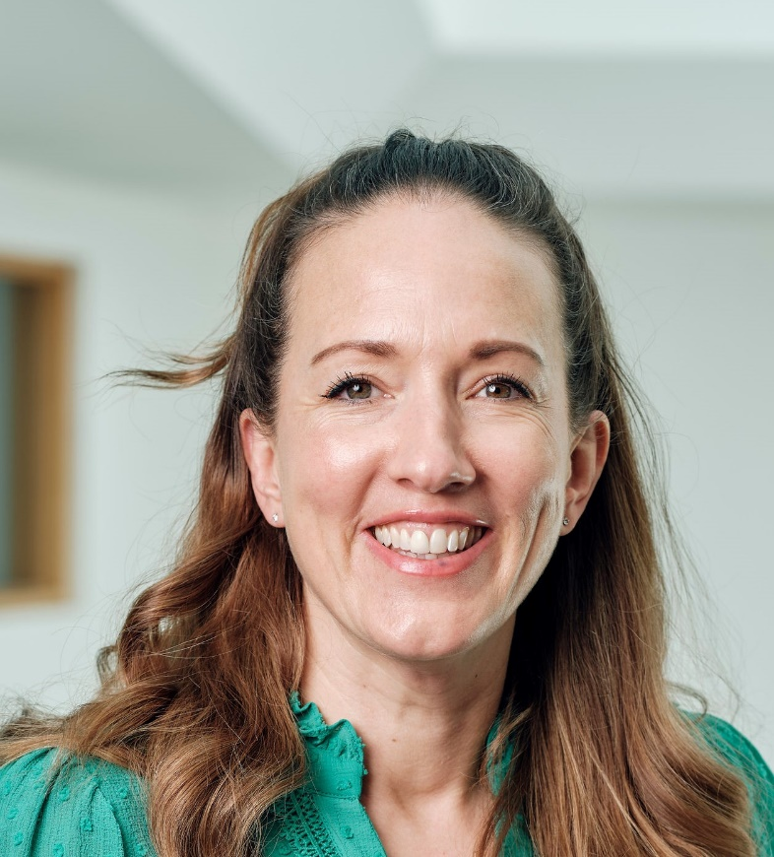
Mrs Kedge
Student Support Lead and Positive Mental Health and Wellbeing Manager

Slide 28
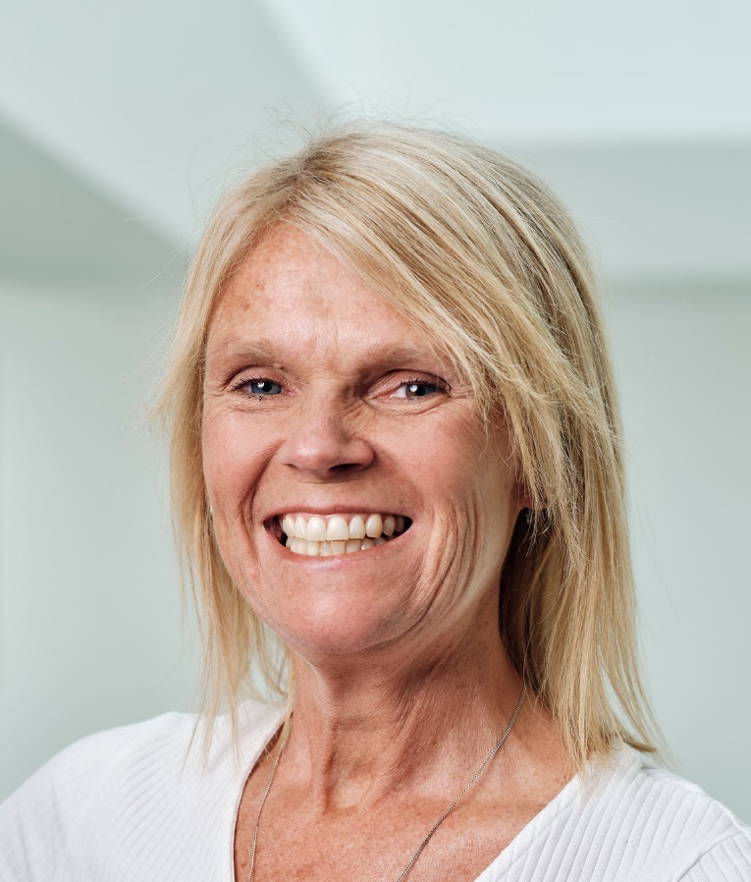
Mrs Kelly
Designated Safeguarding Lead (DSL)

Slide 29
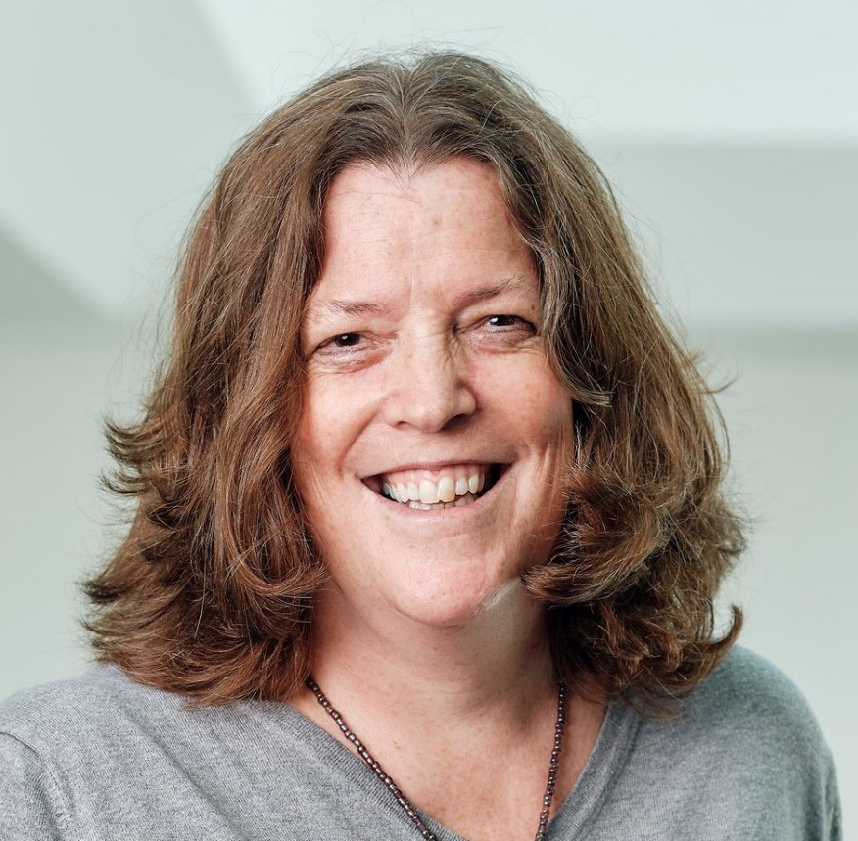
Judy
School Counsellor
Tel: 07797799662
Email: j.cornwall@hautlieu.sch.je

Slide 30
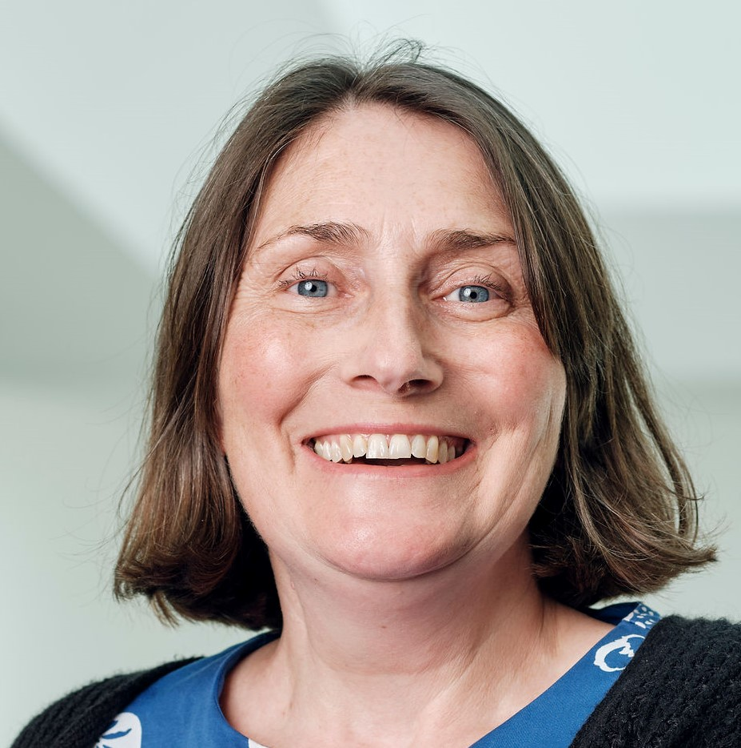
Mrs Priestley
Special Education Needs Co-Ordinator (SENDCo)

Slide 31
A levels can be stressful – how can I support my child?
Talk to them. Set aside one to one time so that they can talk to you about any worries.
Help them find solutions. Let them know their feelings are valid and normal but also offer support and solutions where possible.
Instigate good sleep habits. Anxiety is often worst at night, and this means it is useful to encourage a good bedtime routine.
Seek help. If anxiety and stress start impacting their day-to-day life, seek help from your GP. Work with your child to find what revision style works for them.

Slide 32
Assessment and Reporting

Slide 33
Assessment and Reporting
Support student progress
Improve study habits of learners
Use feedback to inform planning and teaching
Student ownership and parent/carer understanding of progress in learning and predicted attainment
Monitor and evaluate student progress… to ensure ALL students are supported to fulfil their academic potential

Slide 34
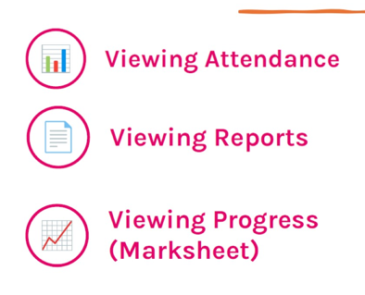
Parent Engagement – Go4School
Transparent platform
Up to date information and data (attendance syncs overnight)
Detailed insight into student progress for each subject
Encourage conversations and support at home
Visibility NEXT WEEK

Slide 35
Reports & Grades
    Target Grade
  Fixed
  Informed by prior attainment (GCSE)
  Intentionally aspirational
  Predicted Grade
  Realistic indication of A Level outcome
  Professional judgment of subject teacher
  Contributing factors
  Current Grade
  Informed by internal data and any external exams
  Reflect qualification grades and components

Slide 36
Attributes for Successful Learning
Outstanding – consistently models
Good – Frequently models
Developing – Occasionally models, but can require prompting
Requires improvement – infrequently models and there are emerging concerns

Slide 37
Exams
Regular assessments throughout each term
End of Year 12 exams.
Expected to achieve a grade D or above in their subjects during these exams.
You will have visibility of their progress on GoForSchools
  First progress review: w/c 16th November
  Second progress review : w/c 1st March

Slide 38
Key Dates
13th October – Enhancing Successful Outcomes
w/c 16th November – Autumn Interim Report
w/c 1st March – Spring Interim Report
Tuesday 21st April – Year 12 Parents’ Evening
w/c 17th May – End of Year Exams
w/c 21st June – Summer Term Full Report

Slide 39
Post 18 destinations

Slide 40



Post 18 destinations

Slide 41
Guidance and support for post 18 destinations starts now
All Year 12 students have one ‘core’ session per half term
Higher Education & Employment Fair preparation
Supports university applications (UCAS) and career planning.
Students develop key employability skills, including CVs and covering letters.

Slide 42
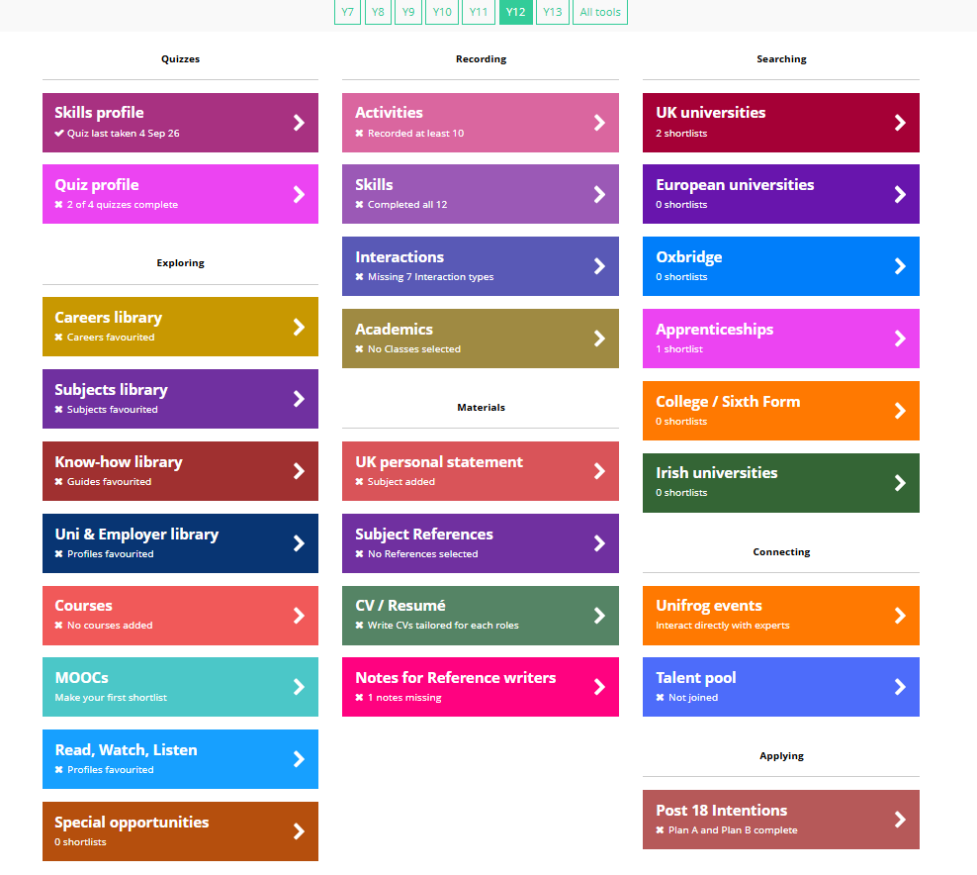
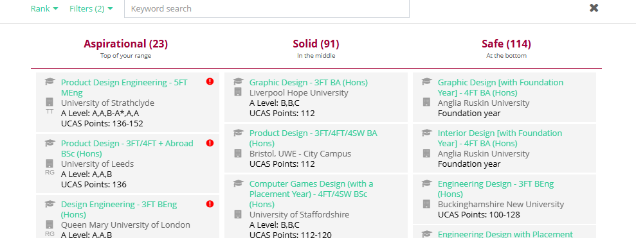
Unifrog is a platform to look through with your child
This platform assists in all aspects of supporting students with their post 18 choices.
Students logged on to this platform in their first core session.
Please encourage them to keep using the platform for:
  Quizzes about deciding their future.
  Read/ Watch / Listen to learn more about the subject they might want to study at university/ favourite subject at A level.
  Understanding USA/ Europe applications.
  Researching University choices (this will be covered in more detail in the second session).

Slide 43
Early applicants
For students applying to Oxford, Cambridge, Medicine, Dentistry or Veterinary Science.
Applications are submitted earlier (usually by mid-October in Year 13).
Students should undertake wider reading and subject research.
Medicine, Dentistry and Veterinary applicants should gain relevant work experience and voluntary experience.

Slide 44
Questions regarding 18+ choices?
Any questions regarding careers support for students, whether for University or Employment or Gap year, please contact Steven Price s.price@hautlieu.sch.je
Careers bulletin with various careers-based opportunities comes out roughly every fortnight. This is emailed to parents and carers and students.

Slide 45
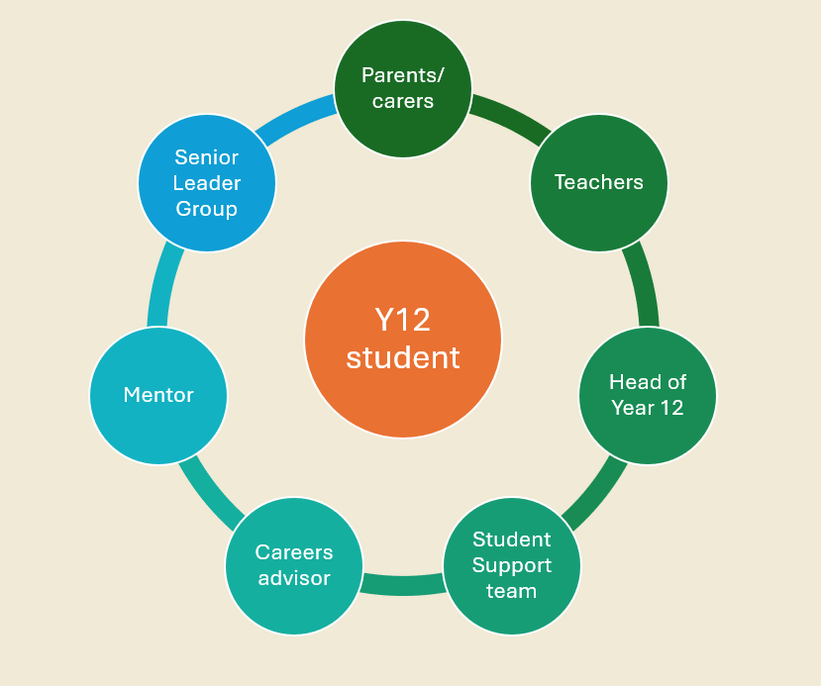
Thank you for your time today
We look forward to working with you to support the students of 2028 and helping them all to thrive

Slide 46
Key Contacts
Academic Head of Year 12
a.wilson@hautlieu.sch.je
Reporting attendance
office@hautlieu.sch.je
Attendance SLG Lead
l.campbell@hautlieu.sch.je
Designated safeguarding lead
n.kelly@hautlieu.sch.je
Careers advice/post 18 choices
s.price@hautlieu.sch.je

Slide 47
Any questions?

Slide 48
Access to school site
Drop-off & Pick-up
Use the road adjacent to the school via Bon Air Lane.
Do not use Oakfield parking spaces.
Please keep school bus access clear.
Consider arranging drop-off/pick-up away from the school site
Student Parking
Oakfield parking is shared with Active Sports users.
Only 40 Year 13 parking permits are available.
No Year 12 student parking is available.
Mopeds & Motorbikes
Designated parking is available next to the JET building.

